Slide 1
YEAR 10 SESSION 1:
WHAT IS HE IN CONTRAST TO FE?

Slide 2
SESSION OBJECTIVES
OBJECTIVE 1: Understand the importance of your GCSEs.
OBJECTIVE 2: Be aware of your options after year 11.
OBJECTIVE 3: Comprehend the difference between BTECs and A Levels.

Slide 3
ICEBREAKER
SNOWBALL FIGHT!
On a scrap piece of paper, write:
1 thing you have learnt this week OR 1 thing you would like to do when you finish school.
Scrunch the piece of paper into a ball, close your eyes and have a SNOWBALL FIGHT (throw in a random direction)!
Pick up the nearest ‘snowball’ to you and read out what’s written.
Do you have any comments?

Slide 4
DIAMOND 9
Write out your current GCSE subjects on the diamonds on the paper in front of you.
Order them with your favourite subject at the top and your least favourite at the bottom.
What do you value most?
Now rearrange them into the order you think your school values the most.
What’s the difference?
Are there any subjects you would continue studying after you finish school?
Notes:
Resource Booklet Page 4: 1.1 Diamond 9
1.2
Get students thinking about what they enjoy vs what they think is important for the future, highlight why the school’s prioritised subjects are English, Maths & Science. Many jobs require a pass in English, Maths & Science, it’s not just the school’s decision. Students may feel pressure but it’s vital that you emphasise how important it is for them to pass their core subjects since this will be a requirement for many future endeavours. Their options will assist them with their own personal path so it’s up to them how well they perform!

Slide 5
CARD SORTING
MATCH THE DEFINITION TO ITS MEANING
Work in pairs to identify the terms and pair them correctly.
Are there any you are unsure of?
Did you get any mixed up?
Notes:
Use resource booklet handout and get students to match up the cards. Fill any knowledge gaps!

Slide 6
POST-16 OPTIONS
WWW.INFORMEDCHOICES.AC.UK
COLLEGE
BTECs
VOCATIONAL
DIPLOMAS
SIXTH FORM
APPRENTICESHIPS
A-LEVELS
T-LEVELS
COMPULSORY
ACADEMIC
Notes:
Resource Booklet Pages 5-6: 1.2 Post-16 options
1.2
Relate to definitions from Card Sorting activity. Get students to volunteer any answers. Ask about ones they have never heard of and clarify any knowledge gaps.
To help students understand the range of possibilities, you could also discuss with students the definitions that weren’t on the previous sorting activity, which were: vocational, academic, diplomas, compulsory.
College – Sixth form or FE college (discuss pros/cons)
BTECs – Level 3, more vocational
Vocational – Hands on
Diplomas – A type of qualification
Sixth form – You can go to a different school’s sixth form (discuss pros/cons)
Apprenticeships – Various levels, discussed later in powerpoint, hands on
A levels – Level 3, more academic
T levels – Very new, specific subjects
Compulsory – You have to do this (FE study)
Academic – More exam based

Slide 7
POST-16 OPTIONS
COLLEGE | SIXTH FORM | APPRENTICESHIPS
WHAT WOULD YOU CHOOSE?
Notes:
Either do this as a whole group or split students into pairs. Discuss the differences and pros/cons between sixth form, college and apprenticeships. Discuss A Levels vs BTECs. There is no right or wrong answer, it depends on the individual student and their interests. What do they think they would prefer?

Slide 8
POST-16 QUALIFICATIONS
A Levels vs BTECs– What’s the difference?
Organise the strips in front of you into the headings ‘BTEC’ and ‘A Level’
Discuss the biggest differences you have identified!
Notes:
Resource Booklet Page 7-8: 1.2 Post-16 options
Ask whether students know any obvious differences and then get them to complete the activity. Which one best suits them? Do they realise that they can do a mixture of BTECs and A Levels at sixth form? Emphasise that BTEC Level 3 and A Levels are equivalent as they are both level 3. 95% of universities accept BTECs. Discuss the positives and negatives, i.e. BTEC is very hands-on and will give you chance to explore the subject through coursework and experience. A Levels are more exam-based and focus on theory.

Slide 9
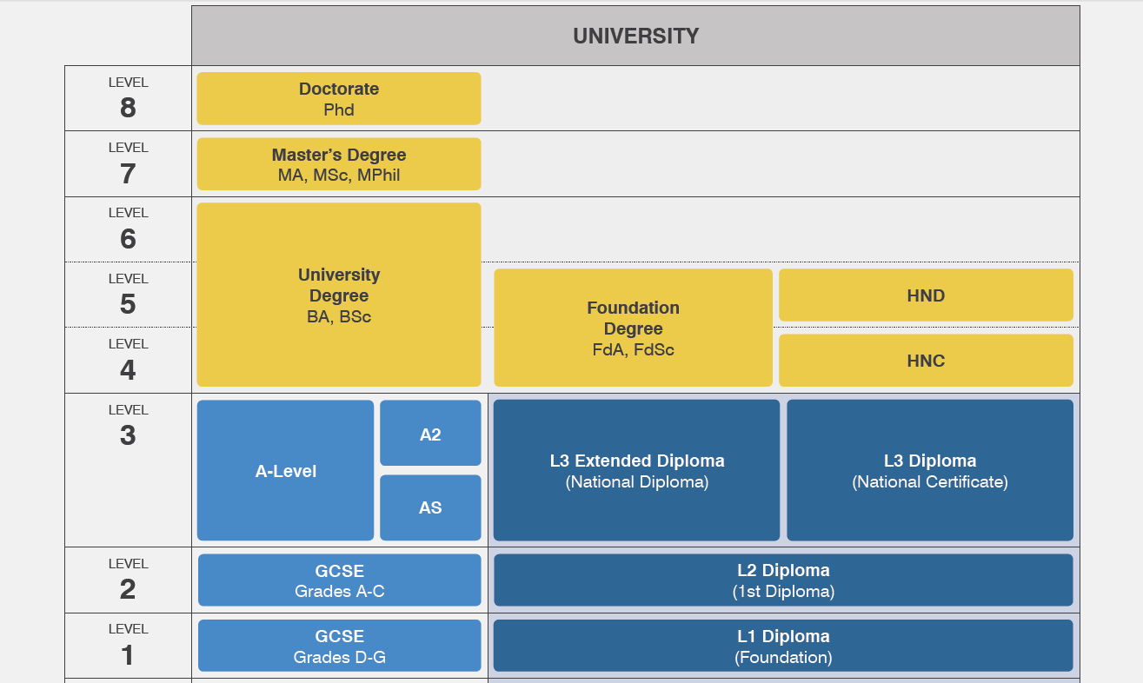
QUALIFICATION CHAIN
Notes:
Resource Booklet Pages 9-10: 1.3 Qualification Chain
1.3
Give students resources from Resource Booklet and get them to order the qualifications.

Slide 10
QUALIFICATION CHAIN
Notes:
Clarify any knowledge gaps here.

Slide 11
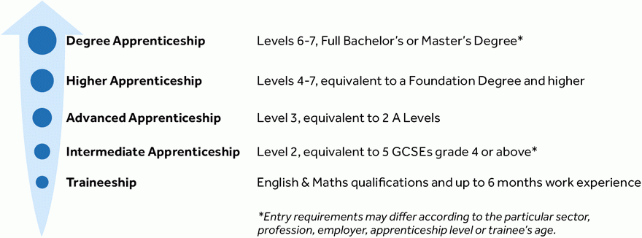
APPRENTICESHIP LEVELS
Notes:
Apprenticeship levels – talk through the different levels of apprenticeships and discuss the main differences between them and how this may compare to university study.
This may appeal to the vocational students, talk through how level 4-7 is equivalent to university standard and is a valuable route to take.

Slide 12
SNAKES & LADDERS
Think about one of your goals and write it on the ‘Finish’ space. On the snakes, write out potential threats to achieving your goals while using the ladders to identify opportunities that may help you reach your goal!
FINISH
32
31
30
29
28
27
26
25
17
18
19
20
21
22
23
24
16
15
14
13
12
11
10
9
START
1
2
3
4
5
6
7
8
Notes:
Resource Booklet Page 11: 1.3 Snakes & Ladders
Either play as whole group or split into smaller numbers and print off resource from Resource Booklet. Students should use the ladders as opportunities that will help them achieve their goals while the snakes are potential barriers. Their end goal can be anything from learning how to cook a certain dish or getting a degree!

Slide 13
FOR NEXT SESSION:
INDEPENDENT ACTIVITY:
Research further into different post-16 options in your area.
Are there any courses you would like to pursue?
You could also research degrees and apprenticeships to find one that you think is interesting!

Slide 14
@aspiretohe

