Slide 1


YEAR 10 SESSION 2:
WHAT DOES HE STUDY ENTAIL?

Slide 2

LAST SESSION
OBJECTIVE 1: Understand the importance of your GCSEs.
OBJECTIVE 2: Be aware of your options after year 11.
OBJECTIVE 3: Comprehend the difference between BTECs and A Levels.

Slide 3
CHECK-IN
POST-16 COURSES
From your research into post-16 options, degrees and apprenticeships, did you find any courses you would like to pursue in the future?

Slide 4
SESSION OBJECTIVES
OBJECTIVE 1: Understand the difference between hobbies and future careers.
OBJECTIVE 2: Be aware of competitiveness within FE and HE.
OBJECTIVE 3: Start creating a CV.

Slide 5

HOBBY OR CAREER?
Write a list of the things you enjoy to do in your spare time. Make sure to include activities you don’t do that often, such as photography or painting.
Sort these into the two columns on the grid in front of you – is this a hobby or a potential career for you?
Notes:
Resource Booklet Page 12: 2.1 Hobbies and careers
2.1
It’s important for students to understand that many of their hobbies could turn into a career for them! Use this activity to find out more about your learners and to encourage them to pursue their hobbies – why wouldn’t they consider certain hobbies as careers?
Image from VectorStock.

Slide 6
DIAMOND 9
Write out your current GCSE subjects in the diamonds on the paper in front of you and cut them out or use the ones you had from last session.
Again, order them with your favourite subject at the top and your least favourite at the bottom.
Do you think you could pursue a career in this subject area? What is more important for your future career?
Notes:
Resource Booklet Page 13: 2.1 Diamond 9
In last session, we focused on what their school values most and why, i.e. it is essential for all future endeavours. On this occasion, focus on whether students would consider their favourite subject as a potential career. Why or why not?

Slide 7
ACTIVITY
In this next activity, you are going to be an ADMISSIONS BOARD.
A group of people who decide whether you are accepted into college, university or an apprenticeship.
Both education and your experiences will be taken into consideration.
Remember: the person you accept will represent your institution or company.
You must choose between 2 pupils at the end of each slide.
Once you have all of the information, you must make a final decision.
Notes:
2.2
This activity should be used to highlight the importance of extra-curricular activities and passing their GCSEs. Students often come up with great ideas on this so let them lead and see what them come up with! At the end of this activity, highlight that university and apprenticeships are very competitive, they shouldn’t expect to find it easy when against other candidates.

Slide 8


ADMISSIONS BOARD
Tyler wants to study History at university. He has got 12 GCSEs at Grace 4 and above, including a Grade 4 in GCSE History.
Anna wants to study History at university. She has got 5 GCSEs at a Level 4 and above. This includes a Grade 8 in GCSE History.
Who would you choose?
Notes:
This activity should be used to highlight the importance of extra-curricular activities and passing their GCSEs. Students often come up with great ideas on this so let them lead and see what them come up with! At the end of this activity, highlight that university and apprenticeships are very competitive, they shouldn’t expect to find it easy when against other candidates.

Slide 9
ADMISSIONS BOARD
Tyler is predicted AB at A Level in History and English and a Merit in BTEC PE.
Anna is predicted BCC in A Levels, including a C in History.
Who would you choose?
Notes:
This activity should be used to highlight the importance of extra-curricular activities and passing their GCSEs. Students often come up with great ideas on this so let them lead and see what them come up with! At the end of this activity, highlight that university and apprenticeships are very competitive, they shouldn’t expect to find it easy when against other candidates.

Slide 10
ADMISSIONS BOARD
During his work experience placement, Tyler volunteered at a local primary school.
During her work experience placement, Anna volunteered at the Black Country Living Museum.
Who would you choose?
Notes:
This activity should be used to highlight the importance of extra-curricular activities and passing their GCSEs. Students often come up with great ideas on this so let them lead and see what them come up with! At the end of this activity, highlight that university and apprenticeships are very competitive, they shouldn’t expect to find it easy when against other candidates.

Slide 11
ADMISSIONS BOARD
Tyler attends a weekly drama club after school. He works on a Saturday morning in his local newsagents. He is currently working on his Silver Duke of Edinburgh award.
After school, she goes home to play video games but also enjoys watching history documentaries on Netflix every now and again.
Who would you choose?
Notes:
This activity should be used to highlight the importance of extra-curricular activities and passing their GCSEs. Students often come up with great ideas on this so let them lead and see what them come up with! At the end of this activity, highlight that university and apprenticeships are very competitive, they shouldn’t expect to find it easy when against other candidates.

Slide 12
ADMISSIONS BOARD
Think about everything you know about both of these candidates.
Who would you choose to represent your company, university or college?
Why?
Notes:
This activity should be used to highlight the importance of extra-curricular activities and passing their GCSEs. Students often come up with great ideas on this so let them lead and see what them come up with! At the end of this activity, highlight that university and apprenticeships are very competitive, they shouldn’t expect to find it easy when against other candidates.

Slide 13
BEING COMPETITIVE
HOW ARE YOU GOING TO SECURE YOUR PLACE?
In pairs, discuss with your partner the following:
2 things you think you are doing well
1 thing you would like to improve
Notes:
Examples of this could include working hard, being on-time, attending extra-curricular clubs etc. but it’s important for the students to self-reflect!

Slide 14
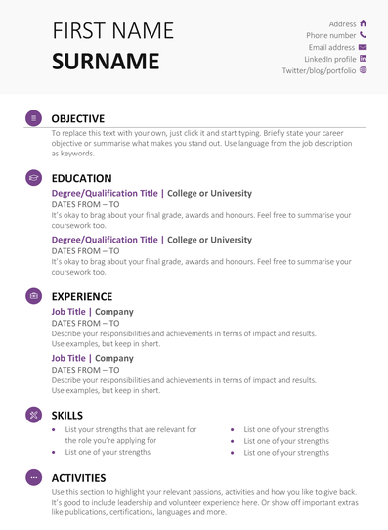
WHAT IS A CV?
CV stands for ‘Curriculum Vitae’.
This is a document citing a person’s education, qualifications, previous occupations and skills.
You will also need to provide character references from employers or academic staff.

Slide 15
PLANNING YOUR CV
Knowledge and skills | Personal attributes | Work experience | Qualifications | Extra-curricular
Fill out the grid in front of you using the headings above.
Notes:
Resource Booklet Page 14: 2.2 CV building
These headings will make the base of their CV. They should think about what they can bring to a business and how they would help an employer. Remind them that it’s vital to have examples of where they gained or used these skills which is why it’s important not to lie on your CV as employers will ask about what you’ve written!

Slide 16
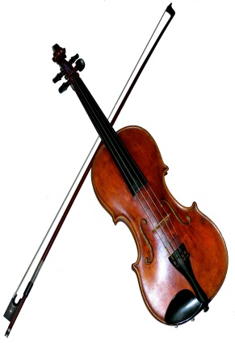

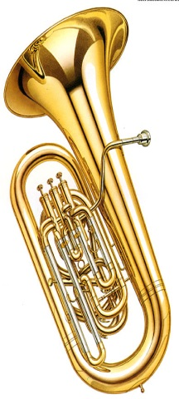



TRANSFERABLE SKILLS
Communication
Solving Problems
Teamwork
Confidence
Leadership
Decision Making
Multitasking
Identifying Problems
Notes:
These are examples of some skills they may have or should try to develop.

Slide 17
EXAMPLE
Knowledge and skills | Personal attributes | Work experience | Qualifications | Extra-curricular
Teamwork Leadership Good at problem solving Planning sessions Good knowledge of football and basketball | Honest Caring Hard-working Patient Compassionate | Volunteering to help train the under 10s at a local football team every Saturday morning Year 10 work experience at a local garage | GCSEs in English (4), Maths (5), Science (5), PE (6), History (4) and Food Technology (5) Predicted grades: Merit in BTEC Sport, B in A Level Biology and C in A Level Business Studies | Part of local football team Play for school basketball and football teams

Slide 18
GETTING THE JOB
For this activity, you will be competing with each other for a job. There are only 3 jobs available at the end.
You need to try and create the best CV you can from the options on the next slides.
Chose ONE option from each of the CV sections.
Pick carefully as you only have one chance to create the perfect CV for this job!
Notes:
Resource Booklet Pages 15-16: 2.3 Getting what you want
2.3
Hand students a copy of the relevant resource from the Resource Booklet so they can tick their answers as they go along.
Students will need to tick on their sheets to select a character to play. They then need to select one option for each of the CV sections (‘knowledge and skills’, ‘personal attributes’, ‘work experience’, ‘qualifications’ and ‘extra-curricular’.
At the end of the activity, ask students, based on the CV they have built, which job they would be most suited to. If feasible, try to select the student or character you think would be best suited to each of the 3 jobs given at the end: teacher, architect or barista.

Slide 19
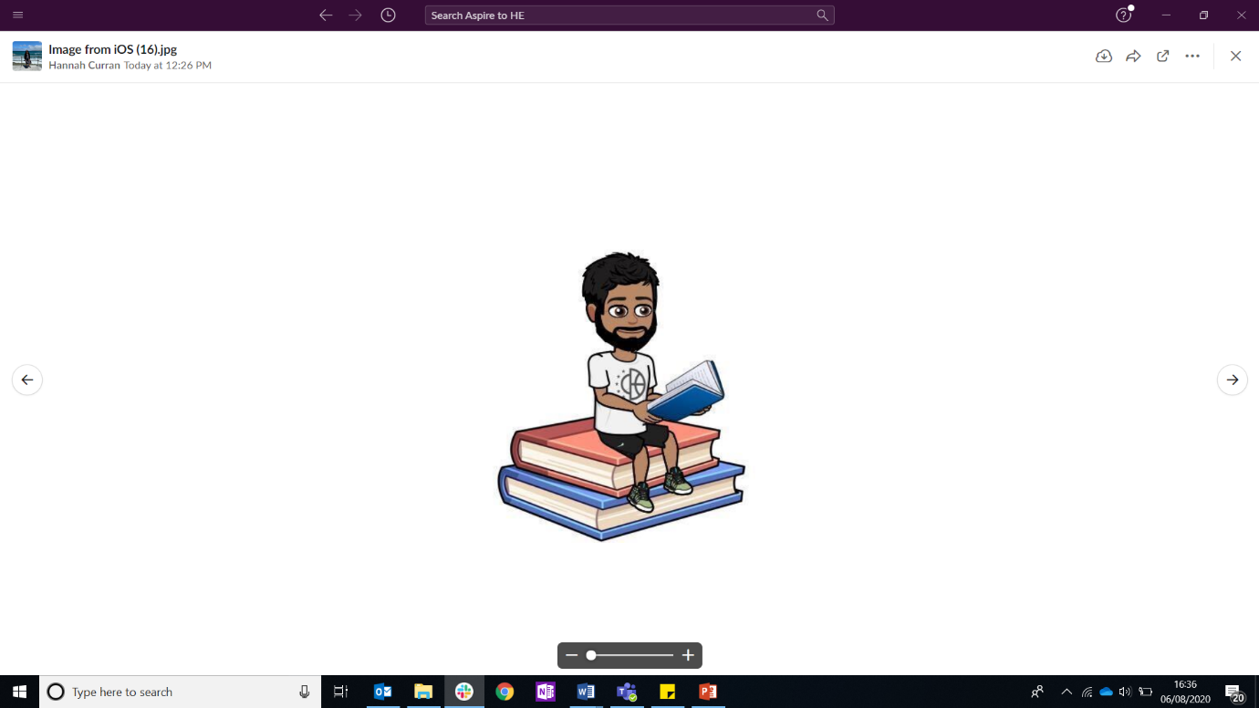
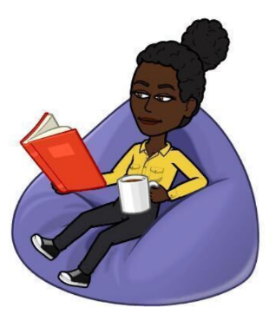
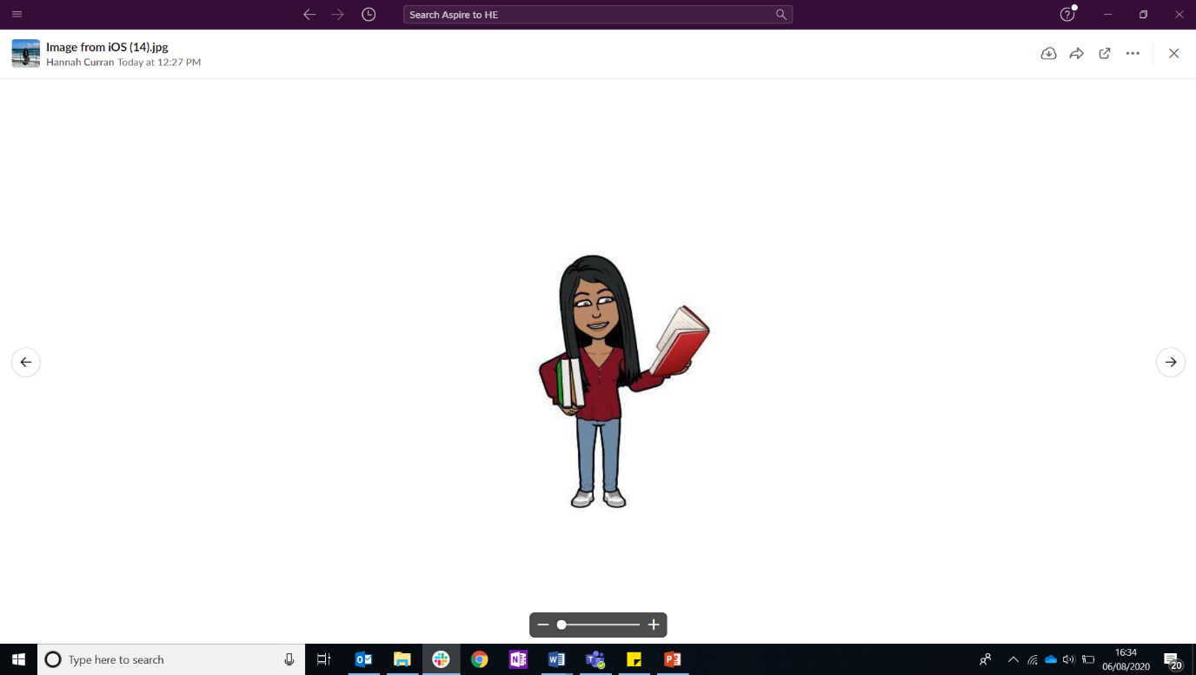
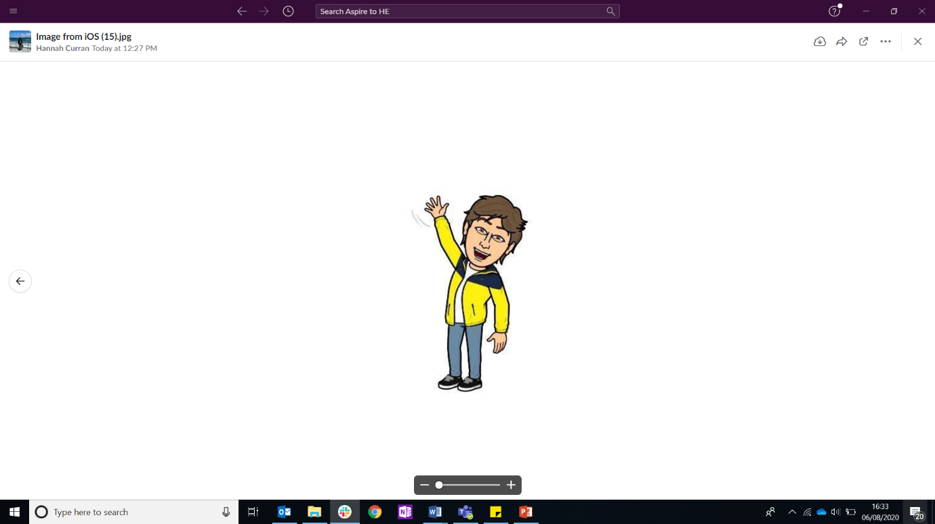
CHARACTER
Henna
24 years old
Tom
29 years old
Renee
21 years old
Rikki
26 years old
Notes:
First students need to select a character for their CV. They can choose any they wish and this can multiple students could chose the same character. This is just to bring it to life.

Slide 20
KNOWLEDGE AND SKILLS
I am very good at problem solving. My friends and I go to Escape rooms regularly and love working under pressure!
I am the captain of my hockey team and like organising the fixtures for my team. My peers say I am a good leader and I'm always on time!
I love helping my Dad on his building site. It's hard work but has taught me the importance of commitment and team work.
Notes:
For the next 5 slides, students need to select just one of the options they see on the screen and tick this on their worksheet.

Slide 21
PERSONAL ATTRIBUTES
I am very honest with my friends and that's why we have such a good relationship. Specifically when doing school work, we give each other constructive feedback to help each other improve.
I'd describe myself as a caring person. I look after my little sister and make sure she is happy whenever I babysit!
I'm a compassionate person as I love to volunteer. I volunteer for my town council and assist with various charity events.

Slide 22
WORK EXPERIENCE
I have volunteered at school open evenings and careers events where I have spoken to prospective students and their parents.
On Saturdays I help out with the younger classes at my dance school.
I do a paper round every evening.

Slide 23
QUALIFICATIONS
I have 6 x GCSEs at grade 5 – 7 including English, Maths and Science. My A Level results include English Literature (A), Biology (C), and a BTEC Extended Diploma (DMM).
I have a Level 2 BTEC National Diploma (MP) in Dance and a Level 3 Extended Diploma (DDM) in Creative Arts.
I have an A Level qualification in Graphics (B), Computer Science (D) and Fine Art (C).

Slide 24
EXTRA-CURRICULAR
I am part of the school's drama club.
I train with a football team twice a week, alongside attending weekly matches. I am also a member of the school's club.
I attend the chess and debating clubs at school during lunchtime. I was recently selected to join a STEAM (Science, Technology, Engineering, Art and Maths) club after school.

Slide 25



GETTING A JOB
Which job do you think your character is most suitable for between these options?
Why do you think this?
Teacher
Architect
Barista
Notes:
Looking at all of the options they’ve selected on their work sheet, ask students which job they think their character is most qualified for with the options they chose. Why?
Now explain that most skills can be used for multiple jobs, i.e. ‘Being part of the school’s drama club’ could be used for all of these roles because of the skills you gain, e.g. being punctual, confidence, public speaking, organisation etc.

Slide 26
FOR NEXT SESSION:
INDEPENDENT ACTIVITY:
Find a volunteering opportunity or explore extra-curricular activities in your local area.
Could you sign up for one of these? What interests you?
If you already do this, what skills have you gained from this opportunity?

Slide 27



@aspiretohe

