Slide 1


YEAR 10 SESSION 3:
WHAT ARE THE BENEFITS?

Slide 2

LAST SESSION
OBJECTIVE 1: Understand the difference between hobbies and future careers.
OBJECTIVE 2: Be aware of competitiveness within FE and HE.
OBJECTIVE 3: Start creating a CV.

Slide 3
CHECK-IN
OPPORTUNITIES
What extra-curricular or volunteering opportunities did you find in your local area? Have you signed up for any of them?
If you are already involved in volunteering or extra-curricular clubs, what skills have you identified?

Slide 4
SESSION OBJECTIVES
OBJECTIVE 1: Understand your transferable skills.
OBJECTIVE 2: Be aware of graduate premium.
OBJECTIVE 3: Comprehend the benefits of pursuing HE.

Slide 5

TRANSFERABLE SKILLS CHECK
On the sheet in front of you, there is a list of activities.
Tick the letters next to each one if you feel the statement applies to you:
A – I’ve done this at least once
B – I’d easily/happily do this again
C – I will challenge myself to do this in the next 3 months
Once completed, fill in the next sheet to identify which skills match up with the activities from the previous worksheet.
Notes:
Resource Booklet Pages 17-19: 3.1 Transferable skills check
3.1
Use resources from the Resource Booklet and get students to self-reflect. This activity is designed to help students understand that even the small things provide them with skills! They don’t need to have climbed Mount Everest to feel accomplished, it’s the little things that count!

Slide 6
GUESS THE WAGE
Over the next few slides, we have a series of people in varying jobs and careers.
Some have degrees and some do not.
Can you guess the salary?
Notes:
3.2
Degree vs non-degree careers. Ask pupils what they think the salary is of each career to compare the difference between having a degree and not having one. Ask questions as you go, such as: Which of these jobs requires a degree? What other qualifications might this person need?
OPTIONAL ACTIVITY. This graph (Figure 13) shows the average earnings of many popular careers. What do students notice? You can use this to show the various sectors within a career and the range of salaries. https://www.ons.gov.uk/employmentandlabourmarket/peopleinwork/earningsandworkinghours/bulletins/annualsurveyofhoursandearnings/2018

Slide 7
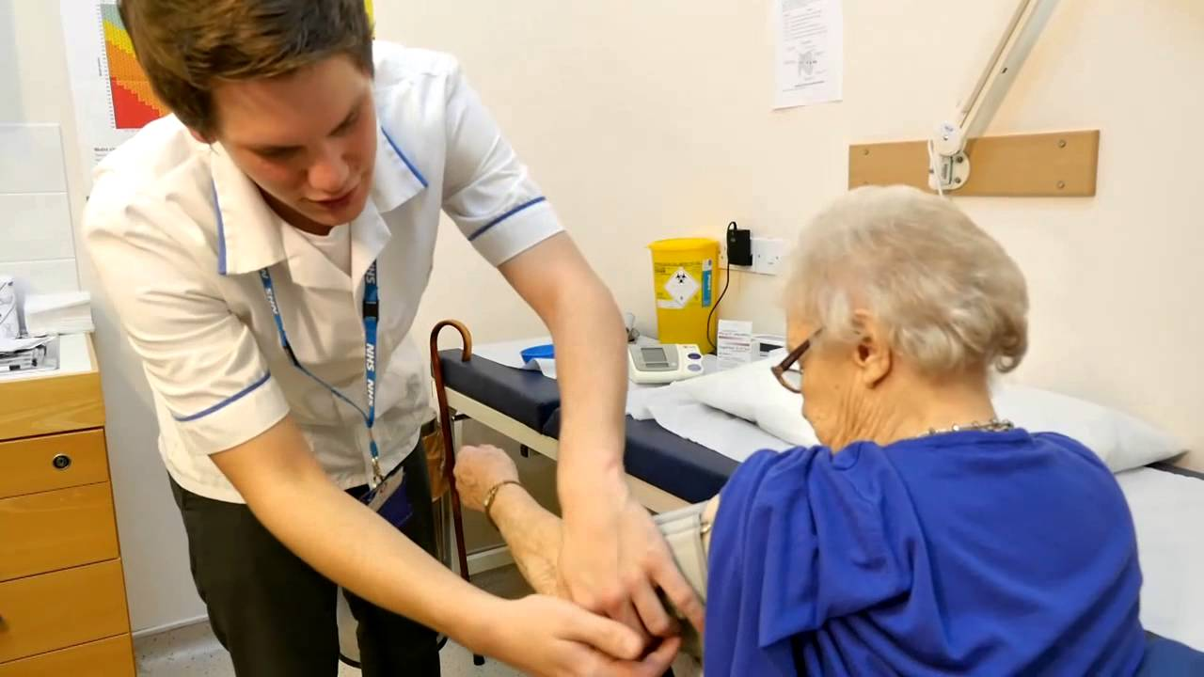

GUESS THE WAGE
Which one requires a degree?
Health Care Assistant (HCA)
Nurse
£17,000
£30,000
Guess the salary for these jobs!
Notes:
Students guess which profession requires a degree
Students guess the salaries.
Degree vs non-degree careers. Ask pupils what they think the salary is of each career to compare the difference between having a degree and not having one. Ask questions as you go, such as: Which of these jobs requires a degree? What other qualifications might this person need?

Slide 8


GUESS THE WAGE
Which individual has a degree?
Entrepreneur (created own business)
Business Manager
£26,000
£60,000
Guess the salary for these jobs!
Notes:
Degree vs non-degree careers. Ask pupils what they think the salary is of each career to compare the difference between having a degree and not having one. Ask questions as you go, such as: Which of these jobs requires a degree? What other qualifications might this person need?

Slide 9

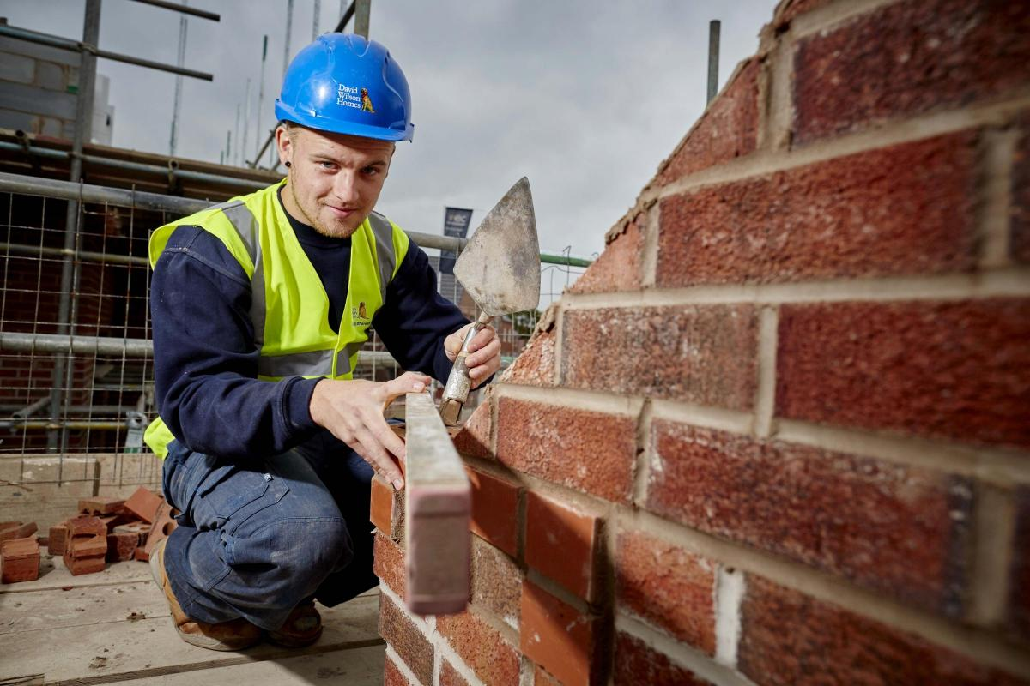
GUESS THE WAGE
Which career requires a degree?
Architect
Apprentice Bricklayer
£27,000
£8,000
Guess the salary for these jobs!
Notes:
Degree vs non-degree careers. Ask pupils what they think the salary is of each career to compare the difference between having a degree and not having one. Ask questions as you go, such as: Which of these jobs requires a degree? What other qualifications might this person need?

Slide 10
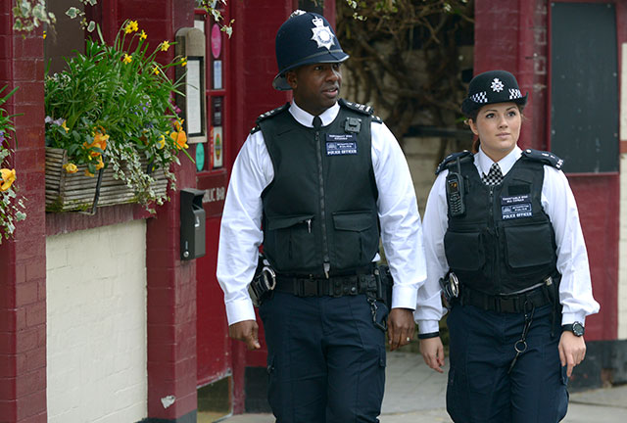
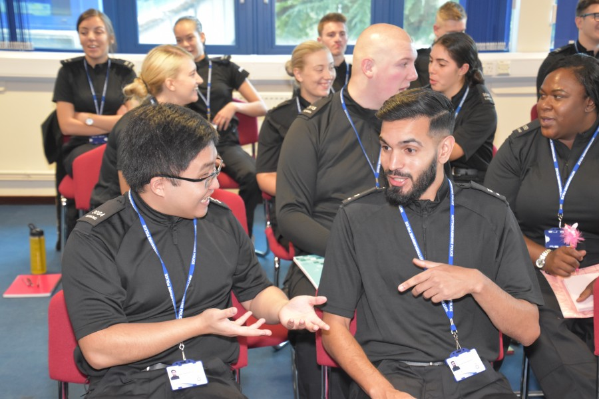
GUESS THE WAGE
Which one HAS a degree?
(Degree) Apprentice Police Constable
Police Constable
£24,000
£20,000
Guess the salary for these jobs!
Notes:
Degree vs non-degree careers. Ask pupils what they think the salary is of each career to compare the difference between having a degree and not having one. Ask questions as you go, such as: Which of these jobs requires a degree? What other qualifications might this person need?
You will get a degree upon completion of your apprenticeship!

Slide 11


GUESS THE WAGE
Which career requires a degree?
Teaching Assistant
Teacher
£12,000
£36,000
Guess the salary for these jobs!
Notes:
Degree vs non-degree careers. Ask pupils what they think the salary is of each career to compare the difference between having a degree and not having one. Ask questions as you go, such as: Which of these jobs requires a degree? What other qualifications might this person need?
University Lecturer – Usually working or has a Masters or Phd

Slide 12
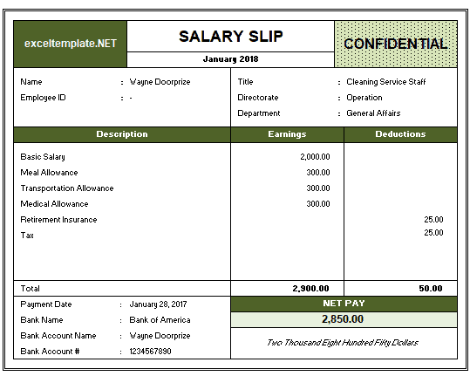
FUTURE FINANCE
What do you think of when you hear ‘student loan’?
Take a look at the two pay slips in front of you and decide which one you think belongs to the Graduate and which one belongs to the Non-Graduate?
What about the pay slips tell you this?
Does the deduction surprise you?
Notes:
Resource Booklet Page 20: 3.2 Guess the wage
This activity is designed to debunk myths about repayment while also focusing on the benefits of graduate pay. Use the resources from Resource Booklet.

Slide 13
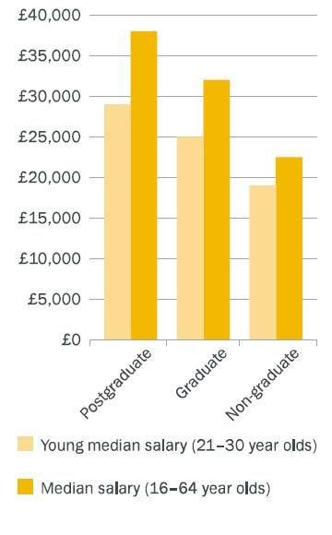
GRADUATE PREMIUM
What do you think ‘Graduate Premium’ means?
1) Take a look at the graph in front of you – what do you think it is showing?
2) On average, how much more is a graduate likely to earn per year than a non-graduate?
This is called the ‘Graduate Premium’.
On average, a graduate is likely to earn £10,000 a year more than a non-graduate!

Slide 14







BENEFITS OF HE
Join a Sports team
Join a Society
Networking
Develop independence
Higher level of employability
Travel
Make new friends
Notes:
Ask students what they think each image represents, animation is set up. Use resources from Resource Booklet for activity.
Other things to consider:
Try new things
Learn more about a subject you’re passionate about
Opens the door to more opportunities such as work experience or study abroad
Chance to do a placement
Access to materials related to subjects/hobbies
Enact change through charity work or the Students’ Union

Slide 15



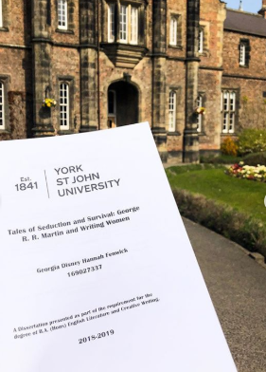

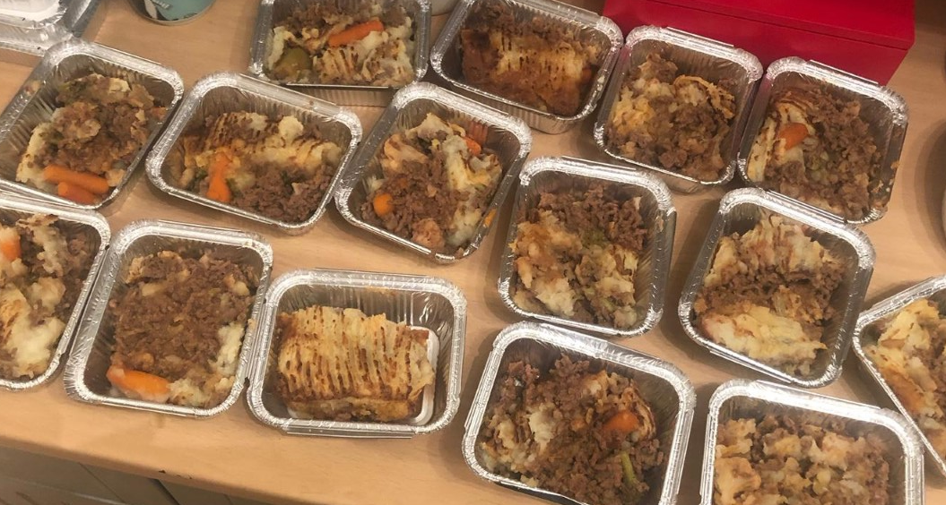

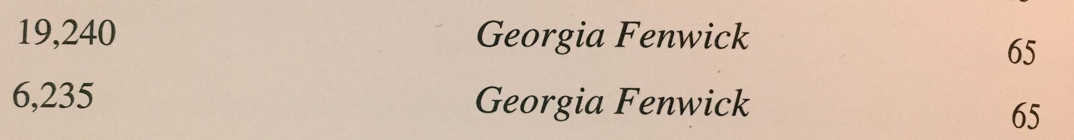

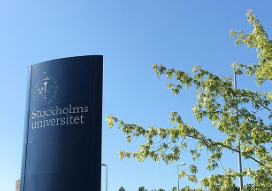
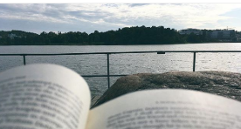

BENEFITS OF HE - EDUCATIONAL
Notes:
Optional slide. This is Aspire to HE staff member’s example. You can change this slide to demonstrate your own benefits of HE and discuss this with your students! Focus on what you enjoyed, challenges, how you overcame any barriers and your own reflection looking back.

Slide 16


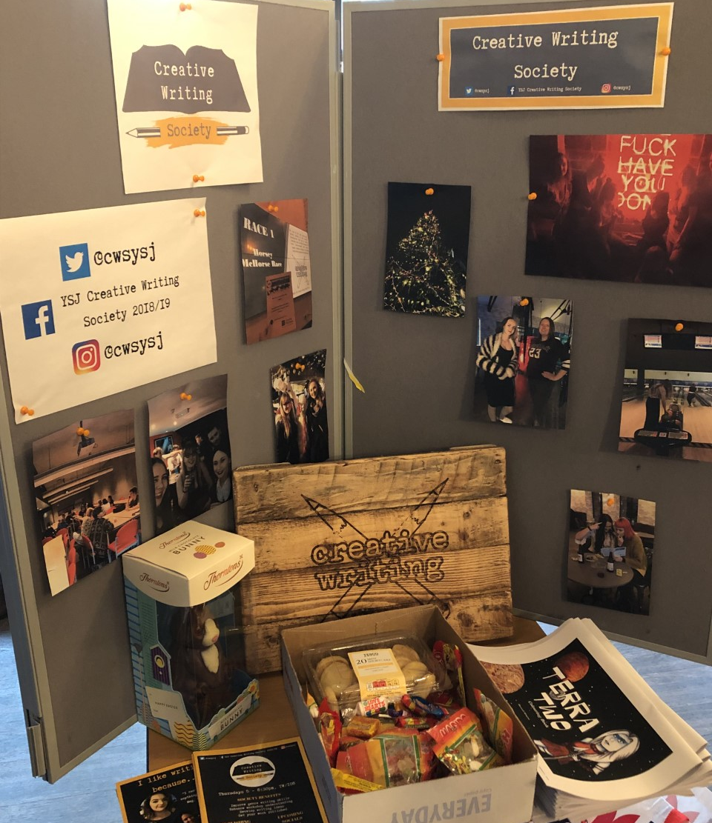


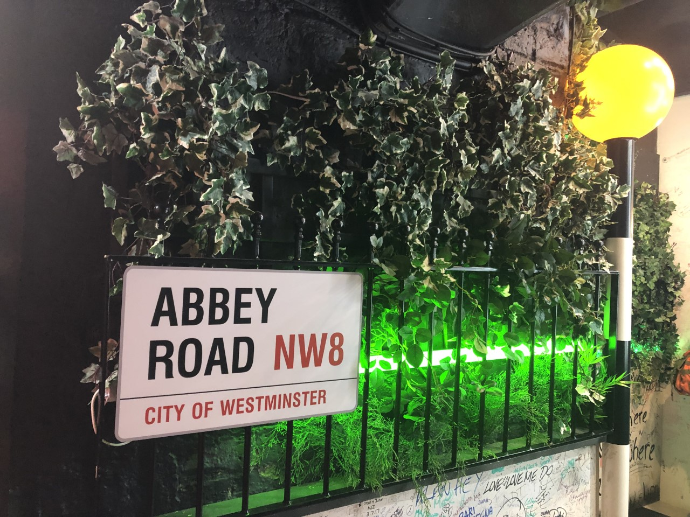


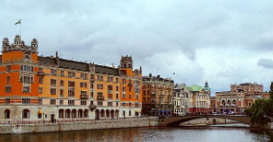

BENEFITS OF HE - PERSONAL
Notes:
Optional slide. This is Aspire to HE staff member’s example. You can change this slide to demonstrate your own benefits of HE and discuss this with your students! Focus on what you enjoyed, challenges, how you overcame any barriers and your own reflection looking back.

Slide 17
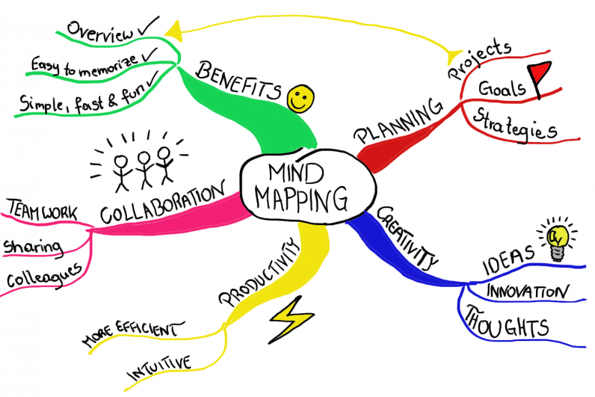
MIND MAPPING
Following everything we have discussed today, make a mindmap of the benefits of HE!
Notes:
Resource Booklet Pages 21-22: 3.3 Mind mapping
Encourage pupils to think carefully about how they create their mindmap. Could they organize their benefits into ‘sections’ such as skills, social benefits etc.?
What skill do they think they have developed through the use of a mindmap? Where else could they apply this in their life?

Slide 18
FOR NEXT SESSION:
INDEPENDENT ACTIVITY:
On a post-it note, write down an FE or HE-related question to be answered in a short Q&A next session.
We’re half-way through, so your question could be regarding anything we have discussed so far or that you would like to be covered in our remaining sessions.
This will remain anonymous!

Slide 19



@aspiretohe

