Slide 1


YEAR 10 SESSION 4:
WHAT ARE MY CHOICES?

Slide 2

LAST SESSION
OBJECTIVE 1: Understand your transferable skills.
OBJECTIVE 2: Be aware of graduate premium.
OBJECTIVE 3: Comprehend the benefits of pursuing HE.

Slide 3

CHECK-IN
HALF-WAY Q&A
We’re halfway through the Aspire to HE programme!
This is your chance to ask any questions regarding what we’ve already covered or what you’d like to cover in our remaining sessions!
Remember, all questions are important!
Notes:
Answer questions from post-it notes and allow students to ask any new ones!

Slide 4
SESSION OBJECTIVES
OBJECTIVE 1: Understand different types of campuses.
OBJECTIVE 2: Be aware of opportunity cost and your time management.
OBJECTIVE 3: Comprehend the difference between skills, qualifications and qualities.

Slide 5
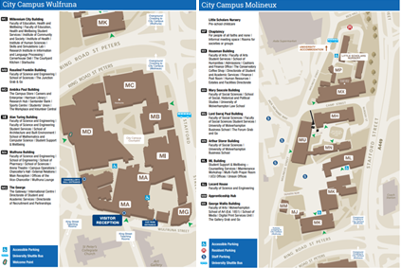
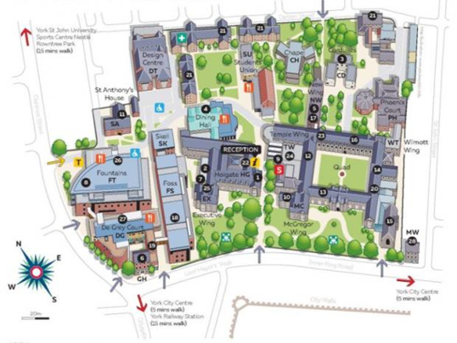
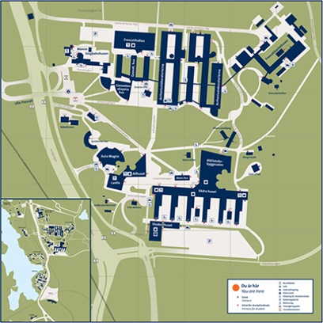
University of Wolverhampton, City Campus
CAMPUS MAP
Stockholm University
York St John University
23,000 students
33,000 students
8,000 students
Notes:
1.1
Aspire to HE staff example. Maybe add in your own university. Discuss what a campus is, their differences, how they prioritise their buildings, lay out, number of students etc.

Slide 6
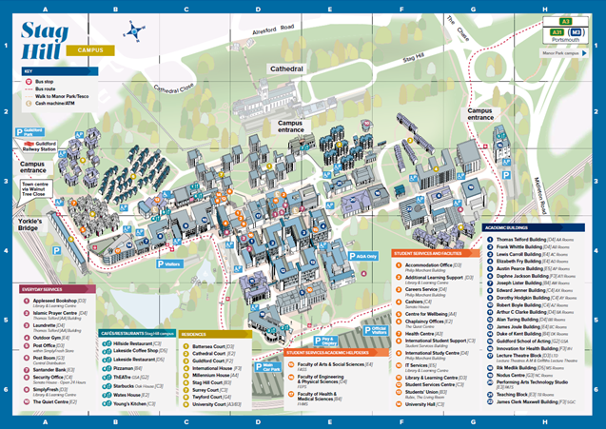
CAMPUS MAP
1. Get into pairs
2. Put your instructions in order
3. Take it in turns to roam around the campus using the directions
4. Find the end destination!
Notes:
Resource Booklet Pages 23-24: 4.1 University Campuses
Activity from Causeway Education. Resources from Resource Booklet.

Slide 7
CREATE YOUR OWN UNIVERSITY
Design your own university using ideas from the campus maps we have looked at.
What is most important to you? Will you have a city university or a countryside university? Is it sporty? Quiet? The decisions are yours!
Notes:
Resource Booklet Page 25: 4.1 Design your own university
Give students A3 (preferable) or A4 piece of paper. See how they draw their campus. Handout included in the Resource Booklet; this includes ideas for various buildings and necessary buildings for most universities such as a library and students’ union. Can be used to inspire students to think about what various universities have available.

Slide 8
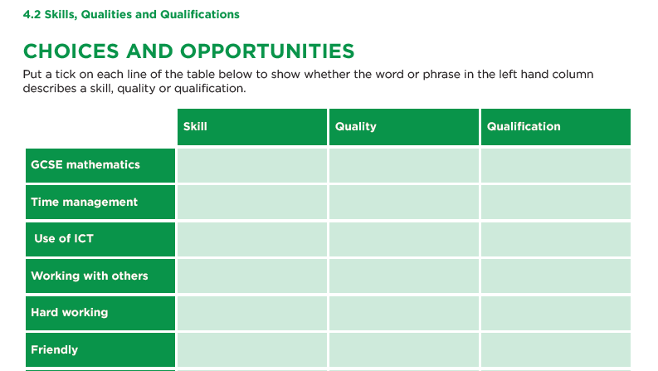
SKILLS, QUALITIES & QUALIFICATIONS
Do you know the difference?
Use the worksheet to identify the differences between skills, qualities and qualifications.
Is there anything you would like to learn or develop?
Notes:
Resource Booklet Pages 26-27: 4.2 Skills, qualities and qualifications
4.2
Use resource in Resource Booklet. Answers behind square. Print off worksheets. Discuss with students – is there anything on there they don’t understand? Would they like to develop or learn any of these?

Slide 9
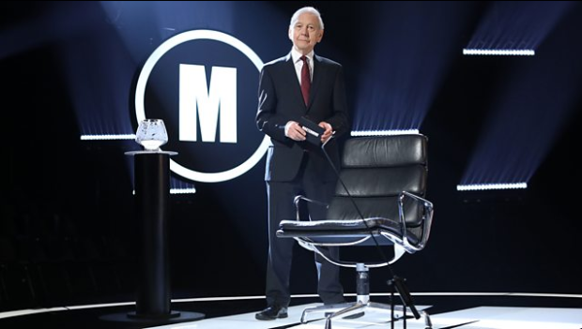
MASTERMIND
What is your MasterMind subject?
Do you know everything about one particular topic?
How did you learn about it?
Would you do a PhD if you could?
Notes:
Give examples of your mastermind subject. Ask them to talk to each other about what it would be and why they think they have extensive knowledge of that subject. Explain the link to the qualification chain – each level becomes more specialised. Would you study it at Masters or PhD level if you could? Ask for volunteers to talk about their chosen subject for one minute or get students to create a short 5-question quiz about their subject.

Slide 10
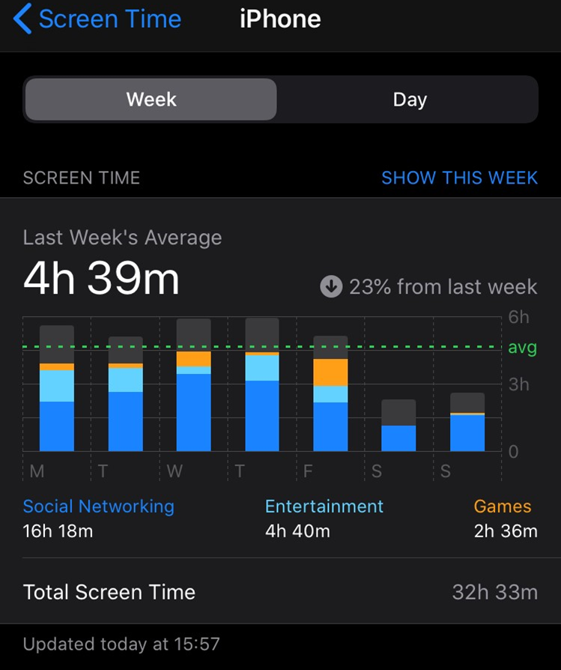
SCREEN-TIME REPORT
A screen-time report is available on most devices and details how much of our time we have spent on that particular device.
This is an example report.
What do you think? Here are some questions for you to consider:
Is this a large amount of time?
What could I be doing with this time instead?
Is it worth the time I’ve spent on the device?
What benefits am I getting from this?
Do you think your report would be higher or lower?
Notes:
Aspire to HE staff member’s report - can change to add in your own. Discuss what they could be doing with this time as opposed to being on their phone. Are they happy with how much time they spend on their phone?

Slide 11
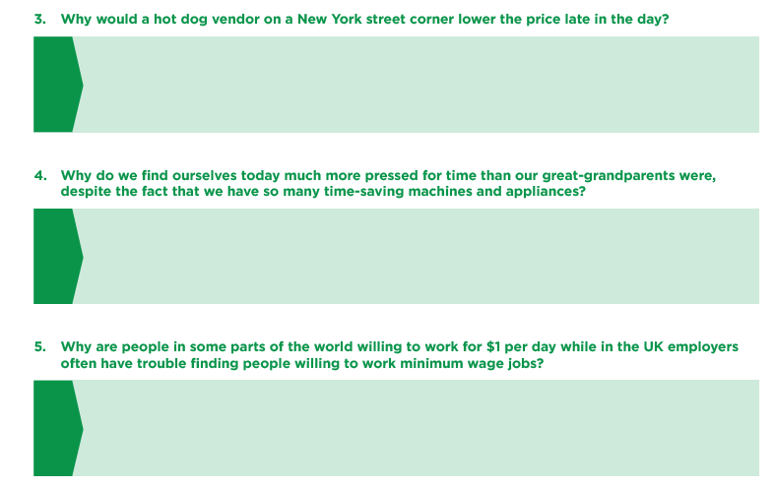
OPPORTUNITY COST
Every single decision you make has an impact on something else.
We all have to make decisions.
Some of these are more important than others and the only person who can validate these decisions is you.
Think about these questions.
What are the benefits and costs of their decisions?
What would you do in this situation?
Notes:
Resource Booklet Page 28: 4.3 Opportunity cost
4.3
Use resources in Resource Booklet. Use these questions to get students thinking about the reasoning behind decisions. Link to screen-time report – what are the benefits and costs for these individuals?
Give personal examples – e.g. I moved out for more freedom, now I have to cook my own tea! Is the cost/benefit ratio worth it?
Optional video to show: https://www.youtube.com/watch?v=TNxg1auV2AM

Slide 12
OPPORTUNITY COST
Every single decision you make has an impact on something else.
Using the cards provided, decide which one belongs in each column.
Would you take the cost for the benefit?
Give me an example of your own!
OPPORTUNITY | BENEFIT | COST
Notes:
Resource Booklet Pages 29-31: 4.3 Opportunity cost
Use resources in Resource Booklet. Use the cards and get students to assign them to each column. You do not need to use all of the cards from the resources. This can be done as a group on the table – you do not need to print out a physical table as shown above. Discuss the weighting between benefit/cost for each scenario. Ask them to come up with their own and/or use your own examples! E.g. Travelling – Exploring cultures and developing knowledge – Can cost a lot of money and would have to have time off work. Personally, the benefit of this scenario outweighs the cost.

Slide 13
FOR NEXT SESSION:
INDEPENDENT ACTIVITY:
Think about your current timetable and how it would change for sixth form, university or an apprenticeship.
Consider one thing you would change about your timetable.

Slide 14



@aspiretohe

