Slide 1


YEAR 10 SESSION 5:
WHAT ARE MY OPPORTUNITIES?

Slide 2

LAST SESSION
OBJECTIVE 1: Understand opportunity cost.
OBJECTIVE 2: Be aware of your time management.
OBJECTIVE 3: Comprehend the difference between skills, qualities and qualifications.

Slide 3
CHECK-IN
TIMETABLE
What is one thing you would change about your timetable?
This could be adding more of your favourite lesson, making the day shorter or time put aside for a specific activity such as meditating or studying.
Notes:
Get students to analyse their timetable and where their time is being spent. What would they keep, add in or take out? Discuss your own thoughts.

Slide 4
SESSION OBJECTIVES
OBJECTIVE 1: Understand the difference in timetables.
OBJECTIVE 2: Be aware of UCAS and its support.
OBJECTIVE 3: Comprehend HE support for equality and inclusion.

Slide 5
UNIVERSITY TIMETABLES
Look at this example of a university timetable. What are the biggest differences compared to school?
Time | Monday | Tuesday | Wednesday | Thursday | Friday
9:00-10:00 |  |  |  | Module 3 (Lecture)
10:00-11:00 | Module 1 (Lecture) |  |  | Module 3 (Seminar)
11:00-12:00
12:00-13:00
13:00-14:00 | Module 1 (Seminar)
14:00-15:00
15:00-16:00
16:00-17:00
17:00-18:00 |  |  | Module 2 (Workshop)
18:00-19:00
19:00-20:00
Course studied:
Creative Writing and English Literature
Institution:
York St John University
Notes:
5.1
7 hours a week with the expectation of independent reading.
Discuss the main differences and expectations students had before seeing the timetable. Do they realise a university timetable allows lessons anywhere between 9am and 8pm? Discuss what a module is and the difference between lecture, seminar, workshop and tutorials. Talk about what you would do in the empty spaces – studying, reading, tutorial with supervisor, sports/societies etc.

Slide 6
UNIVERSITY TIMETABLES
Look at this example of a university timetable. What are the biggest differences compared to school?
Time | Monday | Tuesday | Wednesday | Thursday | Friday
9:00-10:00 |  |  | Module 3 (Lecture)
10:00-11:00 | Module 1 (Lecture) | Module 4 (Lecture) |  | Module 3 (Tutorial)
11:00-12:00 |  |  |  |  | Module 2 (Tutorial)
12:00-13:00 |  |  |  | Module 3 (Lecture)
13:00-14:00 | Module 2 (Lecture) | Module 1 (Lecture) | Module 4 (Lecture)
14:00-15:00 |  |  |  |  | Module 4 (Tutorial)
15:00-16:00 |  | Module 2 (Lecture) |  | Module 1 (Tutorial)
16:00-17:00
17:00-18:00
18:00-19:00
19:00-20:00
Course studied:
Mathematics and Computer Science
Institution:
University of Liverpool
Notes:
16 hours a week with less expectation of independent work.
Discuss the main differences and expectations students had before seeing the timetable. Do they realise a university timetable allows lessons anywhere between 9am and 8pm? Discuss what a module is and the difference between lecture, seminar, workshop and tutorials. Talk about what you would do in the empty spaces – studying, reading, tutorial with supervisor, sports/societies etc.

Slide 7
UNIVERSITY TIMETABLES
Look at this example of a university timetable. What are the biggest differences compared to school?
Time | Monday | Tuesday | Wednesday | Thursday | Friday
9:00-10:00 |  | Practical (Embroidery)
10:00-11:00 | Practical (Weave) |  |  |  | Theory Lecture
11:00-12:00 |  |  |  | Practical (Surface Design)
12:00-13:00
13:00-14:00
14:00-15:00
15:00-16:00
16:00-17:00
17:00-18:00
18:00-19:00
19:00-20:00
Course studied:
Textile Design
Institution:
Birmingham City University
Notes:
20 hours a week with the expectation of independent learning.
Discuss the main differences and expectations students had before seeing the timetable. Do they realise a university timetable allows lessons anywhere between 9am and 8pm? Discuss what a module is and the difference between lecture, seminar, workshop and tutorials. Talk about what you would do in the empty spaces – studying, reading, tutorial with supervisor, sports/societies etc.

Slide 8
UNIVERSITY TIMETABLES
Your turn! Fill in the timetable with what you might expect from a different course/qualification. You can make up a subject or do a timetable for an apprenticeship.
Time | Monday | Tuesday | Wednesday | Thursday | Friday
9:00-10:00
10:00-11:00
11:00-12:00
12:00-13:00
13:00-14:00
14:00-15:00
15:00-16:00
16:00-17:00
17:00-18:00
18:00-19:00
19:00-20:00
Notes:
Resource Booklet Page 32: 5.1 University Timetable
Ask students to now create their own timetable. They can do this for any qualification of their choice. Get them to create a pretend subject if they’re not sure what they want to do! Think of sports/societies, socialising, work, shopping etc.

Slide 9
UNIVERSITY TIMETABLES
What HE route did you base your timetable on? University, apprenticeship, something else?
Tell me 1 thing that is essential for your personal timetable.
Is it playing a sport? Travelling?
What would you do if your family or friends didn’t want you to go into HE?
Notes:
Links to upcoming role-play activity on the next slide.

Slide 10
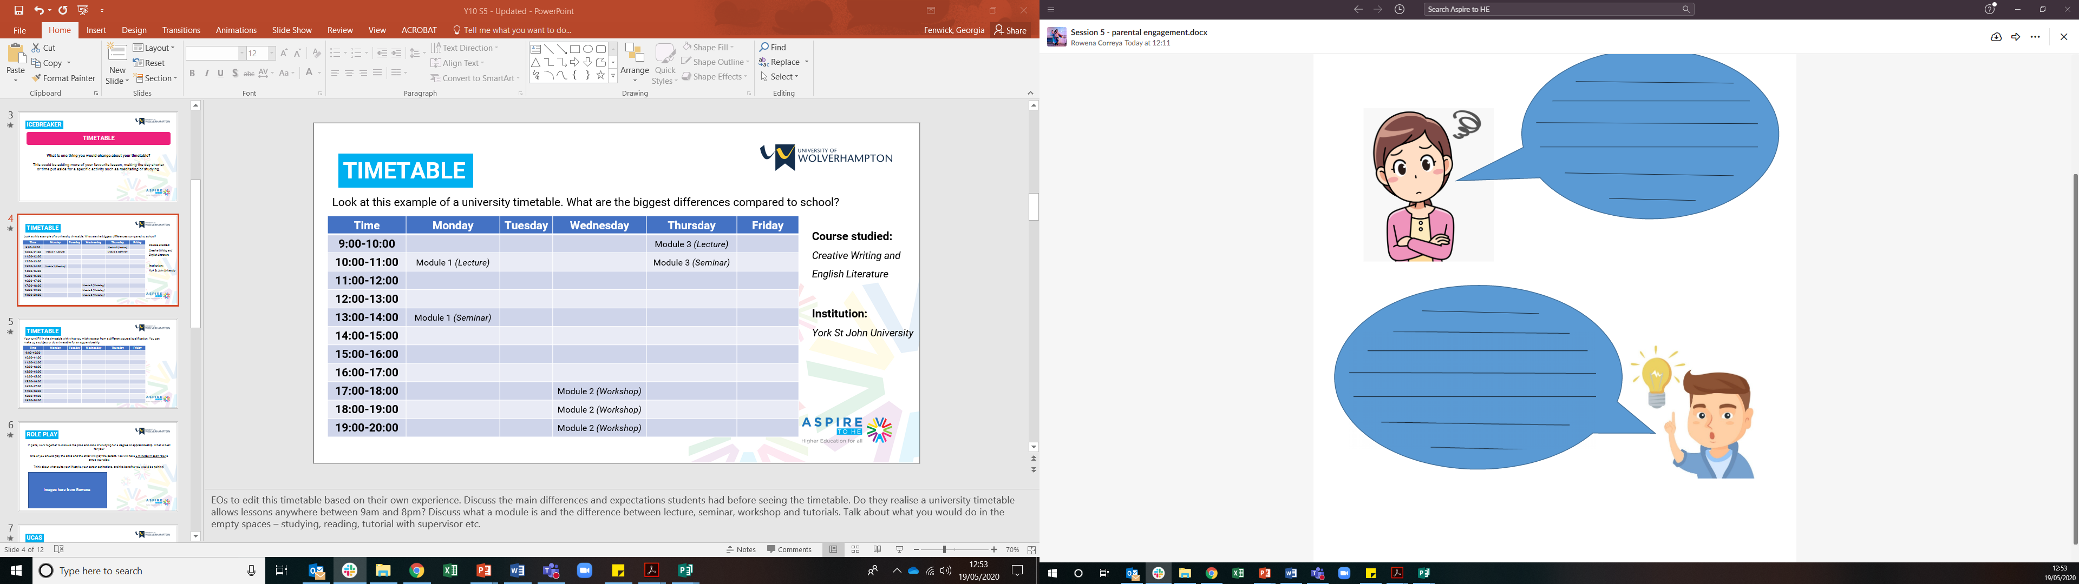
ROLE PLAY
In pairs, work together to discuss one of the following scenarios.
One of you can be the student and one of you can be the parent/carer.
Spend 2 minutes arguing your point either for or against the experience.
Now swap roles and chose a different scenario.
Alex wants to do an apprenticeship but their parent/carer wants them to get a full-time job.
Sam would like to take a gap year but their parent/carer thinks they should go to university.
Ashley wants to go to university but their parent/carer wants them to do an apprenticeship.
Think about what suits your lifestyle, your career aspirations, and the benefits you would be gaining!
Student
Parent/carer
Notes:
Resource Booklet Page 33: 5.1 Parental Engagement
This activity is designed to get students to think subconsciously about everything they have learnt with you so far. They should imagine that the parent disagrees with the child’s choice, for example, university is too expensive or an apprenticeship will limit you to one career. The child can argue the reasons behind their decision and it will encourage them to understand the benefits of these qualifications.

Slide 11
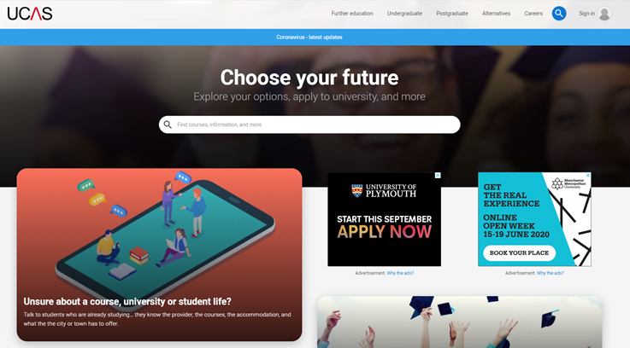
UCAS
What is UCAS?
The Universities and Colleges Admissions Service provides information about HE institutions via their online site.
They also provide knowledge regarding student finance, support available, and their website is used for students to submit their applications for HE institutions.
Notes:
5.2
Discuss UCAS with students but do not provide too much detail.

Slide 12
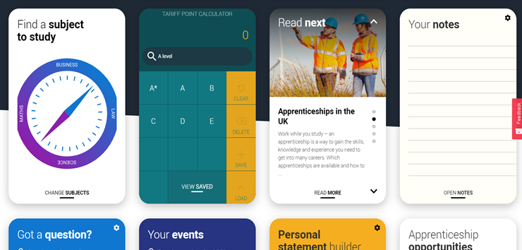
UCAS
UCAS Hub
Via the UCAS website, they have launched a ‘UCAS Hub’ portal that allows students to explore courses, build a personal statement, research opportunities and many other elements.
Why not explore this at home? You won’t need UCAS for a while but it’s always good to begin your research early!
Notes:
Discuss UCAS Hub with students but do not provide too much detail.

Slide 13

EQUALITY & INCLUSION
https://www.youtube.com/watch?v=4K5fbQ1-zps
Notes:
Resource Booklet Page 34: 5.3 Overcoming hurdles
5.3
The $100 race. Either show https://www.youtube.com/watch?v=4K5fbQ1-zps and discuss its meaning or stage the race yourself with students. Explain that HE is inclusive and that opportunities are not limited by identity. That doesn’t mean that some students won’t find it harder, but that for every student who completes it, it gets a little easier for the next one, and they are not the first to conquer the obstacles they’ve identified. Explore the difference between equality and equity.
There is an example of questions that you can act out with students if you don’t have access to the internet.

Slide 14

EQUALITY & INCLUSION
F
I
N
I
S
H
S
T
A
R
T
Grades
Finance
Health
Confidence
Support
Some students face more barriers than others. What do you think the most common hurdles are? Do these hurdles have any solutions?
Notes:
Use this activity to emphasise the importance of the previous video. Some students will face more barriers than others through no fault of their own and it’s vital to help those where we can. Work as a whole class to label these hurdles. Animations available to give students ideas of what they may face. Talk through solutions for any hurdles they come up with.

Slide 15
EQUALITY & INCLUSION
What do you think universities/employers should put in place to help these situations?
How do you think you could get involved at university to improve the experience?
Notes:
Show the wellbeing/support page of a university and discuss the positives and negatives with students. Explain the various roles within a Students’ Union to support students and other ways they could get involved, e.g. societies.

Slide 16
FOR NEXT SESSION:
INDEPENDENT ACTIVITY:
Physical and mental wellbeing is extremely important, especially at university.
Research any UK university and identify one example of support they have in place for their students.
Could it be improved? What would you offer?

Slide 17



@aspiretohe

