Slide 1


YEAR 11 SESSION 1:
FE vs HE
Notes:
1.1 Recap Y10, difference between FE & HE
1.2 What is an apprenticeship/sixth form/college - main focus on apprenticeships and different types
1.3 How to choose a subject, the impact of these decisions on your HE future, making a check-list to complete before Y12

Slide 2

SESSION OBJECTIVES
OBJECTIVE 1: Understand the differences between HE and FE.
OBJECTIVE 2: Be aware of your post-16 options.
OBJECTIVE 3: Comprehend how your FE choices influence your HE options.

Slide 3
RECAP Y10
WHAT CAN YOU REMEMBER?
What is Opportunity Cost?
What is a benefit of HE?
What is the difference between your timetable and a university timetable?
What is a transferable skill?
What is a tuition fee?
What is the difference between FE and HE?
Name one of your post-16 options.
Notes:
1.1
Could be turned into a game e.g. students throw a ball to each other and answer a question.
Key points from Y10 programme, highlighting important facts, ask students what they want to know more about and anything they do remember that stands out.
Topics covered in Y10:
Post-16 Options, Qualification Chain, Goal Setting, Why GCSEs are important.
Hobby vs Career, Competition, CVs, Getting a Job, Transferable Skills.
Degree jobs vs Non-degree jobs, Pay Slips, Benefits of HE, Mindmapping.
Specialisation, Opportunity Cost, Skills, Qualities & Qualifications.
School Timetable vs University/Apprenticeship Timetable, Pros/Cons of HE Roleplay, UCAS & UCAS Hub, Equality and Inclusion.
Student Finance, Budgeting, 16-19 Bursary.
Is there anything you want to go back to?

Slide 4
WHY ARE GCSES IMPORTANT?
What if I don’t get the GCSE grades I was expecting?
Your GCSEs can determine what or where you study at Level 3.
Universities will look at your GCSEs!
Most jobs or educational programmes won’t accept you unless you have passed English, maths or science.
They are your stepping stones into further education and your future career!
Your GCSEs will be on your CV forever.
Notes:
Important to remember that some institutions have higher expectations than others so you may need to check the entry requirements of your desired sixth form, college or apprenticeship.
Your GCSEs represent your academic ability and will be used on you CV.
You may not be thinking about university just yet but it’s important to be aware that universities will look at your GCSEs.
It is vital to work hard and gain a good ticket for your future.
Don’t worry if you don’t get the grades you were expecting – talk to your school or college to see if they will still accept you. You can consider resitting your exams if possible or you may have to apply for a different course or pathway. PLEASE DON’T STRESS – everything will turn out okay in the end.

Slide 5





YOUR WELLBEING
This year might be stressful, HOWEVER…
You are in control
2) Talk to someone
3) Be kind to yourself
4) Start as you mean to go on
5) Celebrate the small things
Notes:
This year might have been really stressful but remember this 5 things:
You are in control – everyone is different so it’s important to make your own revision timetable that suits you and manage your time effectively.
Talk to someone – friends, family, teachers
Be kind to yourself – this year may have not gone to plan so don’t be too hard on yourself – everyone will be in the same boat.
Start as you mean to go on – get a head start with revision to be extra prepared. Start strong and positive!!
Celebrate the small things – celebrate your small successes and hold your head up high.

Slide 6
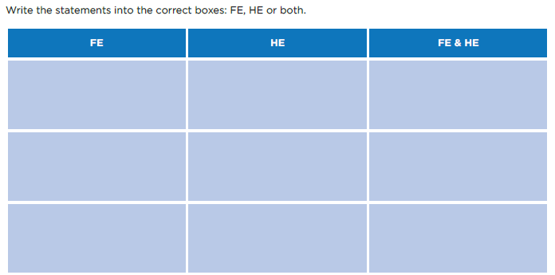
ACTIVITY
Think you can tell the difference? Listen to these statements and decide whether they apply to FE or HE. There may be a few that apply to both!
Notes:
Resource Booklet Pages 37-38: 1.2 FE or HE?
1.2
Read the statements out below and ask students if they know if they relate to FE (further education) or HE (higher education)
This is optional. (HE)
This is compulsory. (FE)
You study this at Level 4 and above. (HE)
You can study A Levels here. (FE)
You can study this at 18 years old. (FE & HE) – You can study these courses at any age!
You can specialise in one subject. (FE & HE) – Certain colleges only allow you to study one subject, and you may choose to study a joint honours course at university.
You can get a Master’s Degree here. (HE)
You have to pay to study. (FE & HE) – If you are over 18, you may have to pay for college. Tuition fees at university are currently £9,250 per year.
You will attend a variety of lectures, seminars, tutorials and workshops here. (HE)
At this level, you could attend Sixth Form. (FE)
Activity to get students understanding the differences between FE study and HE study.

Slide 7
WHAT IS FE?
FE stands for ‘Further Education’.
Everyone has to study in FE until they are 18.
‘Further Education’ is any qualification/training you gain at Level 3.
These qualifications could be A Levels, BTECs, Diplomas, HNCs, HNDs & more!
Your FE institution could be a sixth form, college or apprenticeship.
FE allows you to specialise in certain subjects after your GCSEs.
Notes:
Discuss each point separately and answer any questions from students. Touch on social opportunities or benefits if possible!

Slide 8
WHAT IS HE?
HE stands for ‘Higher Education’.
HE is optional.
‘Higher Education’ is any qualification/training achieved at Level 4 or above.
These qualifications include a Foundation, Bachelor’s or Master’s degree, a Doctorate, or a higher/degree apprenticeship!
HE institutions are typically universities or your training provider.
You specialise in one subject when pursuing HE.
Notes:
Discuss each point separately and answer any questions from students. Touch on social opportunities or benefits if possible!

Slide 9
FE OPTIONS: SIXTH FORM
At a sixth form, you are often encouraged to choose 3-4 subjects, either A Levels or BTECs, and you will learn in a formal, school setting.
It is worth researching local schools with a sixth form to see if this is the right path for you.
Pros | Cons
Pros | Cons
Already know the institution and your teachers/peers | Not gaining as much independence (unless you move to a new sixth form)
Support with work | Entry requirements are usually higher
Usually less students, allows for more 1-1 support | School environment
If you are already at a school with a sixth form, why not speak to the Head of Post-16 to get first-hand knowledge?
Notes:
Discussion regarding sixth form – pros and cons. Explain that some of the cons may be a pro for them and vice versa!

Slide 10
FE OPTIONS: COLLEGE
FE college: College is an adult environment where you take more responsibility for yourself and your learning – there’s support and guidance available, but it’s also a chance for you to prepare for work and life post-education.
Sixth form college: These colleges can be more informal than school sixth forms. They’re usually bigger, and they can offer you more study options.
Pros | Cons
Pros | Cons
Gain independence and self-discipline | May only be able to do one course
A wider variety of subjects available | Different learning environment
Relaxed teaching style (this may be a con for you!) | Potentially difficult to build rapport with tutors
It’s important to check what colleges offer such as a free bus service or bursaries that you may qualify for!
Notes:
Discussion regarding college – pros and cons. Explain that some of the cons may be a pro for them and vice versa!

Slide 11
FE OPTIONS: APPRENTICESHIP
Training providers work closely with employers who offer work-based training as part of placement or employment, including NVQs and apprenticeships.
Some are specialists focusing on particular sectors and job roles, such as construction, business administration, childcare, or hair and beauty.
Pros | Cons
Pros | Cons
Earning a wage while you learn | Could limit your options as they mainly focus on one area e.g. hair and beauty, mechanics etc.
Gain independence and real-life experience | You may get paid less than others
Building a network within your chosen area | Very different to school and can be a lot of pressure
This may be a good option for you if you are set on working in one particular area.
Notes:
Discussion regarding apprenticeships – pros and cons. Explain that some of the cons may be a pro for them and vice versa!

Slide 12
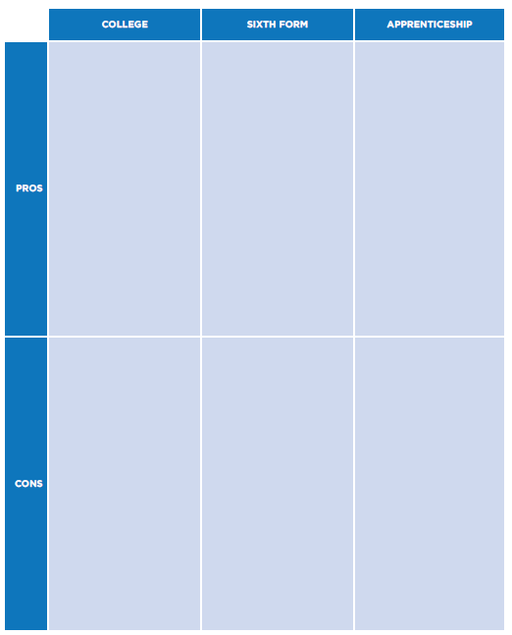
FE OPTIONS: ACTIVITY
Fill in the following table with your pros and cons for studying at sixth form, college, or an apprenticeship.
You will all have different reasons for your choices – there’s no wrong answer!
Notes:
Resource Booklet Page 39: 1.2 Post-16 Destinations
Students can use examples from previous slides or any of their own that they think of! Encourage different viewpoints and an ongoing discussion.

Slide 13
YOUR HE FUTURE
It’s ok to not know what you want to do in the future, HOWEVER, your FE choices will impact any of your HE decisions.
GCSE qualifications, including pass grade for English, Maths and Science.
FE qualifications, e.g. relevant A Levels, BTECs, apprenticeship.
HE Degree Apprenticeship or Bachelor’s Degree.
Job or qualification you want in the future e.g. Doctor, Business Manager, Master’s Degree.
REMEMBER: You can’t progress to the next stage without completing the previous qualification.
Notes:
1.3
This slide should demonstrate how important the previous qualification is to be able to move onto their next educational step. Each circle will appear in order of usual educational timeline. Then work backwards to demonstrate how students need certain qualifications before they can progress to the next stage e.g. you can’t progress into HE or most jobs without a Level3 (FE) qualification. Importance of FE choices on their HE future. How these factors will impact their education.

Slide 14
YOUR HE FUTURE
Important things to remember:
Most jobs/qualifications require you to pass GCSE English, Maths and Science.
You need to choose relevant subjects at FE for your future, e.g. a science for a healthcare degree.
Many high-paying jobs require a degree, although this could be any degree.
If you have a specific destination in mind, do your research! Don’t just guess.
Being unsure of what you want to do is ok! Try a transferable subject that can be tailored to any job, such as English.
You can study at any age! Don’t let this stop you from achieving your goals.
Your decisions at this point can seriously impact your future! Be mindful.
Notes:
Importance of FE choices on their HE future. How these factors will impact their education. Do acknowledge how their decisions are not the be-all and end-all; foundation degrees exist which may allow them to pursue their desired course, or gaining relevant work experience may help them to secure an apprenticeship. Timing is irrelevant; it’s never too late to change your mind!

Slide 15

CHOOSING A SUBJECT
How do I know what subjects to choose at FE?
Remember the impact these choices have on your future
Consider what you would like to do in the future or what areas you excel at
Don’t forget to think about transferable subjects that are useful across the board
Every university is different, so bear that in mind!
Notes:
Next activity instructions:
Ask students what subject they think is required for the degree at the top of each slide.
Discuss what other subjects may be beneficial for this area of study.
Explain how each university is different, use examples on the right-hand side.

Slide 16


CHEMISTRY DEGREE
*Every university is different
*Required subject(s):
Maths
Chemistry
'B,B,B. To include grade B from A Level Chemistry.'
Biology
Physics
Equivalent or Beneficial subject(s):
‘ABB including Chemistry.’
Maths
Physics
Biology
Similar subjects: Biochemistry, Pharmacology, Environmental Science, Forensic Science
Notes:
What A-level subjects are needed or essential for chemistry?
chemistry
maths (sometimes)
Most courses require chemistry and would like maths and one other science subject (eg physics, biology).

Slide 17


FINE ART DEGREE
*Every university is different
*Required subject(s):
Design and Technology
BTEC Art
‘B,B,B. At least one A Level in a relevant creative subject.’
Psychology
Art A Level
Equivalent or Beneficial subject(s):
‘C. We require a C at A level in an Art related subject as part of the Tariff.’
Photography
Design Technology
Similar subjects: Art and Design, Illustration, Creative Arts, Performing Arts
Notes:
What qualifications are essential for art and design?
Some courses require a diploma in foundation art and design or a BTEC National Diploma in general art and design (or equivalent). This will help you to build up the portfolio you need when applying to creative arts degree courses. You may be able to study this at a university, and then continue with your degree at that same institution.
Art A-level or a design-related subject.
What A-levels (or equivalent) are useful for art and design?
design technology.
photography.
history of art.

Slide 18


VETERINARY DEGREE
*Every university is different
*Required subject(s):
‘A,A,B. Including grade A in Chemistry and Biology and grade B in a third subject (excluding General Studies and Critical Thinking) at A level.’
Chemistry
Biology
Geography
Physical Education
Equivalent or Beneficial subject(s):
‘A,A,A. - level: Three A-levels in Biology, one other academic science related subject and any other subject excluding General Studies, Critical Thinking and Citizenship Studies.’
Maths
Physics
Biomedical Admissions Tests (Additional AS Level)
Similar subjects: Bioscience, Mechanical Engineering, Biomedical Science
Notes:
Combining chemistry, biology and either maths or physics (or taking both) is the best way to keep all veterinary courses open to you.
Critical thinking will help with section three of the Biomedical Admissions Test (BMAT), but it’s better to take it as a fifth AS-level rather than as a replacement for maths or physics.

Slide 19


PHYSIOTHERAPY DEGREE
*Every university is different
*Required subject:
*Required subject(s):
Physics
History
‘A-levels: AAB. Biology or PE at Grade A.’
Biology
Physical Education
Equivalent or Beneficial subject(s):
‘A-levels: ABB, to include Biology, Human Biology or PE.’
Maths
Physics
Chemistry
Similar subjects: Sports and Exercise Science, Sports Rehabilitation, Anatomy and Physiology, Sports Psychology
Notes:
What A-levels are essential for studying physiotherapy?
biology for most courses
some courses ask for physical education – either as well as biology, or as an alternative
What A-levels are useful for studying physiotherapy?
other scientific subjects eg chemistry, physics
maths
physical education. If this isn’t an essential requirement for your course, it might still be a good idea, as understanding how the body works can only be a boost to your course prospects

Slide 20


PSYCHOLOGY DEGREE
*Every university is different
*Required subject(s):
‘Two A-level subjects from mathematics, psychology or other science subjects’
Psychology
Law
None
Maths
'BBB 3 A level subjects. Five GCSEs at Grade C/4 or above are also required, including English language and maths.'
Equivalent or Beneficial subject(s):
Psychology, Sociology
Biology, Chemistry, Physics
Maths
English
Similar subjects: Sociology, Criminology, Philosophy
Notes:
What essential A-levels do I need to study psychology?
Psychology, and other social sciences like sociology, are popular degrees normally open to you with any A-levels ie they don't usually have strict subject requirements.
However, certain A-level subject choices will help prepare you for studying psychology at degree level, and may give you an edge over other applicants.
A few courses could ask for one or more of the following A-levels:biology
chemistry
maths
physics
What A-levels would be useful to have to study psychology?
Some unis suggest that a mix of sciences and humanities would be useful. You could consider studying psychology, or sociology – having a feel for the subject before you start it is always helpful.
Other typical A-levels taken by psychology students include:English
general studies
history

Slide 21


NURSING DEGREE
*Every university is different
*Required subject:
*Required subject(s):
'A-levels: science or health-related subject preferred. Grades BBC. General Studies not accepted.'
Health and Social Care
Sociology
Psychology
Biology
Equivalent or Beneficial subject(s):
'A-levels: AAB'
Psychology
Sociology
Chemistry
CACHE
Similar subjects: Midwifery, Paramedic Science, Child Nursing, Clinical Psychology
Notes:
What A-levels are essential for studying nursing?
Courses usually ask for biology or another science.
Get some personal statement help to make yours stand out from the competition
What A-levels are useful for studying nursing?
psychology
sociology
chemistry
CACHE
What is CACHE?
CACHE offers a range of qualifications for those involved in early years education, childcare, and health and social care.

Slide 22


ENGINEERING DEGREE
*Every university is different
*Required subject(s):
'A*AA. To include Mathematics and Physics. Offers exclude General Studies and Critical Thinking.'
Physics
Chemistry
Design Technology
Maths
'BBC. Qualifications should include Mathematics and Physics (or Technological Studies).'
Equivalent or Beneficial subject(s):
Physics
Chemistry
Design Technology
Similar subjects: Economics, Accounting, Business, Marketing
Notes:
What A-levels do I have to have to study engineering?
First and foremost, you must have maths, whatever area of engineering you want to study.
A science A-level is generally needed too. Some courses ask for chemistry and maths, some ask for physics and maths. Some will ask for all three.
At the end of the day, always check the entry requirements for your chosen uni course. Search for a course now to see what requirements universities are asking for.
What are university entry requirements?
What A-levels are useful to have if I want to study engineering?
Some unis also ask for further maths. Further maths is an AS or A-level which broadens and deepens the maths syllabus. It acts as an add-on to your maths qualification – you can’t take it unless you’re already taking maths.
Design technology might also be helpful, to help further your literacy in design

Slide 23


BUSINESS MANAGEMENT DEGREE
*Every university is different
*Required subject(s):
None
Business
‘ 3 B’s at A Level.’
Economics
Law
‘ Any A Levels at grade C or above.’
Equivalent or Beneficial subject(s):
Business (AGCE, National and Diploma)
IT
Economics
Maths
Similar subjects: Human Resources, Accounting, Law
Notes:
Essential A-levels (or equivalent)
None (very occasionally maths for management degrees).
Useful A-levels (or equivalent)
Maths.
Business studies (AGCE, National and Diploma).
Economics.
AGCE - Applied General Certificate of Education (AGCE) is a vocational qualification that replaced the AVCE in September 2005. Vocational Certificate of Education, usually shortened to VCE or Vocational A-Level or AVCE, was a vocational qualification that used to be available in further education colleges and sixth forms in the United Kingdom.

Slide 24
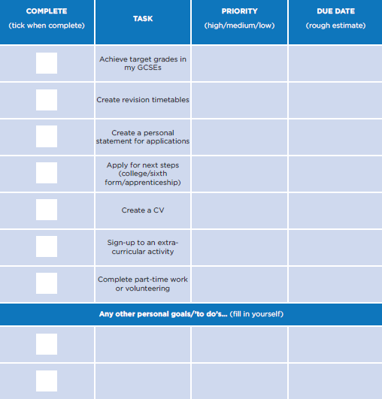
Y11 CHECK LIST
Try to complete this check list throughout year 11!
Don’t forget to add any other tasks you can think of.
Notes:
Resource Booklet Page 40: 1.3 Year 11 Checklist
A check-list for Y11s to use in preparation for their next step post-16. Use/create their own examples. Students to complete as voluntary activity and use to identify what they need to do before the end of the year.

Slide 25
FOR NEXT SESSION:
INDEPENDENT ACTIVITY:
What’s missing? Complete the check-list for yourself with your own options of what you need to achieve by the end of Y11.
Think about what you could do by next September!

Slide 26



@aspiretohe

