Slide 1


YEAR 11 SESSION 2:
POST-16 OPTIONS

Slide 2

LAST SESSION
OBJECTIVE 1: Understand the differences between HE and FE.
OBJECTIVE 2: Be aware of your post-16 options.
OBJECTIVE 3: Comprehend how your FE choices influence your HE options.

Slide 3
SESSION OBJECTIVES
OBJECTIVE 1: Understand how you might apply for your FE options.
OBJECTIVE 2: Be aware of what makes an effective application.
OBJECTIVE 3: Comprehend the differences between skills, qualities and qualifications.

Slide 4
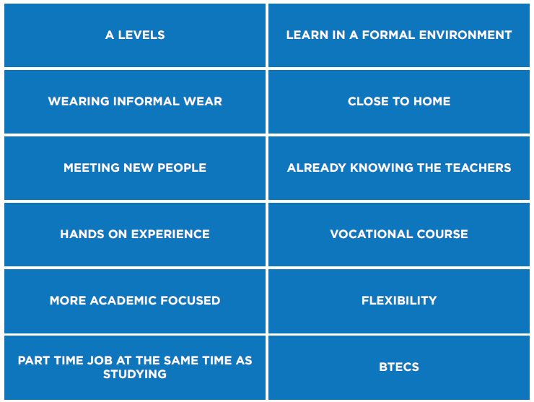
WHAT’S IMPORTANT TO YOU?
Use the cut outs to think about what’s most important to you?
Rank the options in order of ‘most important’ to ‘least important.
Here are a few examples:
Notes:
Resource Booklet Page 41: 2.1 What’s important to you?
2.1
Use resource from Resource Booklet. Answers behind square. Print off worksheets. Discuss with students – is there anything on there they don’t understand? Would they like to develop or learn any of these? Will be good to remember for their FE applications.

Slide 5
POST-16 OPTIONS
Why not make your own table to consider the pros and cons of each option? Remember, the choice is yours!
COLLEGE | SIXTH FORM | TRAINING PROVIDER | APPRENTICESHIPS
FE College: College is an adult environment where you take more responsibility for yourself and your learning – there’s support and guidance available, but it’s also a chance for you to prepare for work and life post-education. Sixth Form College: These colleges can be more informal than school sixth forms. They’re usually bigger and offer more study options. It’s important to check what colleges offer – you may be eligible for a free bus service or bursaries. | At a sixth form, you are often encouraged to pick 3-4 subjects, either A-levels or BTECs and you will learn in a formal school setting. It is worth researching local schools with a sixth form to see if it is the right path for you. If you are already at a school with a sixth form why not speak to the Head of Post-16 to get some first-hand knowledge? | Training providers work closely with employers who offer work-based training as part of a placement or employment. Some are specialists focusing on particular sectors and job roles e.g., construction, business admin, childcare, hair and beauty etc. This may be a good option for you if you are set on working in one particular area. | Apprenticeships are where you're employed to do a real job whilst studying for a formal qualification - usually for one day a week either at a college or training centre. You normally work beside experienced staff and gain industry specific skills as well as earning a wage. This may be a good option for you if you want to jump start your career and gain lots of work experience.
Notes:
Read through all 4 options.
Explain that it may be good for students to make a pro/con list for each option – that will help them make an informed choice. For example, colleges may be less formal than school sixth forms or apprenticeships you earn money whereas going to a training provider you won’t.
Get students to think of their own pro/cons – discuss as a group.

Slide 6
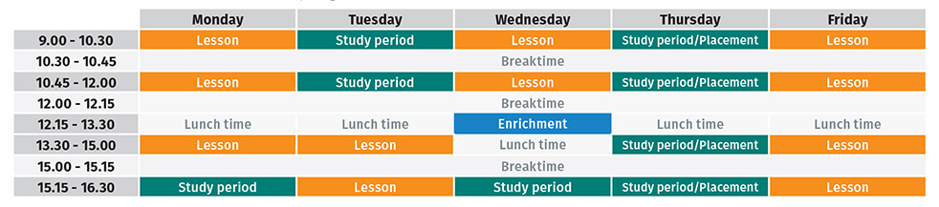
COLLEGE TIMETABLE
Notes:
Look at these 3 different timetables (college, sixth form, apprenticeship) and discuss the differences
Discuss which one students would like the most and why
Explain that in college you get lots of time for enrichment (sport clubs, extra-curricular etc) and time for independent studying.
Also get some time to do work experience/placements
Some free periods as well – ask students what they would do in their spare time at college.

Slide 7
APPRENTICESHIP TIMETABLE
Monday – college | Tuesday - workplace | Wednesday - workplace | Thursday - workplace | Friday - workplace
9am – Business admin tutorial module 1 | 9am – Meeting with manager | 9am – Getting on with tasks set for the week | 9am – Getting on with tasks set for the week | 9am – Whole team meeting
 | 10am- Getting on with tasks set for the week |  |  | 11am – College work
1pm – study group session |  |  | 3pm – College work
3pm – Business admin tutorial module 2 | 5pm – End of day | 5pm – End of day | 5pm – End of day | 5pm – End of day
Notes:
Look at these 3 different timetables (college, sixth form, apprenticeship) and discuss the differences
Discuss which one students would like the most and why
Look at apprenticeship timetable – discuss differences
Explain that they will be more than likely in college 1 day a week and in the workplace 4 days a week.
Ask students if they could work 9am-5pm every day.

Slide 8
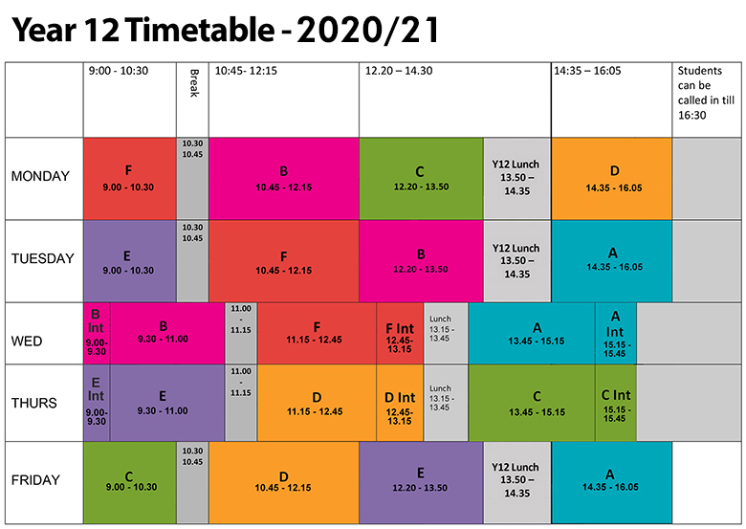
SIXTH FORM TIMETABLE
Notes:
Look at these 3 different timetables (college, sixth form, apprenticeship) and discuss the differences
Discuss which one students would like the most and why
More structured routine and plenty of break times.
More academic studying

Slide 9
YOUR NEXT STEPS
A Levels, BTECs or a college course?
Extra-curricular opportunities
RESEARCH!
Application
It’s up to you
Notes:
It’s important to research your options. Check out everything that local colleges offer such as a free bus service or bursaries.
A Levels, BTECs or a specific course? Think about your future career and what you need to get there.
Think about your application. You need to answer professionally and work out any areas you need to fill such as work experience or volunteering. Don’t forget to get someone to proofread!
Linking to this, you need to find these opportunities to make you stand out from the crowd. Look at programmes that you can complete!
Finally, there is no wrong answer! This is completely down to you. Do what’s best for your future and whatever you enjoy.

Slide 10
LEARNING STYLES
Visual
You learn best by reading or seeing pictures.
Best revision tips:
Try to visualise things when you hear them.
Write down, draw pictures, and colour code your revision notes.
Remember, you need to see things, not just hear things, to learn well.
Auditory
You learn best by hearing and listening.
Best revision tips:
Use flashcards and read them out loud.
Record yourself or ask a teacher to read notes and listen back.
Remember you need to hear things, not just see things, to learn well.
http://www.educationplanner.org/students/self-assessments/learning-styles-quiz.shtml
Tactile
You learn best by touching or doing.
Best revision tips:
Do lots of hands-on activities.
Use flashcards and arrange them into groups to demonstrate relationships.
Remember you learn best by doing and not just by reading, seeing or hearing.
Notes:
Explain to students they will each have preferred learning styles (auditory, tactile or visual). Ask students to complete this learning styles quiz (http://www.educationplanner.org/students/self-assessments/learning-styles-quiz.shtml) if they have access to a computer (or demonstrate it on your screen). How could this impact their post-16 pathways?

Slide 11
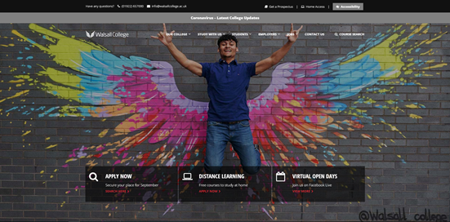
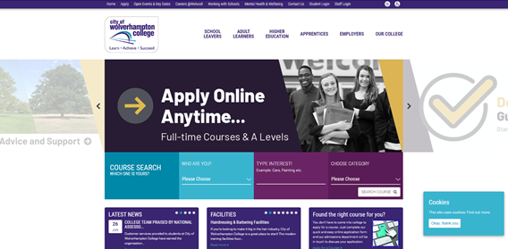
PROSPECTUSES
https://www.walsallcollege.ac.uk/order-walsall-college-prospectus/
https://www.wolvcoll.ac.uk/apply/
Notes:
2.2
Find some local colleges/sixth forms/apprenticeships to discuss with students.
Ideally, bring some printed copies of FE prospectuses for students to look through, or allow students to search on the internet.

Slide 12
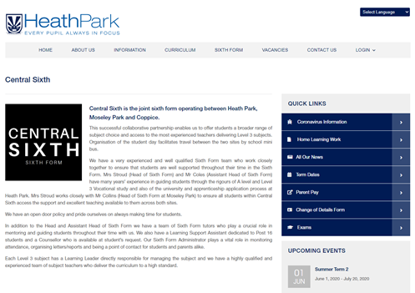

PROSPECTUSES
https://www.heathpark.net/sixth-form/central-sixth/
https://www.smestow.org/sixth-form/sixth-form-courses
Notes:
Find some local colleges/sixth forms/apprenticeships to discuss with students.
Ideally, bring some printed copies of FE prospectuses for students to look through, or allow students to search on the internet.

Slide 13
PERSONAL STATEMENTS
Read the following personal statements. Which one do you think is better?
Example 1
I have good communication skills and I really enjoy history at school because my teacher is good. I did work experience at a primary school in Year 10 which made me want to be a teacher.
Example 2
I am a determined and hard-working individual who enjoys working with others. During my 2-week, Year 10 work experience at my local primary school, I developed great communication skills by working with young children and professional adults. This work experience has developed my passion for working with children and has encouraged me to pursue a career in teaching.
Notes:
2.3

Slide 14
APPLICATIONS
Q: Hobbies and interests – Briefly discuss any hobbies, interests or extra-curricular activities that you may have. Think about how these may have benefited you?
Q: School and Personal Achievements – Think about any responsibilities you have in school or out of school such as caring responsibilities or something you are proud of.
Q: Future Aspirations – This could help the college/sixth form guide you towards certain subjects/courses. If you have specific destination in mind, make sure you mention this e.g. “I want to study psychology at a local University, possibly Birmingham” or “I would like to take up a Higher Apprenticeship in the finance sector”.
Notes:
Resource Booklet Pages 42-43: 2.3 Personal statements and applications
Discuss these questions with the group and ask them how they would answer. Pointers on the next page.
Good and bad examples in the Resource Booklet that can be used to demonstrate what students should strive for.

Slide 15
REMEMBER:
YOUR TURN!
Use the template to make notes about what you could write for each section.
Spelling and grammar are important! Triple-check your work by asking others to proof read.
The reader wants to know about you so be honest and genuine about your reasons!
Always use examples – remember to PEE.
Point
Explanation
Evidence
Don’t lie!
Think about the little things! Caring for a younger sibling shows responsibility. Being on time for school demonstrates punctuality!
Notes:
Resource Booklet Page 44: 2.3 FE applications

Slide 16
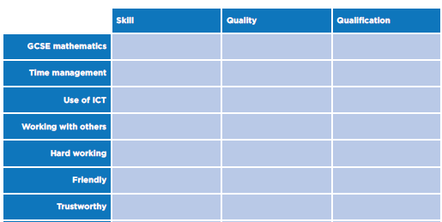
SKILLS, QUALITIES & QUALIFICATIONS
Do you know the difference?
Use the worksheet to identify the differences between skills, qualities and qualifications.
Is there anything you would like to learn or develop?
Notes:
Resource Booklet Pages 45-46: 2.3 Skills, qualities and qualifications
Use resource from Resource Booklet. Answers behind square. Print off worksheets. Discuss with students – is there anything on there they don’t understand? Would they like to develop or learn any of these? Will be good to remember for their FE applications.

Slide 17
FOR NEXT SESSION:
INDEPENDENT ACTIVITY:
Research further into local colleges and sixth forms.
Find a course you’re interested in!
You could also request a prospectus to see what else they offer.

Slide 18



@aspiretohe

