Slide 1
YEAR 11 SESSION 4:
PROFESSIONALISM

Slide 2
LAST SESSION
OBJECTIVE 1: Understand how you would prepare for an interview.
OBJECTIVE 2: Be aware of your interview strengths and weaknesses.
OBJECTIVE 3: Comprehend the differences between a job description and a person specification.

Slide 3
CHECK-IN
WHAT DID YOU FIND?
What job opportunities did you find?
Are there any interesting roles you’d like to pursue?

Slide 4
SESSION OBJECTIVES
OBJECTIVE 1: Understand how to make the most of your summer.
OBJECTIVE 2: Be aware of professional etiquette.
OBJECTIVE 3: Comprehend what a CV is and how to write one.

Slide 5
MAKING THE MOST OF YOUR SUMMER
When applying for your post-16 options or a job, it’s vital to remember that you will be competing with other candidates.
What makes you stand out? Why should they choose you?
It’s important to use your Y11 summer wisely!
Work experience:
This is a perfect time to get some more work experience in the area you’re interested in! You could even try virtual work experience online.
Volunteering:
You could work with organisations such as Girl Guiding UK, St John’s Ambulance or at a relevant workplace.
Activities:
Why not try completing short courses to add to your CV? Universities also offer summer schools for you to get involved with!
Notes:
4.1
Discuss the various options available to them. You could research local opportunities for their students. Emphasise that it’s important for them to stand out and this will follow them throughout their professional life. This summer is the perfect chance for them to gain new experiences!

Slide 6
SUMMER PLANS!
“I wanted to chill before I started further education so I spent my days binge watching Netflix series and taking long naps. Though, I did cut the grass for my elderly neighbours and finished a book”.
“My summer holiday before I started my apprenticeship was spent training and completing a half marathon for charity. I also spent a lot of time completing online courses on FutureLearn”.
What skills do you think this student learnt over her summer?
“The deadlines I had for the courses I completed taught me time-management and organisation, and my half marathon taught me to be committed and never give up”.
Notes:
Green student – read through speech bubble & ask students why is was beneficial for the student to take part in these extra activities and learning.
[Click once for Green student skills tab.]
Talk about the benefits of completing mini online courses and doing things for charity; mention that any extracurricular activities will help boost your CV and confidence!
Read through Yellow speech bubble.
[Click second time for Yellow student skills question.]
Ask students if the Yellow student learnt anything? Discuss how it is important to be proactive over the summer, even doing small jobs and being kind to others as well as accomplishing personal goals such as finishing a book.
Mention that it is important that students also take this time to enjoy themselves – they should be proud of what they’ve achieved so far and take the time to do things they enjoy (within reason - don’t binge watch series all day!).

Slide 7
SUMMER PLANS!
“I spent my summer volunteering at my local food bank. I’m not sure of exactly what career I want to pursue but I know I want a career where I am helping people. I am going to study English, Social Care and Business at Sixth Form”.
“During the summer I did work experience at my local Primary School teaching PE. This was really valuable as I am going to college to study Sport; I want to be a Sports Therapist”.
Skills I learned whilst teaching:
Communication
Time management
Leadership skills
Skills I learned whilst
volunteering:
Interpersonal skills
Organisation
Commitment
Notes:
Talk through speech bubbles.
Ask students what skills do they think the student learnt and why do they think doing work experience and volunteering is beneficial to their education and future?
[Click once for skills tab for Red student, click again for skills tab for Purple student.]
By doing work experience and volunteering you are developing many valuable skills and also testing out potential career paths to see what kind of jobs you like.

Slide 8
CHECKLIST
Below is a checklist for when you leave school including some of the things you can do to make your time off worth while. Try to rank these in what you think is the most important for you.
Attend a college or sixth form open event
Research your career options after college/sixth form
Research your course modules to get a head start
Familiarise yourself with your timetable
Look for volunteering opportunities
Start looking for a placement/work experience opportunities
Buy stationary, books, folders, uniform etc.
Book a private tour of your college or sixth form
Complete some useful online courses
Research travel routes (get a bus pass)
Any more you can think of?
Notes:
Discuss these questions with the group and ask them how they would answer. Pointers on the next page.
Good and bad examples in the Resource Booklet that can be used to demonstrate what students should strive for.

Slide 9
PROFESSIONAL ETIQUETTE
Remember: adults will be reading your applications or conducting your interview.
It’s important to maintain a professional manner when contacting them to demonstrate your maturity and dedication to this job or opportunity.
PHONE CALLS:
Should you be offered a phone interview, or if you follow up with a phone call, remember:
Try not to use colloquial language e.g. ‘mate’, ‘sound’ or ‘tar’
Don’t use filler words such as ‘erm’, ‘like’ or ‘basically’
No swearing
Be polite and thankful
Make sure you hang up!
Notes:
Go over how you would conduct yourself on the telephone

Slide 10
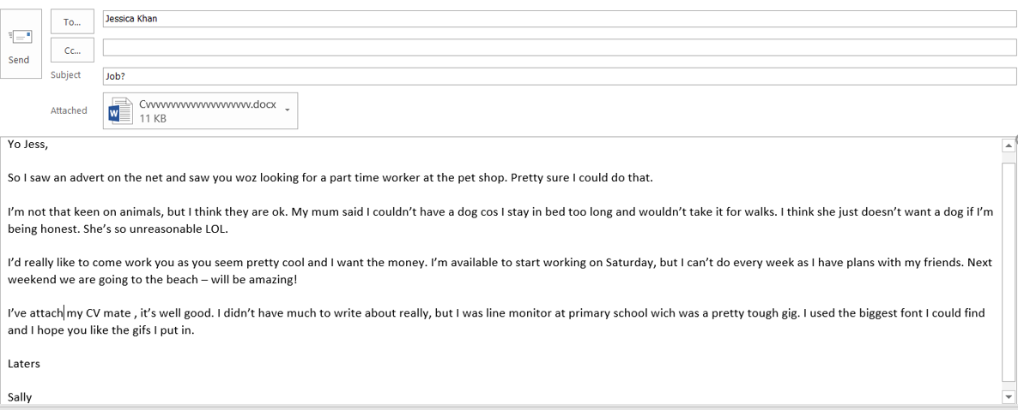
PROFESSIONAL ETIQUETTE
What is wrong with this email?
Notes:
Students to identify what is wrong with this email.

Slide 11
PROFESSIONAL ETIQUETTE
Emails are just as important!
Here are some key things to remember when writing an email:
EMAILS:
It’s important to think about who you’re emailing:
Always use their name if you know it, otherwise address them as ‘Sir/Madam’
Use spell check before sending an important email
Sign your email with ‘Kind regards’, ‘Best wishes’ or ‘Many thanks’
Use spaces to emphasise different points, just like an essay. Hit the enter key!
Choose a relevant subject so that you can find it easily.
Notes:
Resource Booklet Page 51: 4.2 Example email
Use example email in Resource Booklet and discuss with students.

Slide 12
PROFESSIONAL ETIQUETTE
In the last session you had a go at practising some interview questions.
Choose a question and working in pairs, write an answer to one of the questions below.
Make sure you use professional language and try and answer the question fully.
INTERVIEW QUESTIONS
What activities do you do outside of school?
Can you explain a time when you have worked as part of a team?
What would you class as your best skill and why?
Notes:
4.2
This could be delivered as a role-play activity.
You could include Teams/Zoom interviews here.

Slide 13
CVs & COVER LETTERS
Not all job applications require a cover letter, but it’s important to know how to write one should you need it!
These may be used for job applications or opportunities such as working abroad or work experience.
Discuss the role or opportunity you’re applying for.
Why are you applying for this role?
What relevant experience do you have for this?
Why should they choose you?
Notes:
Resource Booklet Pages 52-54: 4.3 Example cover letter and example CV
4.3
Use cover letter example in Resource Booklet to discuss with students.

Slide 14
CVs & COVER LETTERS
Your CV is the first thing the professional will see about you. It’s vital that you have some personal touches and portray yourself well.
Profile:
A short section on you. Highlight your best qualities and try to sell yourself! The professional wants to know about you.
Education:
List your achieved or predicted grades here, prioritising the most relevant subjects first.
Work experience:
Try to use this section to relate to the job/opportunity you’re applying to. Skills are valuable no matter how you got them!
Achievements/Interests:
This section gives you the opportunity to discuss your successes. It’s your time to shine!
References:
You should have 2 references: a character reference and a factual reference. One for you as a person, and someone to list facts/figures, e.g. attendance.
Notes:
Resource Booklet Pages 55-56: 4.3 CV Template
Use the CV example in Resource Booklet to break down each section, discussing why students need to discuss those sections and what the employer/professional will be looking for.
Use the CV template to get students to start their CV – actually begin filling it in if you have time!

Slide 15
WORK EXPERIENCE
What can you do about work experience in the current climate?
Virtual Work Experience
Many companies are currently offering a work experience programme that can be completed virtually. You’ll have to research into your preferred area to see what they offer but it is still a great opportunity!
Free Alternatives
While this won’t have the same advantages as in-person work experience, gaining knowledge is always a benefit! You should attempt to speak to students who are living the experience first-hand or get in touch with professionals via websites.
Paid Alternatives
InvestIN: They offer a wide variety of programmes in different subjects that include a virtual experience. The cost is currently £95 per day or £165 for the two-day programme. You may be able to get your school to fund some of this!
Notes:
Tips for work experience
Virtual Work Experience: https://www.prospects.ac.uk/jobs-and-work-experience/work-experience-and-internships/virtual-work-experience
Free Alternatives: UniBuddy is a great platform that many universities use. You can also do research via companies’ websites. https://www.themedicportal.com/blog/covid-19-the-best-work-experience-alternatives/
Paid Alternatives: investin.org

Slide 16
FOR NEXT SESSION:
INDEPENDENT ACTIVITY:
Complete first draft of your CV using the template provided.

Slide 17
@aspiretohe

