Slide 1


YEAR 11 SESSION 6:
BUDGETING
Notes:
6.1 – Budgeting activity
6.2 – Endpoint Survey
6.3 – Ring of Aspire

Slide 2

LAST SESSION
OBJECTIVE 1: Understand what you need to prepare for FE.
OBJECTIVE 2: Be aware of the common HE barriers and misconceptions.
OBJECTIVE 3: Comprehend the benefits of HE.

Slide 3
CHECK-IN
STUDENTS’ UNION
Which students’ unions did you research into?
What did you find?
Is there anything you would want to get involved with?

Slide 4
SESSION OBJECTIVES
OBJECTIVE 1: Understand how to budget for university.
OBJECTIVE 2: Review your knowledge of FE and HE.

Slide 5
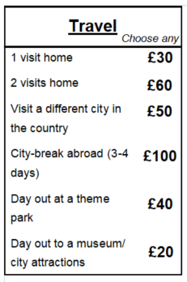
BUDGETING
It’s important to manage your money properly to ensure that you have enough to live on.
Use this activity to understand what your priorities are and where you can save money!
University
Higher Apprenticeship
Degree Apprenticeship
If you choose to go to university, the maximum maintenance loan awarded is £9,978. Use this figure for the budgeting activity.
If you choose to study a higher apprenticeship, you do not need to select a part-time job. The average salary is £17,500.
If you choose to a degree apprenticeship, the average salary is £22,500. You do not need to select a part-time job from the list.
Choose between going to university, a higher apprenticeship or a degree apprenticeship.
Select the amount of money you would receive from this and write it at the top of your ‘Expense’ sheet.
Work through the options selecting where you will be spending your money.
Figures correct as of October 2020*
Notes:
Resource Booklet Pages 60-62: 6.1 Budgeting and expenses game. Scholarships and bursaries handout
6.1
For this activity, you will need the ‘Monthly Expenses Blank Sheet’ and the ‘Expense Game’ document. Students have free reign on this. You should encourage discussing the positives and negatives of each pathway. Students should choose the path they think they are most likely to pursue. Spend time discussing extra options, what their priorities are and any recommendations you have.
- Make sure students are aware that these amounts could change depending on where they live e.g. living with parents or living in London
- What could students do if they went over budget? Get a job? Where could they save?

Slide 6
BUDGETING
Can you think of any ways you could save money?
Notes:
Ask students if they know ways in which they would save money?
Discuss…

Slide 7





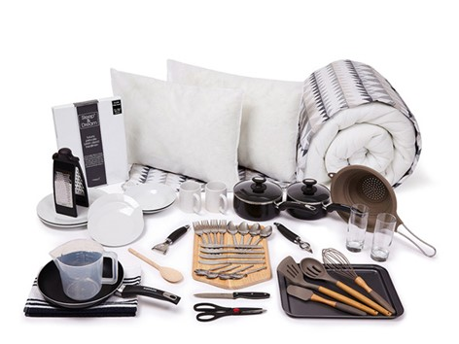

BUDGETING GUIDANCE
Notes:
There are lots of way to help you manage your money and budget effectively!
Ask students if they know what any of these brands/companies are and what services they offer - discuss…
Why not create a cash flow using excel – put in all of your expenses to see how much you can save and what you will have left over at the end of each month.
You could also look into student banking options – certain banks offer student accounts which are designed to support you with your finances.
Unidays & Student Beans are student discount apps so you can get money off clothes, tech, food etc; there are many brands to choose from and they offer great ways to spend less.
NUS extra is a student discount card you can purchase in order to save money in the long run; they too offer discount of a wide range of popular brands.
Some companies also offer deals for students such as Ikea who offer Student Starter Packs - have a look into what other companies offer student deals.
Emma is an app that helps you budget and manage your money; why not look into apps like Emma to discover ways to help you budget - go to next slide for more info.
There are many forms of support available when you stand and throughout university to make your student experience better. Do your research and see what support is out there for you.

Slide 8
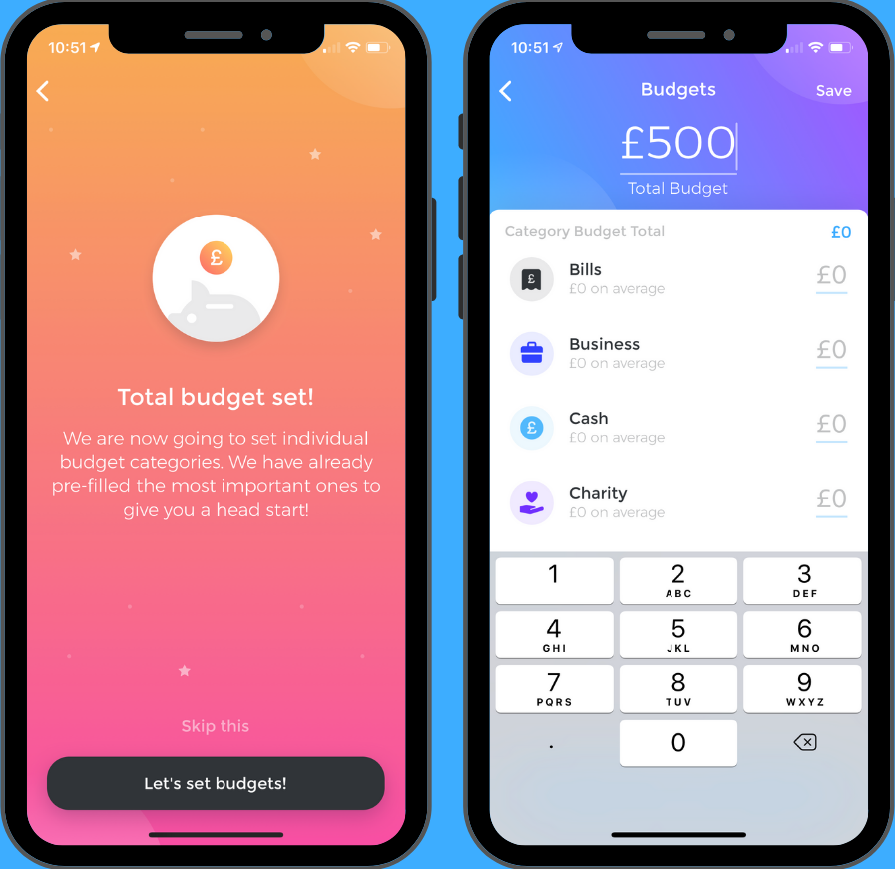

BUDGETING APPS: EMMA
Track your spending and subscriptions, look at breakdowns of your spending habits and set savings goals, all in order to help you budget effectively
Do some research and see if you can find other useful ways to help you manage your money safely and effectively!
Notes:
Talk though this budgeting app in a bit more detail
https://emma-app.com/

Slide 9


DISCOUNT OPTIONS: NUS TOTUM
Gets you offers on a wide range of brands including clothes, tech, food and home essentials etc.
Another way to help you save money, budget effectively and ultimately make your student loan go further
You also have the option to get a Totum card & an ID card too!
Notes:
Talk through NUS Totum as an option to help you save money

Slide 10
QUESTION!
Do you think you would use any of these money saving techniques?
Which ones do you think are most useful?
Notes:
Ask students…Discuss

Slide 11
RING OF ASPIRE
Inspired by a classic University icebreaker… here’s the rules of the game!
A – ASPIRE = Going clockwise, say a skill that you would put on your CV, first person to repeat or make a mistake must put a sweet in the bowl.
2 – YOU = You try and describe the definition of FE and HE.
3 – ME = Name one thing you’ll always remember from our Aspire to HE sessions.
4 – FORTUNE = Everyone takes a sweet from the bowl.
5 – THUMBMASTER = Last person to put their thumb down on the table must put a sweet back in the bowl.
6 – UP STICKS = Name a benefit of moving away for University.
7 – HEAVEN = Last person to put their hand in the air must say a benefit of HE.
8 – MATE = Choose someone to go 1 on 1 with for a HE word association game!
9 – RHYME = Choose a word, going clockwise everyone must say a word that rhymes with it – first person to repeat or make a mistake must put a sweet back in the bowl.
10 – CATEGORIES = Choose a category (jobs/subjects), going clockwise everyone must say something that fits in that category – first person to repeat or make a mistake must put a sweet back in the bowl.
J – JACKPOT = Tell the group what your post-16 steps are!
Q – QUESTION = Name a common interview question, the rest of the group must answer!
K - KO = Everyone puts a sweet back in the bowl, name a barrier to HE.
Notes:
6.3
Get a pack of cards and shuffle! Pick one card at a time, potentially asking students to pick a card, and do whatever action links to that card.

Slide 12



@aspiretohe

