Slide 1
YEAR 12 SESSION 1:
WHAT IS HE?
Notes:
Intro: Quiz. Sessions 1.1 – 1.3 key terms. (Mark using self or peer assessment. Close any knowledge gaps)
Check-in from independent activity:

Slide 2
SESSION OBJECTIVES
OBJECTIVE 1: To understand the strengths and limitations of university and apprenticeships.
OBJECTIVE 2: To think about what would inform your choices when applying to university or an apprenticeship.
OBJECTIVE 3: To compare and contrast different layouts and locations of university campuses.

Slide 3
CURRENT PLANS?
What are everyone’s current plans?
University?
Apprenticeship?
Unsure?
Notes:
1.1
Try to find out if each learner has any ideas of if they would like to pursue HE, and if so:
University or apprenticeships?
What course/apprenticeship?
What uni/company?

Slide 4
BENEFITS AND POSSIBLE LIMITATIONS
In groups, write down the strengths or limitations of either apprenticeships or university.
In groups, write down the strengths or limitations of either apprenticeships or university.
In groups, write down the strengths or limitations of either apprenticeships or university.
Notes:
Resource Booklet Page 4: 1.1 University of Apprenticeship
University Pros and Cons:
Pros:
You Can Access More Specialist Jobs
Increase Your Earning Potential
Make new friends
Participate in new activities (societies)
Explore a new city
Gain independence
Develop Transferable Skills
Makes you more employable
Cons:
It’s expensive (loans and day-to-day living)
A degree doesn’t guarantee a job
Time consuming
Lack of practical experience (depending on course)
Homesickness
Apprenticeship Pros and Cons:
Pros:
Earn while you learn
Gain real-life experience
Acquire new skills
Discover your interests
No debt to pay back
Gain qualifications
Cons
Might change your mind (i.e. it limits your options)
You may get paid less than others
It may be a shock to the system after school – full working hours
Very competitive
Holidays are short

Slide 5
BENEFITS OF HE – PROFESSIONAL DEVELOPMENT
Earn while you learn!
Completing a higher apprenticeship will increase your lifetime earning potential by up to £150,000!
Opportunities to network and meet people with similar interests
Gain a qualification!
Work experience/Internships/Part-time jobs/Volunteering
More career options available after graduation
On average, graduates earn £268,000 more than the average non-graduate over the course of their lifetime.
Notes:
Potential professional benefits of uni and apprenticeships:
Opportunities available to network
Work placements/Internships/Part-time jobs/Volunteering
Qualifications
More career options available after graduation - Predicted that 54% of jobs will be held by those with high level qualifications by 2024 (UKCES 2016) - “qualifications inflation”
Increased earning potential - On average, graduates earn £10,000 per year more than the average non-graduate (Department of Education 2019).
Earn while you learn
Try to emphasise the benefits, but can also discuss limitations
Have to pay back student loans – i.e. have student debt
You’re not guaranteed a graduate job afterwards
Might miss home
Contact hours vary, so you may not get as much time with lecturers as you want

Slide 6
BENEFITS OF HE – PERSONAL DEVELOPMENT
Experiencing a new city
Handling your own money – budgeting
Making new friends
Live independently!
Confidence
Develop transferable skills!
Notes:
Potential Personal Development benefits of uni and apprenticeships:
Confidence
Develop transferable skills
Living independently
Handling your own money – budgeting
Making new friends
Experiencing a new city
New activities/Societies

Slide 7
LET’S REVIEW

Slide 8
IT’S UP
TO YOU
Notes:
Make it clear that these are the pros and cons of each, this is what you get from both experiences, but the decision is completely up to them.

Slide 9
WHAT WILL INFORM YOUR UNIVERSITY CHOICES?
Close to home
Most important
Russell group
Staff
Sports teams
Social factors
Rankings
City vs. Campus
Least important
Move city
Finances
Notes:
Resource Booklet Page 5: 1.2 What will inform your university or apprenticeship choice?
1.2
Get the students to think about the things that are going to influence their decision regarding university/apprenticeship choices first… ranking them from most important to least important.
Once they have done this, go through the ones written on the slides, and see if they have similar ideas of influencing factors, or if they hadn’t thought about these things, see if they can fit them in on their thermometer.
This is totally subjective - there is no “right” answer, just food for thought.

Slide 10
WHAT WILL INFORM YOUR APPRENTICESHIP CHOICES?
Most important
The type of qualification you’ll be working towards
Close to home
Its duration
The wage
The company’s reputation
Move city
Least important
Progression within the company
Notes:
Get the students to think about the things that are going to influence their decision regarding university/apprenticeship choices first… ranking them from most important to least important.
Once they have done this, go through the ones written on the slides, and see if they have similar ideas of influencing factors, or if they hadn’t thought about these things, see if they can fit them in on their thermometer.
This is totally subjective - there is no “right” answer, just food for thought.

Slide 11
HOW DO YOU MAKE AN INFORMED DECISION?
A
A decision needs to be made
S
Speak to other people
P
Pros and cons
I
Identify the best decision for you
R
Record the actions you are going to take
E
Evaluate the decision-making process
Notes:
We’ve come up with a helpful acronym for the process of informed decision making.
Encourage them to guess them in order, then they will come up on screen at every click.
A decision needs to be made – make sure you identify what choice you’re making narrow down what your options are and as do some research relating to those options.
Speak to other people – You can speak to people you know or you can use Uni Buddy to speak to current students or staff at a university.
Pros and cons – write a list of pros and cons for each option, making sure to decide how this will help.
Identify the best option for you – remember that this is your decision to make. Your priorities and feelings will be different to somebody else and remember that this is your decision to make.
Record the actions you are going to take – such as writing your personal statement or starting your UCAS application.
Evaluate the decision-making process – go through each step and decide if you think the decision you’ve made is the correct choice.

Slide 12
CITY VS CAMPUS UNIVERSITIES?
Notes:
1.3
An important consideration to make when choosing a university is where the university campus is based
If you enjoy the city lifestyle and the buzz which comes with it, a city university where the university schools and facilities are spread out across the metropolis may be the best fit for you

Slide 13
CITY VS CAMPUS UNIVERSITIES?
Notes:
Whereas if you like everything you need to be within easy reach and/or prefer somewhere a little quieter, then a campus university may be better, as everything is purpose-built for university students
You will need to be aware that some courses will pretty much choose your location for you – e.g. if you are keen on studying marine biology, you will need to be somewhere by the sea!

Slide 14
CITY VS CAMPUS UNIVERSITIES?
https://www.youtube.com/watch?v=62wBMSUnuaY
https://www.liverpool.ac.uk/virtual-open-day/?/
Notes:
Watch these campus tours and think about the differences between a campus university and a city university!
This will be useful going into the next task!

Slide 15
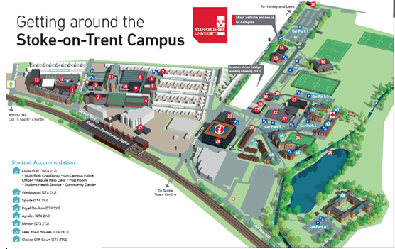
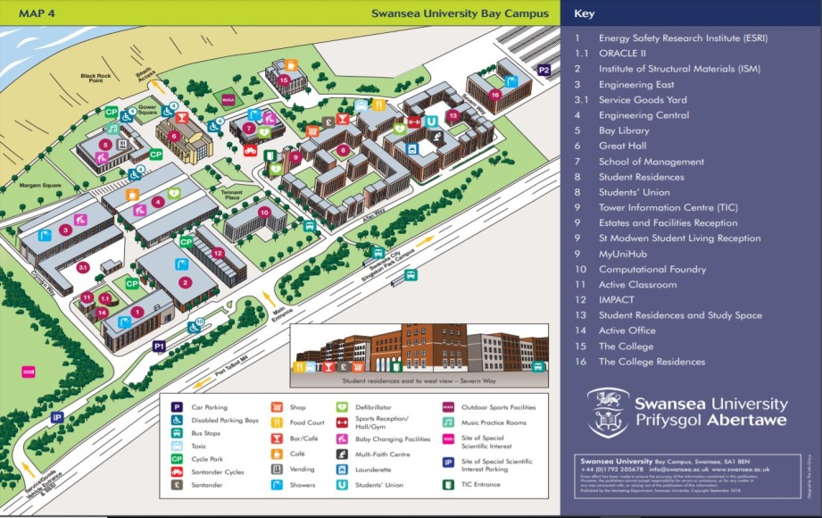
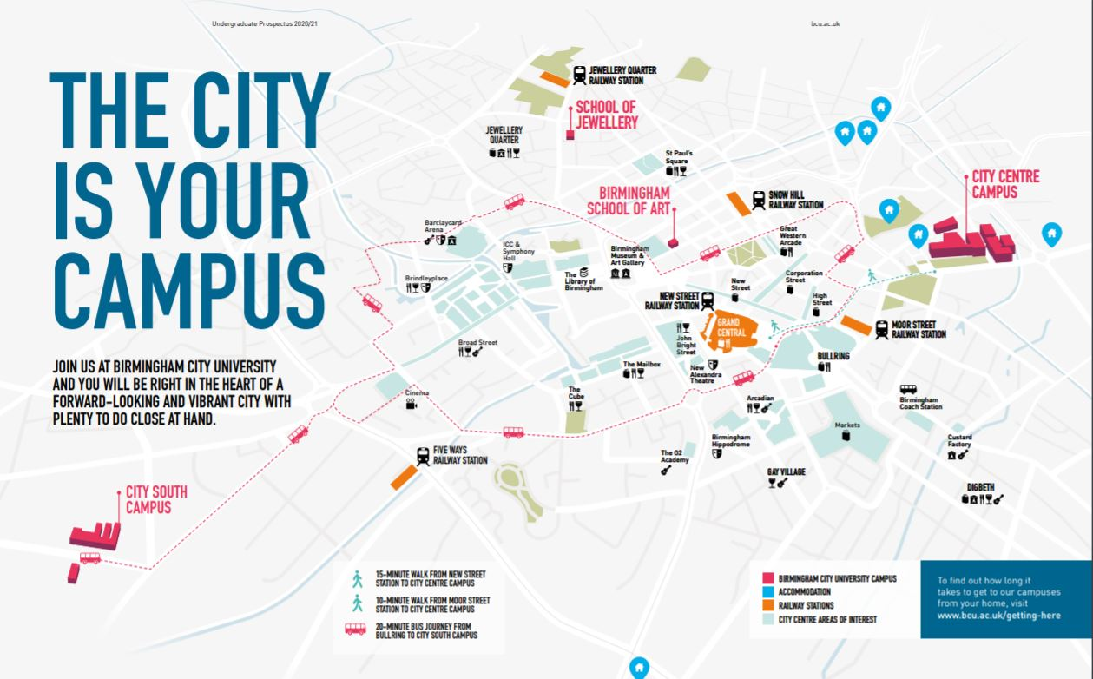
CAMPUS MAP ACTIVITY
Notes:
Resource Booklet Pages 6-8: 3.1 City vs campus
What university campus do you think each of these are? What do you like about each of them? What do you prefer? Relate campuses to courses – you can only do marine biology by the beach, i.e. Plymouth/Portsmouth.
Map 1 – Staffordshire University
Map 2 – Swansea
Map 3 – BCU (Birmingham City)

Slide 16
CAMPUS MAP ACTIVITY
Look at the university campus maps and consider the similarities and differences between them.
Which do you prefer?
What isn’t there that should be?
What do you like the look of?
Notes:
What are we trying to achieve? what do you prefer? what are the differences? what do you like the look of?

Slide 17
COURSE CARD ACTIVITY
Get into pairs or threes.
Select two course cards that sound interesting!
Ask each other questions about your chosen courses and compare notes.
Think about entry requirements, assessment methods, employability, fees, modules, career progression etc.
What are the differences between the courses? Grade differences?
What information do you find useful? Is there enough information to make a decision?
Notes:
In pairs, ask the learners to pick two subject cards that are of interest and then give prompting questions about entry requirements, assessment methods, employability, course costs, modules, career progression – compare the two, think about why they’re different – important to start thinking about these key ideas, in preparation for next session.
What do you notice about them – grade difference? What information do you find useful? Is this enough to make a decision? If not, where should you look to find more information? What else would you like to hear about?

Slide 18
INDEPENDENT ACTIVITY
Find two courses (either university or apprenticeship - or one of each) based on your informed choices!
Write down where they are, what the courses are and what made you choose those two!
Notes:
Independent activity: Make sure this doesn’t come across as ‘homework’, but as an activity that could benefit them in thinking about HE and their future.

Slide 19
@aspiretohe

