Slide 1


YEAR 12 SESSION 2:
WHAT DOES HE STUDY ENTAIL?
Notes:
Intro: Quiz. Sessions 1.1 – 1.3 key terms. (Mark using self or peer assessment. Close any knowledge gaps)
Check-in from independent activity: Did students find courses of interest to them online or on the UCAS website? How many did they find? What were these courses?

Slide 2

PREVIOUS SESSION’S OBJECTIVES
OBJECTIVE 1: To understand the strengths and limitations of university and apprenticeships.
OBJECTIVE 2: To think about what would inform your choices when applying to university or an apprenticeship.
OBJECTIVE 3: To compare and contrast different layouts and locations of university campuses.

Slide 3
CHECK-IN
Find two courses (either university or apprenticeship - or one of each) based on your informed choices! – What did you find?
Write down where they are, what the courses are and what made you choose those two! – What did you find?

Slide 4
SESSION OBJECTIVES
OBJECTIVE 1: To understand university entry requirements and why courses and universities have different requirements.
OBJECTIVE 2: To understand the different types of learning and assessment at university.
OBJECTIVE 3: To think about your own preferred way of learning and assessment.

Slide 5
ENTRY REQUIREMENTS
WHAT ARE UNIVERSITY ENTRY REQUIREMENTS?
Universities will often ask you to achieve certain grades or marks in your sixth form or college qualifications (such as A Levels or BTECS).
You may have to study certain subjects, e.g. A Level Maths for certain Engineering courses.
Some courses and universities may have additional requirements, such as interviews, competency assessments or Art portfolios.
Notes:
2.1
Additional areas you could expand upon:
Universities make offers based upon predicted grades, which is why it’s important for students to apply themselves in sixth form
Some courses and universities may ask for students to achieve certain GCSE grades too, such as a certain grade at GCSE maths to do Accountancy
Some universities use just grades, some use UCAS Tariffs

Slide 6
ENTRY REQUIREMENTS
WHY DO DIFFERENT COURSES HAVE DIFFERENT ENTRY REQUIREMENTS?
Universities set entry requirements for each course to ensure you have the right skills and knowledge to be successful on the course.
Different types of courses will require you to have different types of skills & knowledge
‘Higher Tariff’ universities, such as the University of Oxford, will have higher entry requirements
Notes:
Ask students why universities actually have entry requirements – often this can be a process to make sure that students don’t struggle on a course.
Ask students to consider what this might suggest about the university / courses at first glance.

Slide 7




DIFFERING ENTRY REQUIREMENTS
Business Management – 3,108 different options for this subject on UCAS website. Entry and qualification requirements can really vary:
Birmingham City University – BBC at A Level or 112 UCAS tariff points
Harper Adams University – 88-104 UCAS tariff points or DDD at BTEC
University of Birmingham – AAB at A Level
University of Wolverhampton – 96 UCAS tariff points
UCAS Tariff points translate your qualifications and grades into a numerical value.
Notes:
Explain to students not only the difference in the range of grades, but also that some universities may only accept certain qualifications, which is why it’s so important for students to do research.

Slide 8
ENTRY REQUIREMENTS
TRUE OR FALSE: ENTRY REQUIREMENTS ARE THE MOST IMPORTANT THING TO CONSIDER WHEN CHOOSING A COURSE OR UNIVERSITY?
FALSE: whilst entry requirements are very important, it’s crucial to consider everything else the university and course offers, such as:
Location, campus facilities, social opportunities, extracurricular activities, career prospects, learning support, teaching/learning methods and assessment methods.

Slide 9

ACCESSIBILITY & LEARNING SUPPORT
Can you think of any types of learning support at your school?
Do you find these useful?

Slide 10

ACCESSIBILITY & LEARNING SUPPORT AT UNIVERSITY
Peer mentoring – a current university student to help you with your course
Academic tutors – university staff member to support you with your course
Library support team – staff and online support to help you with study skills
Notes:
Encourage students to realise and act on the value of peer mentoring and peer-to-peer support. Do they have a study buddy? Is someone at their school well-matched to be that person?
More info about learning support at University of Manchester: https://www.manchester.ac.uk/study/undergraduate/teaching-learning/learning-support/

Slide 11
GENERAL SUPPORT AT UNIVERSITY
Universities also have a lot of general support to help students in a range of ways:
Finance
Housing
Disability
Counselling
Well-being
Emotional

Slide 12
THE UNBELIEVABLE TRUTH
Listen to the following ‘lecture’ and make note of the 5 things you think are true!
Notes:
Resource Booklet Page 12: 2.2 The five truths
2.2
The aim of this is to read out the text and ask the students to listen and make notes. Hidden in a bunch of lies are 5 truths (in bold). For every truth correctly identified the students get a point, for every lie they thought was truth the EO gets a point – see who wins!
The Student Loans Company is a non-profit organisation. It was founded by Lord Ahmar Ehsan in 1066 following the Battle of Hastings. When returning from battle himself with his son, he exclaimed that ‘no man, woman, son or daughter shall go without education’ after having seen first-hand the confusion warriors had in distinguishing which hand to hold their sword in. Having studied a course that is unfortunately no longer an option today, gaining a BA in Close Combat Battle, it was his dream that all people in England would be educated to the highest standard in the whole world.
Nearly 1,000 years on, Lord Ahmar Ehsan’s dream still stands - the Student Loans Company ensure that every student will receive financial help to cover university costs. In 2016 a new rule was introduced stating that student loan money cannot be spent on chocolate, crisps or lottery tickets. This was abolished following student protests across the country just 2 months after the rule was signed in. How much you get depends on your circumstances and how and when you start paying this back is entirely up to you. Although you are required to pay this back, only about 15% of people repay their loan in full because after 50 years, your debt gets wiped off.
In addition to this, scholarships and bursaries are also available. These have to be paid back as soon as possible, with the government taking the last hour of your paid work each day to cover this cost. With bursaries, if they are not paid back within 12 months of graduating, your TV licence gets revoked and bailiffs will seize any property of yours to make up for this debt. If scholarships aren’t paid back in full within 2 years of graduating, your degree becomes revoked until at least 50% is paid back, in which you will get half of your degree back. This means that if you have a BA, it will just be an A until 100% is repaid.

Slide 13
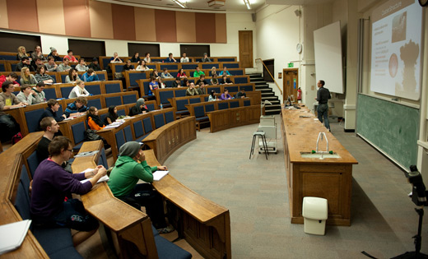
YOU JUST LISTENED TO A LECTURE!
1 lecturer and between 30 and 300 students, depending on course size.
Often PowerPoint-based presentation with explanations. It is often useful to be making notes on what is said.
1-2 hours.
Sometimes a recording of these are put online for students.
Lectures are like supersized classrooms. You can still raise your hand to ask a question about anything you don’t understand!
What are some pros and cons of a lecture?
Notes:
Get the students to discuss pros and cons of a lecture – try to initiate a debate between students by prompting responses and asking them to explain why they have this opinion. Reinforce that everyone’s learning preference is different and there is no right or wrong answers.
Possible pros:
Efficient way to get information
‘easy’ to sit back, listen and make notes rather than engage in a workshop
Possible cons:
Too long to be engaging throughout
Difficult to ask questions
Not personalised

Slide 14
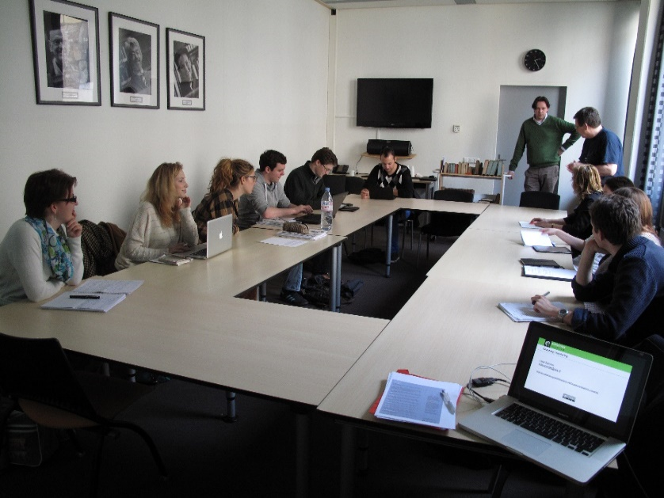
YOU’RE CURRENTLY IN A SEMINAR!
A seminar group consists of typically 15–30 students plus one tutor, which has an emphasis on group discussion.
You will often be required to do preparatory work for seminars, such as reading.
Students may be asked to prepare presentations to show to the rest of the group or even run the seminars themselves (more likely in second or third year).
Tutors can be visiting experts or postgraduate researchers in a particular discipline as well as regular lecturers
What are some pros and cons of a seminar?
Notes:
Get the students to discuss pros and cons of a seminar – try to initiate a debate between students by prompting responses and asking them to explain why they have this opinion. Reinforce that everyone’s learning preference is different and there is no right or wrong answers.
Possible pros:
Personalised and able to ask for help
Able to ask specific questions on topics you don’t understand
Have a professional in the subject you are studying around
Build relationships with peers and professors
Group debates
Smaller in size so easier to engage in
Possible cons:
Preparatory reading

Slide 15

TUTORIALS
Subject-based, working in small groups with your tutor. Group size can vary from a few students to as many as fifteen.
Tutorials often focus on a particular topic or assignment. It is a good way to take part in discussions and to get to know staff.
Personal tutorials are one-to-one sessions which provide individual attention on more general academic or pastoral issues.
What are some pros and cons of a tutorial?
Notes:
Get the students to discuss pros and cons of a tutorial – try to initiate a debate between students by prompting responses and asking them to explain why they have this opinion. Reinforce that everyone’s learning preference is different and there is no right or wrong answers.
Possible pros:
Small in size so can get personalised help
Build a relationship with the professor
Work in a small group and share ideas
Get help on a particular assignment
Possible cons:
Pressure to engage and contribute?

Slide 16

TEDx TALK – WHAT MAKES “GENERATION Z” SO DIFFERENT?
https://www.youtube.com/watch?v=qyCn3APagyU
Notes:
Show the video up to about 2mins 30seconds.
Link to video: https://www.youtube.com/watch?v=qyCn3APagyU
This is an example of learning from online resources. Many universities now are able to provide learning to students through online lectures/webinars.

Slide 17

YOU JUST TOOK PART IN A WEBINAR!
A webinar is a live, virtual class taken online from the comfort of your own room!
These can be similar to seminars in which some work (mostly reading) may be required to do in preparation.
This is an online classroom, so activities may be similar to what would happen in a normal class. The teacher may just teach, or they could engage the students with questions and quizzes.
These have become more widely used as of recent.
What are some pros and cons of a webinar?
Notes:
Get the students to discuss pros and cons of a webinar – try to initiate a debate between students by prompting responses and asking them to explain why they have this opinion. Reinforce that everyone’s learning preference is different and there is no right or wrong answers.
Possible pros:
Can do this in your PJs!
Can do this remotely, even if you went home you can still attend
Ability to record them?
Possible cons:
Dependent on internet connection
May be hard to maintain focus and avoid other distractions

Slide 18
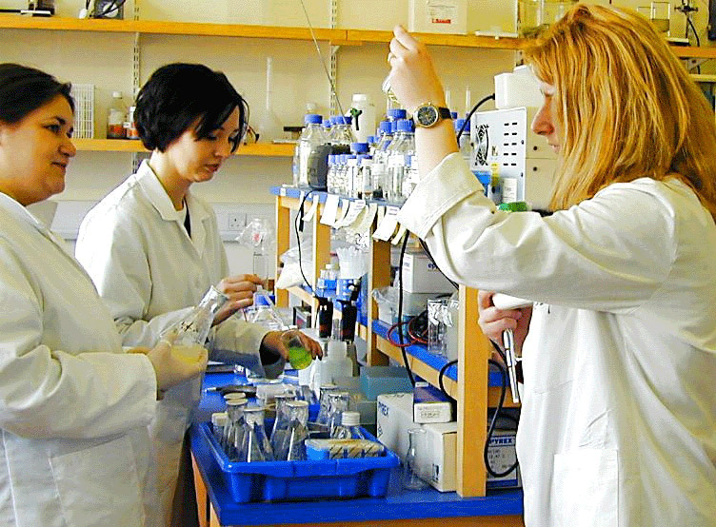
LAB WORK
Lab work is usually for science-based subjects that require practical experiments
Here you will have a professor and often PhD students on-hand to help you carry out experiments safely and successfully
For some science subjects, lab work usually happens once a week and will require write-ups and analysis about the experiments and results
These can provide you with a practical and fun break from academic learning!
What are some pros and cons of lab work?
Notes:
Get the students to discuss pros and cons of lab work – try to initiate a debate between students by prompting responses and asking them to explain why they have this opinion. Reinforce that everyone’s learning preference is different and there is no right or wrong answers.
Possible pros:
Fun and engaging
Get to do real experiments
Get help from professors and PhD students
Use the resources uni has to offer
Possible cons:
-

Slide 19
ASSESSMENT METHODS
Discuss: what’s the best assessment method:
Exams or coursework?
Notes:
2.3
Focus the discussion to draw out individual students’ learning preferences!
Ask students to discuss and debate, in the way they would do if they were in a seminar. One group could argue why exams are most effective and a second group could argue why coursework is most effective.
Prompting questions:
- Which method allows you to prove your knowledge in the best/fairest way?
- Which do you prefer?
- What are positives about both?

Slide 20
ASSESSMENT METHODS
Discuss: what’s the best assessment method:
Group presentation or individual spoken exam?
Notes:
Make sure that these discussions are focused on drawing out individual students’ learning preferences!
Similar format as previous question but build on the point that university can incorporate group-based work and assessment as well as individual.

Slide 21
POSSIBLE UNIVERSITY ASSESSMENT METHODS
Most common at university: | Also possible: (often depending on course)
Written Exams | Spoken/oral Exams
Essays | Computerised Tests
Group Work | Simulated Scenarios (Healthcare)
Project Work | Mooting
Practical Assessment (e.g. labs, field) | Entrepreneurial Projects
Presentation | Posters
Reports | Role Play (e.g. Courtroom – Law)
Portfolios | Performance
Notes:
Slide primarily used to present students with possible assessment methods. Ask questions to check for understanding – students likely to ask about any assessment types they are not sure of, but do make sure that everyone is clear on these assessment types before moving on. Ask students what their preferred assessment method might be.
Useful source - https://www.plymouth.ac.uk/uploads/production/document/path/2/2535/Student_Guide_to_Assessment.pdf
Explain to students the importance of researching how the course(s) they are interested in are assessed.

Slide 22
INDEPENDENT ACTIVITY
FIND OUT HOW THE COURSES YOU’VE BEEN RESEARCHING ARE TAUGHT & ASSESSED
Notes:
Independent activity: for the course(s) students have been researching, can they find out how these courses are taught and assessed?

Slide 23



@aspiretohe

