Slide 1
YEAR 12 - SESSION 6: HOW DO I APPLY?
ASPIRE TO HE | SESSION SIX
Notes:
Introduce the session to the students - potentially add in a ‘Starter’ slide to quiz students about key terms from the previous three sessions (optional).

Slide 2
PREVIOUS SESSION’S OBJECTIVES
OBJECTIVE 1: To understand the financial support available through Student Finance and the government.
OBJECTIVE 2: To understand the financial support available through scholarships and grants.
OBJECTIVE 3: To understand the main costs associated with higher education and university.

Slide 3
CHECK IN
See if the universities you’re interested in offer scholarships or bursaries – What did you find?

Slide 4
SESSION OBJECTIVES
OBJECTIVE 1: To understand what UCAS is and key information about applying for university.
OBJECTIVE 2: To understand university rankings and how to make use of Open Days.
OBJECTIVE 3: To understand what a personal statement is and how important it is to your application.

Slide 5
WHAT IS UCAS?
QUIZ
Notes:
6.1
Ensure that each question is discussed before showing the answer – get ideas and discuss what they’re surprised about or didn’t know before and try to expand if possible.

Slide 6
WHAT IS UCAS?
UCAS stands for ‘Universities and Colleges Admissions Service’.
It’s the centralised service that students use to apply to university.
UCAS does:
process applications
provide information, advice, and training
have a Fraud and Verification Team
take part in education sector engagement
UCAS doesn’t:
suggest courses or universities
make decisions or offers
advise on finance, immigration, or visas for individuals
Notes:
Ask the students what they think UCAS is, what do they do, how do you use it – get the students thinking about what they will be using it for.

Slide 7
HOW MANY UNIVERSITIES CAN STUDENTS APPLY TO?
1
3
5
7
Answer = 5
Students will have the opportunity to apply for up to 5 choices.

Slide 8
HOW MUCH WILL IT COST TO APPLY FOR COURSES VIA UCAS FOR 2021 ENTRY?
£18 for a single choice, £23 for more than one choice.
£20 for a single choice, £30 for more than one choice.
£23 for a single choice, £25 for more than one choice.
£20 for a single choice, or £26 for more than one choice.

Slide 9
WHAT IS SIGNIFICANT ABOUT THE DATE – 15TH OCTOBER?
Answer: It’s the deadline for UCAS applications to most medicine, dentistry, veterinary medicine/science courses, as well as all courses at the universities of Oxford and Cambridge.
It’s the deadline to apply for medicine, dentistry and Oxford and Cambridge.
It’s when you should start your UCAS application.
It’s a bank holiday.
It’s not significant.

Slide 10
HOW MANY APPLICANTS PLAGIARISED IN THEIR PERSONAL STATEMENT IN 2018?
1,500
4,559
5,604
2,589

Slide 11
THE COURSE STUDENTS CHOOSE TO STUDY NEEDS TO BE VITAL TO THEIR FUTURE CAREER…
TRUE
FALSE
Answer = False
In most cases the answer is false. HE courses enable students to gain transferable skills. These skills can be taken to many different careers and job roles. However, some careers will require a particular degree course. E.g. if you want to be a Pharmacist you will need to study Pharmacy.

Slide 12
WHAT IS SIGNIFICANT ABOUT THE DATE – 15TH JANUARY?
It’s the deadline to hand in your UCAS application.
It’s when you should start your UCAS application.
It’s in the third week of the new year.
It’s not significant.

Slide 13
HOW MANY UNIVERSITY DECISIONS ARE THERE?
Answer = 4
Conditional Offer
Unconditional Offer
Unsuccessful
Withdrawal
2
5
3
4
Conditional, Unconditional
Conditional, Unconditional, Withdrawal, Successful, Unsuccessful
Conditional, Unconditional, Withdrawal
Conditional, Unconditional, Withdrawal, Unsuccessful

Slide 14
WHAT IS EXTRA?
It’s where you put extra information on your UCAS application.
Extra allows you to add another university choice if you have used all five of your choices on your original application and you’re not holding an offer.
Extra is a service that helps you fill out your application.
It’s for people that want to receive more information about the universities they have applied to.
Notes:
Ask a bonus question here: ‘how much extra does UCAS Extra cost?’ (answer: £0!)

Slide 15
WHAT IS ADJUSTMENT?
It’s when you lie about your results.
It’s how you accept or reject offers.
It’s where you can change your personal statement.
Adjustment is a chance for students to potentially change their university course if they’ve met and exceeded conditions for their firm choice.

Slide 16
WHAT IS CLEARING?
It’s when you delete your UCAS application.
It’s an opportunity for applicants without an offer to find a university place.
It’s a second chance for those who didn't want to accept the offer(s) they held originally.
A way for universities to fill any spaces they have left for the new academic year.
Notes:
Stress to students that clearing isn’t just results day, it is an ongoing process and lasts way beyond results day

Slide 17
WHAT IS CLEARING?
Answer
Clearing is…
An opportunity for applicants without an offer to find a university place.
A second chance for those who didn't want to accept the offer(s) they held originally.
A way for universities to fill any spaces they have left for the new academic year.
Clearing is for if…
You haven’t already applied for a university course this year.
You haven’t received any offers.
You haven’t met the conditions of any of your offers.
You've changed your mind.
Notes:
Stress to students that clearing isn’t just results day, it is an ongoing process and lasts way beyond results day – for 2020 clearing ran from 6th July-20th October

Slide 18
Apply online using UCAS
Universities consider application
Register with UCAS
This is done by logging on to www.ucas.com
Make firm/ insurance Choice
No offers? UCAS Extra
University offers/rejections
Clearing
Exam Results
DON’T GO ON HOLIDAY FOR RESULTS DAY!!!!!
Confirmation
Adjustment

Slide 19
YOUR TURN!
Now we’ve explored more about UCAS, it’s your turn!
Set up an account on UCAS Hub to find out more about applying to university, student life, financial support and more!
Notes:
If you have access to IT, then ask the students to start researching now during the session! But if you do not have access to IT, set this as an independent task for them to complete before the next session!

Slide 20
UNIVERSITY LEAGUE TABLES
University rankings and league tables offer you an insight into what each University is good and bad at. They include factors such as student satisfaction, student:staff ratio, graduate prospects and entry grades.
League tables contain a lot of information and are often quite closely ranked, with only a few points separating one ranked 40 and another ranked 50. With there not being much overall difference between some Universities, it could be worth looking at which of the factors are most important to you.
Overall rankings may be very different from specific subject rankings. A University for your chosen course could be ranked near the bottom overall, but near the top for a specific course – it’s important to check this!
Notes:
6.2

Slide 21
WHERE CAN I FIND THEM?
There are a few different University league tables out there, and some put more importance on some factors than others.
For example, The Guardian league table favours Universities that students have rated as being good at teaching and assessment, as well as those who are good at helping students who aren’t typically high-achievers. However, The Guardian doesn’t include research quality or academic reputation, so top-ranking Universities included in their league table may not have the most ‘influential’ lecturers in the institution.
You can find the most used league tables here:
The Times
QS World University Rankings
Complete University Guide
The Guardian

Slide 22
RUSSELL GROUP UNIVERSITIES
The Russell Group University website states that ‘The Russell Group’s 24 members are world-class, research-intensive universities. They are unique institutions, each with their own history and ethos, but they share some distinguishing characteristics’.
Russell Group Universities ‘produce more than two-thirds of the world-leading research produced in UK universities and support more than 300,000 jobs across the country’.
Russell Group Universities’ economic output is more than £32 billion every year.

Slide 23
RUSSELL GROUP UNIVERSITIES
Russell Group Universities are often called ‘University of’ major cities, some examples include:
University of Birmingham
University of Newcastle
King’s College London
Cardiff University
University of Nottingham
London School of Economics
University of Liverpool
University of Warwick
Queen Mary University of London
University of Manchester
Imperial College London

Slide 24
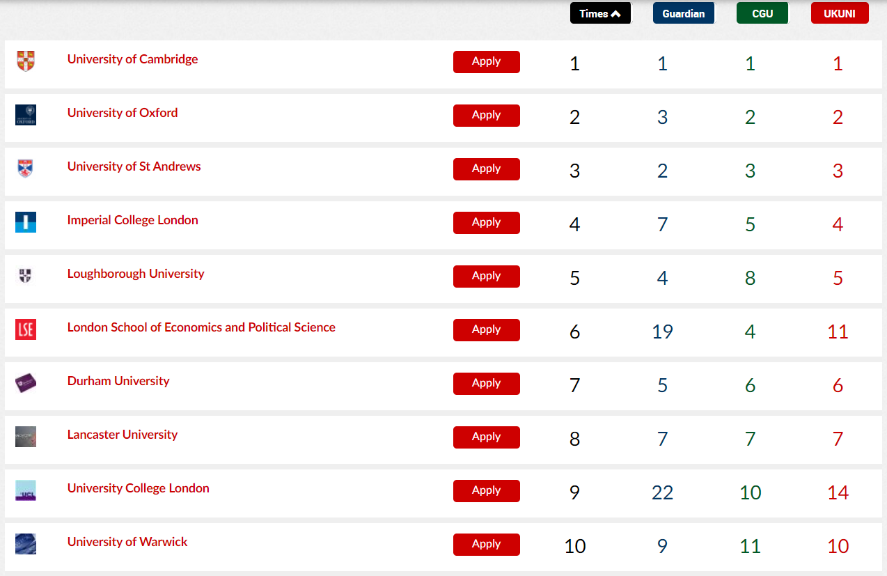
UNIVERSITY RANKINGS
Are Russell Group Universities ‘best’? Below are ‘top 10’ universities according to one league table:
3 of the top 10 universities overall are non-Russell Group.
How does that compare for different subjects?

Slide 25
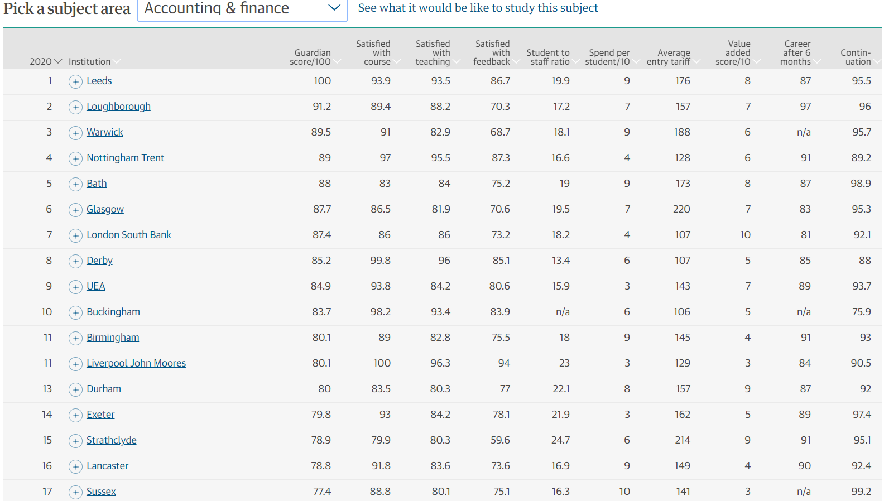
HOW MANY RUSSELL GROUP UNIS?
Out of the top 17 universities for accounting and finance, how many are Russell Group?
Only 6 out of the top 17 universities for accounting and finance are Russell Group universities
Notes:
How many non-Russell Group unis do you think there are in the top 17?

Slide 26
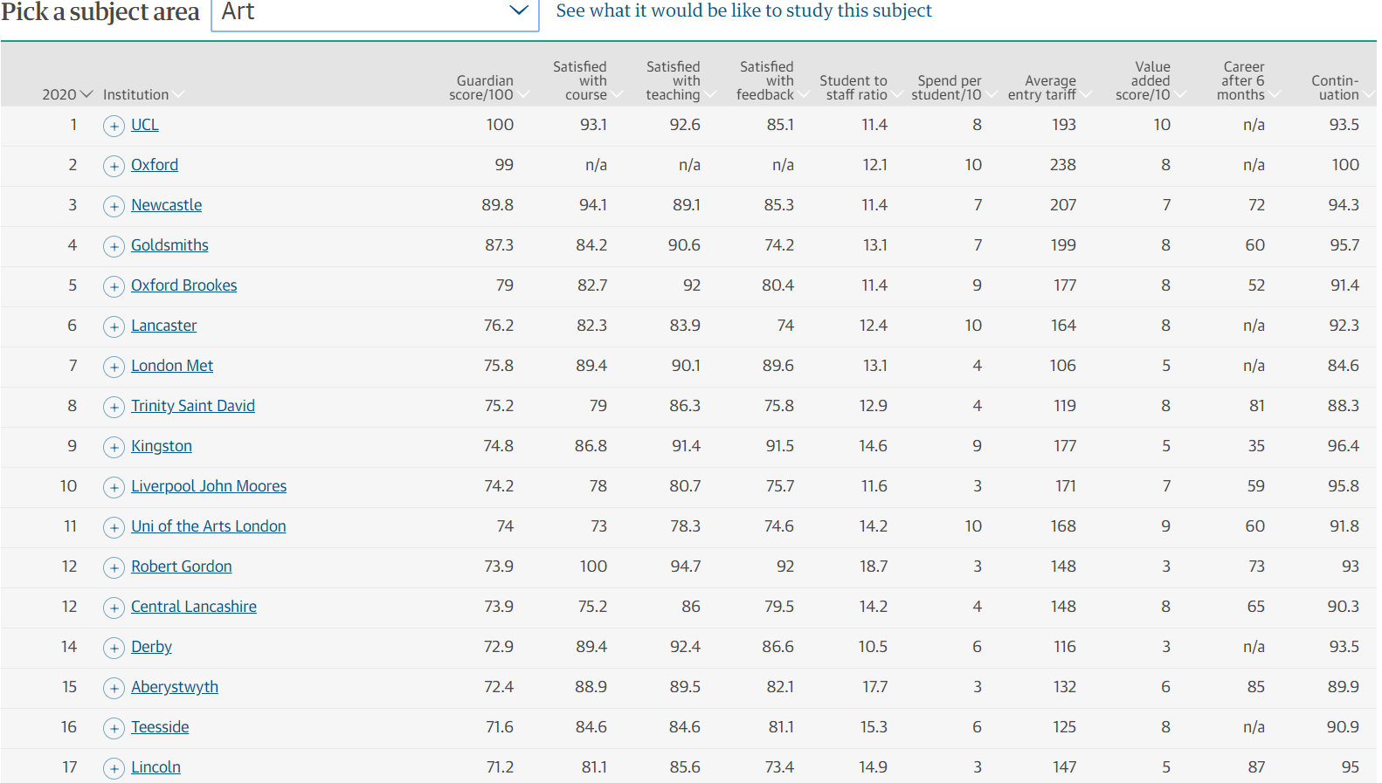
HOW MANY RUSSELL GROUP UNIS?
Out of the top 17 universities for art, how many are Russell Group?
Only 3 out of the top 17 universities for art are Russell Group universities
Notes:
How many non-Russell Group unis do you think there are in the top 17?

Slide 27
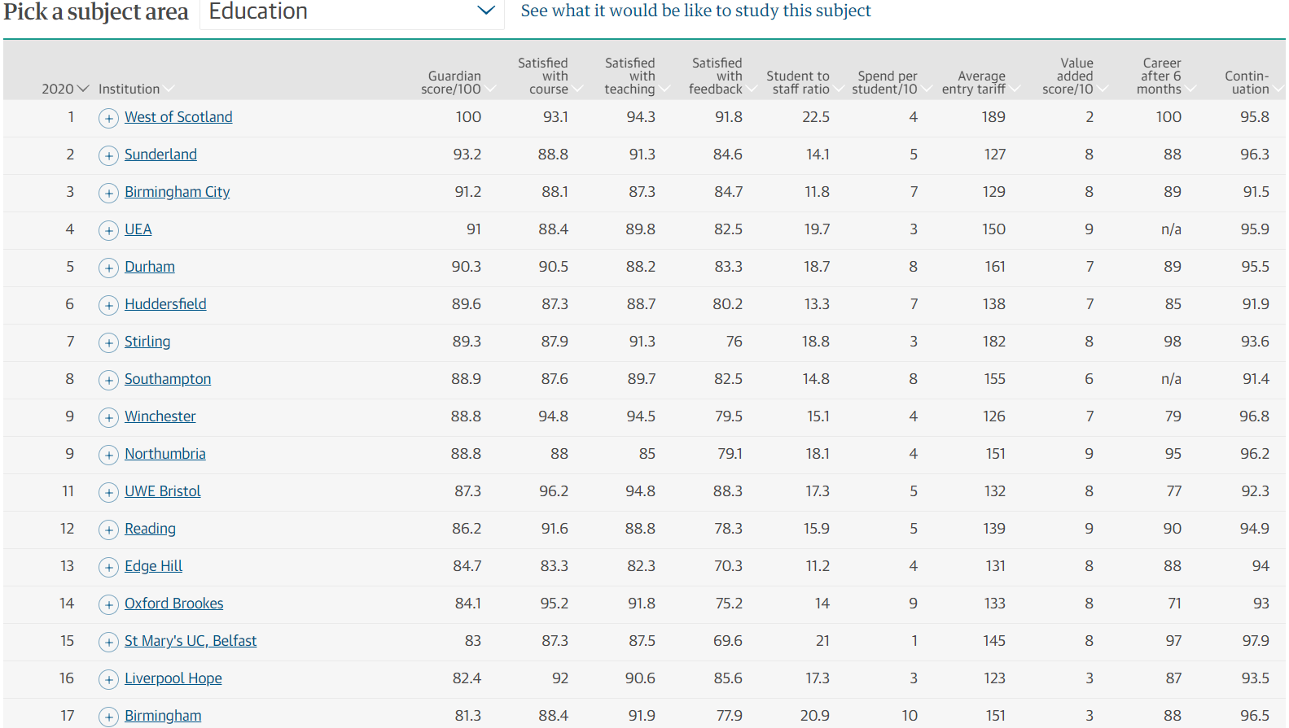
HOW MANY RUSSELL GROUP UNIS?
Out of the top 17 universities for education, how many are Russell Group?
Only 3 out of the top 17 universities for education are Russell Group universities
Notes:
How many non-Russell Group unis do you think there are in the top 17?

Slide 28
WHAT’S IMPORTANT TO YOU?
There are many factors that are taken into consideration when ranking universities. What are the most important factors for you? Rank the following in order of personal importance
– remember, there is no wrong answer!
9
Write each of the following on one of the diamonds on the resource sheet and rank them in order of importance to you:
Student satisfaction of course
Student satisfaction of teaching
Student satisfaction of feedback
Student to staff ratio
Spend per student
Graduate/career prospects
Cost of living
Entry tariffs
Spending on facilities
Notes:
Resource Booklet Page 23: 6.2 Diamond 9

Slide 29
OPEN DAYS AND PROSPECTUSES
Where can I find out about open days?
What is available to me on an open day?
How can I make the most of open days?
What does a prospectus contain?
How do I order one?
Notes:
6.3

Slide 30
OPEN DAYS
Open days are a tremendously useful opportunity to explore the universities you are interested in first-hand.
They are frequently advertised on university websites and on billboards: also check out opendays.com for a full calendar across the UK.
Visits are best to arrange yourself – you can decide how you want your experience to look. Do not wait for someone else to make the first move – your mates or your school!
Have a look at this virtual open day as a taster for what to expect:
https://www.youtube.com/watch?v=NtE1Omjx73U.

Slide 31
REFLECTION
What can you do on an open day?

Slide 32
DOS AND DON’TS
Collaborate to think of some dos and don’ts for open days…
DOS | DON’TS

Slide 33
DOS AND DON’TS
Dos
Visit the local area
Try and have a look around the university yourself
Take photos to remind you of your favourite things
Speak to student ambassadors
Ask yourself: ‘would I be happy here?
Don’ts
Arrive unprepared – what do you want to get out of it?
Be late – you don’t want to miss anything
Leave wishing you had asked a question
Leave early / before seeing everything

Slide 34
PROSPECTUSES
These are complete guides to a given university presented in a catalogue-style format.
They are highly useful resources which contain a wealth of information about the university, including details of courses available.
They are easy to order from university websites, and your school library is likely to have a stash if your sixth-form common room does not!

Slide 35
UCAS APPLICATIONS
HOW MANY PEOPLE APPLIED TO UNIVERSITY THROUGH UCAS IN 2019?
550,000
A. 50,000 B. 250,000 C. 550,000
Notes:
Stress to students that applying to university can be a competitive process! Ask students what are some of the ways they could stand out from the crowd on their UCAS application?
Academic achievements
Reference from school
Personal Statement

Slide 36
PERSONAL STATEMENT
Key part of your UCAS application!
Chance to stand out from the crowd!
Opportunity to tell university course tutors (admissions tutors) why you want a place on their course.
Showcase how your skills, experience, passion and aspirations are suited to the course.
Notes:
Their personal statement is their opportunity to show why universities should select them above the other people who have applied.

Slide 37
UCAS PERSONAL STATEMENT TOP TIPS
https://www.youtube.com/watch?v=_8hFkMAjW-I
Notes:
UCAS video about personal statements: https://www.youtube.com/watch?v=_8hFkMAjW-I
4.45mins

Slide 38
THINGS TO BE DOING NOW
ABC activity: what skills have you developed and how can you apply them to a university course?
Gain experience and skills to include on your personal statement:
volunteering, part-time work, watch online lectures, read online journals.
Come and see me for a Personal Statement workshop or mentoring session!
Make a start! Do a first draft – you can always make improvements!
Notes:
Resource Booklet Page 24-26: 6.3 Personal statements handouts

Slide 39
ENDPOINT SURVEY
To help Aspire to HE record our progress, we need you to complete a short 15-minute survey! Go to the link for your year group and complete the questionnaire. I’m here to help if you need it!
Notes:
Wish students well for the summer break! The programme will continue with them in Year 13 and will provide practical support in areas such as: UCAS application support, student finance application support, mock interviews, preparing to go to university and graduate level pathways.

Slide 40
INDEPENDENT ACTIVITY
USE THE PERSONAL STATEMENT WORKSHEET TO START THINKING ABOUT WHAT MIGHT GO IN YOUR PERSONAL STATEMENT

Slide 41
@aspiretohe

