Slide 1


YEAR 13 SESSION 3:
MOCK INTERVIEWS

Slide 2

PREVIOUS SESSION’S OBJECTIVES
OBJECTIVE 1: To understand how to gain skills and experiences to increase your employability & transferable skills.
OBJECTIVE 2: To understand what makes a good CV and how to create one.
OBJECTIVE 3: To understand how to demonstrate your skills and develop your ‘Personal Brand’.

Slide 3
CHECK-IN
Did you try googling yourself?
What results came up?
Did you need to make anything private?

Slide 4
SESSION OBJECTIVES
OBJECTIVE 1: To understand different types of interview and how to prepare for an interview.
OBJECTIVE 2: To understand what you should be researching before an interview.
OBJECTIVE 3: To take part in a mock interview.

Slide 5

STARTER
Taking it in turns, you will have one minute to talk about a subject non-stop – no pauses, no repetition allowed.
I will start off to demonstrate…
Notes:
For when you start: ask a student to fire a random subject at you. Have a list ready of the most random subjects you can possibly think of. Use the room – e.g. whiteboard pens, windows, desks etc. Prize for who can talk the longest without breaking the rules – ideally one whole minute.

Slide 6


WHAT WAS THE POINT?
We are going to be learning how to handle an interview, where it is likely that you might feel put on the spot!

Slide 7
INTERVIEW TYPES
Face-to-face Interview
This is a straightforward interview with one or two people who will ask you questions. They might be the person who will manage you, someone else from the department you could be joining, or someone from the Human Resources (HR) team, who look after all employees.
Panel Interview
This is an interview with several people who will ask questions. One person may be the ‘chair’ and be in charge, making sure each person gets to ask you a question. Panel interviews are common in the public sector (e.g. jobs paid for by the government).

Slide 8
INTERVIEW TYPES
Telephone Interview
Telephone interviews are sometimes used as the first stage in an interview process. The interviewer asks questions that will identify the best people to invite for a face-to-face interview. Your preparation needs to be just as thorough, though you can keep your CV to hand.
Assessment centre
Interviews at an assessment centre can last half a day or a day. You’ll go there with other candidates. As well as one or more interviews, you may also take ability or personality tests and do role-plays or group exercises where you must work together with the other candidates.

Slide 9

INTERVIEW TYPES
Virtual Interview
An interview that takes place remotely using technology like video conferencing platforms. Virtual interviews are often conducted much the same way as face-to-face interviews.
Virtual communication requires special considerations due to the limited ability to read body language and facial expressions.
Notes:
Note that this is becoming more common post covid-19

Slide 10

PREPARATION
You should always prepare for any interview that you are attending!
What would you do to plan and prepare for an interview?

Slide 11
PREPARATION
Research the company/
university!
Think about the job/course – what is expected?
Practice questions with your family and friends – i.e. why do you want this course/job.
Think about questions you may want to ask the interviewer!

Slide 12
TOP TIPS FOR ON THE DAY
Don’t be late!
Dress professionally and appropriately.
Turn your phone off!
Remember good body language!
Take a bottle of water and a pen and paper!
Be positive!
Notes:
Ask students for contributions before demonstrating. Discuss these. Not late but not too early. Dresscode – start discussion. Prepared for anything – i.e.: CCTV outside. Try to relax, but at the same time, do not get too comfortable with your surroundings.
Too late and the company may refuse to interview you
Too early and they may feel pressured
Remember to plan your travel – buses, traffic, parking etc…
Check your destination before you go. Conduct a ’dummy’ run

Slide 13
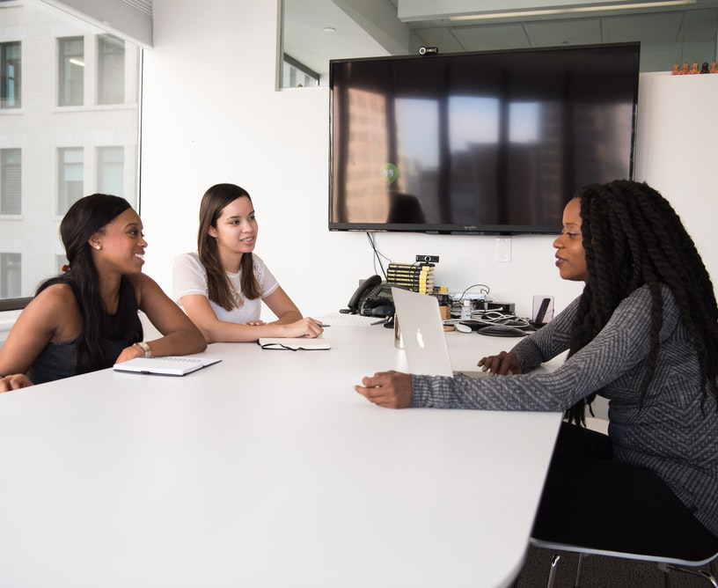

LET’S DO SOME RESEARCH
Shortly you’ll get the chance to do a mock interview!
You’ll be in groups of 3: one person will be the interviewer, one person will be the applicant (the person being interviewed) and one person will observe.
You’ll all get the chance to do each role.
But first, it’s time to prep for your interview!
Notes:
With use of IT, get students to do some research for 5-10 minutes. This can be for either a university/apprenticeship course they’re interested in, or the example job description for Lidl.
https://www.wlv.ac.uk/courses/bsc-hons-midwifery/ could be used as example for a university course if they can’t think of one

Slide 14
WHAT TO RESEARCH?
Research more about the university/apprenticeship/job that you’re applying for!
Re-read the job description/person specification before you attend the interview!
Are there any statistics that you can find that might be useful to remember for the interview?
Find out if there’s anything notable in the news about the university/course/company that you may want to mention!
What questions do you have about the role/university/company? What could you ask your interviewer?
Re-read your personal statement/application form/CV before attending – make sure you know you!
Notes:
Go through what students should be researching prior to an interview, discuss why it’s important to research and practice before hand.
Another good tip for a telephone interview could be to have earphones with a good quality microphone in them.

Slide 15
MOCK INTERVIEWS
Split in to groups of 3!
One person is the Interviewer, one person is the Applicant and one person is the Observer for ‘Interview 1’.
The interview will last 7 minutes and the Interviewer will ask the Applicant questions.
At the end of the interview, the Observer provides some feedback.
After ‘Interview 1’, everyone rotates and ‘Interview 2’ takes place as above, and then same again for ‘Interview 3’.
By the end of the 3 x interviews, everyone will have had the chance to be Interviewer, Applicant and Observer.
Interviewer: the person interviewing the applicant for a place at university or a job. Your handout has the questions to ask the applicant.
Applicant: the person who is interviewed for a place at university or job.
Observer: the person watching the interview and at the end provides feedback. Your handout gives suggestions on feedback
Notes:
Resource Booklet Pages 33-35: 3.3 Mock interview activity
Explain the roles of the interviewer, applicant and observer.
Mock interview questions task:
Split students in to groups of 3, depending on group size you may have to join a group
Hand out the sheets with the interview questions on and tips for the observer to be looking out for.

Slide 16
FEEDBACK
HOW DID YOU FIND THIS?
Notes:
Facilitate discussion after all 3 interviews.
How did students find this?
What did applicants do well?
What did applicants find difficult?
Would they want to do more practice on this?

Slide 17
INTERVIEW QUESTIONS TOP TIPS
Give examples to back up your answers
Make sure you give enough detail in your answers…
but also make sure not to ramble on!
Talk about your experiences and skills as well as your grades
Show your enthusiasm and passion
Try to talk about the university and the course within your answers
Try not to rush - it’s okay to pause for a moment to think about your answer

Slide 18
INDEPENDENT ACTIVITY
Next week we’ll be starting your student finance application. Have a look on the student calculator at how much maintenance loan you could apply for
https://www.gov.uk/student-finance-calculator
Please bring with you for next session;
Passport
University and course details
Bank account details
National Insurance number

Slide 19



@aspiretohe

