Slide 1


YEAR 13 SESSION 4:
BUDGETING AND STUDENT FINANCE
Notes:
Introduce the session to the students

Slide 2

PREVIOUS SESSION’S OBJECTIVES
OBJECTIVE 1: To understand different types of interview and how to prepare for an interview.
OBJECTIVE 2: To understand what you should be researching before an interview.
OBJECTIVE 3: To take part in a mock interview.
Notes:
MAKE GREY

Slide 3
CHECK-IN
Have you brought the items to start your student finance application?
Notes:
Students can still participate in the session if they haven’t!

Slide 4
SESSION OBJECTIVES
OBJECTIVE 1: To understand what budgeting is and how it can help you manage your finances whilst at University.
OBJECTIVE 2: To understand how to make your money go further at University.
OBJECTIVE 3: To make a start on your student finance application.

Slide 5

FINANCE AT UNIVERSITY RECAP
How much per year do you typically pay for tuition fees at University?
C) £9,250
A) £3,500
B) £7,000
C) £9,250
D) £12,000
Notes:
Use this slide and the next to check students’ knowledge of student finance and if they can remember the key messages around the costs of university from the Y12 session
A chance to remind students that there are two costs of going to University – tuition fees and maintenance (i.e. living costs)
Do students know the typical cost of tuition fees? – some universities/ courses may charge different prices
Your tuition fee loan covers the cost of your course.
Currently, the vast majority of courses in the UK cost £9,250 per year, but always check on UCAS or your course’s page to check how much your specific course costs!
Your tuition fee is paid directly to the university you are enrolled in. So remember, this will not go through your bank account!

Slide 6




FINANCE AT UNIVERSITY RECAP
Can you name any other costs you would have at university (on top of tuition fees)?
Can you get financial support for these costs?
Can everyone get the same amount of financial support?
Notes:
Can students think of the other costs they’d have at university? E.g. rent/accommodation, transport, socialising, shopping, course materials etc.
Do students know if there is financial support for these costs? Does every get the same financial support?

Slide 7
MAINTENANCE LOAN (2021/22)
Maintenance Loans are paid directly to the student three times a year, normally around the start of each term:
September, January and April
These are the minimum and maximum amounts of maintenance loan available, depending on where you choose to live whilst at university:
Location | Minimum | Maximum
Living at home | £5,576 | £8,400
Living away from home | £7,125 | £9,978
Living away from home (in London) | £10,120 | £13,022
The amount of maintenance loan you can get depends on your household income
Notes:
Student finance: how you're assessed and paid 2023 to 2024 - GOV.UK (www.gov.uk) more info at section 4.8
As well as your tuition fee loan, you are also entitled to a maintenance loan to support with your living costs, even if you’re staying at home or studying abroad!
This table shows the maximum amounts you could be entitled to receive. The amount of student finance you receive will depend on your household income and where you’re studying (i.e. inside or outside London).
If students aren’t entitled to the maximum loan, parents / carers are recommended by the government to support with costs if possible.
Breakdown
The overseas rate is available for students on a full, approved study year abroad as part of their UK based course.
The maximum you can get is…. The minimum is…. Everyone’s entitled to something.

Slide 8
MAINTENANCE LOAN (2021/22)
These are the amounts you would be entitled to based on your household income:
If you know the figure you might be entitled to, make a note of this for the next activity.
Don’t worry if you don’t know though!
Household income | Maintenance Loan – living away from home and studying outside London | Maintenance Loan – living away from home and studying in London | Maintenance Loan – living with parents
£25,000 | £9,978 | £13,022 | £8,400
£30,000 | £9,265 | £12,297 | £7,694
£35,000 | £8,552 | £11,571 | £6,988
£40,000 | £7,839 | £10,845 | £6,282
£42,875 | £7,429 | £10,428 | £5,876
£45,000 | £7,125 | £10,120 | £5,576
You can find out how much you’re entitled to at:
https://www.gov.uk/student-finance-calculator
* Figures correct August 2024
Notes:
Household income has an impact.
If students want to make a note of the amount they might be entitled to for the next activity. Note: this is not compulsory as this might be a sensitive topic for the student, so we’ll be using an example sum of £7,500 , for a student living away from home (but not in London).
Student finance: how you're assessed and paid 2023 to 2024 - GOV.UK (www.gov.uk)

Slide 9

BUDGETING
Your maintenance loan is paid straight into your bank account in 3 instalments (i.e. one per term)
September, January and April
Budgeting at university is crucial!
It’s the process of working out how much you will have each week to live off.
But how do you do it?

Slide 10

WORKING OUT A BUDGET
For this example you have been granted a maintenance loan amount for the year of:
£7,500
You receive your finance in 3 instalments (one per term). How much do you have per term?
£2,500
Each term is roughly 13 weeks. How much do you have per week?
£192
Notes:
Animations on this slide before calculations displayed.
The purpose is for students to see the process of working out a rough weekly budget. We’ll be using an example sum of £7,500 which is somewhere in the middle of min and max for a student living away from home (but not in London).
DISCLAIMER – this isn’t what you will get, research at home with student calculator
Workings:
£7,500 in 3 instalments = £2,500 per term, paid into their bank account once per term.
For this example, we’re saying there are 13 weeks per term and 39 weeks in the year.
£2,500 / 13 weeks = £192 per week to live off
This is what you have left – how would you want to spend it?

Slide 11
WORKING OUT A BUDGET
In this example, you have £192 to spend per week. Let’s find out how much things cost at your university of choice:
Student accommodation:
?
How much does this leave for your other costs:
Food, socialising, events, phone contract, clothes, course materials etc.
?
Transport to university:
?
Notes:
Continuing the example, if students had £192 per week to spend, let’s start finding some of the costs that might apply to them:
Reassure students at this stage if this amount doesn’t seem like it will go far enough, in the next few slides we’re going to give them all the top tips to make their money go further.
Ask students to look up the accommodation costs at their university and note down the weekly cost
Ask students to work out how they might get to university (would they need to get the bus / train, pay for petrol or parking, or would they walk?). Ask students to note down a likely cost
How much left does this give students to spend on their other living and social costs?
Again, reassure students that there are lots of ways to make their finances go further at university, which we’ll be explaining very shortly.

Slide 12
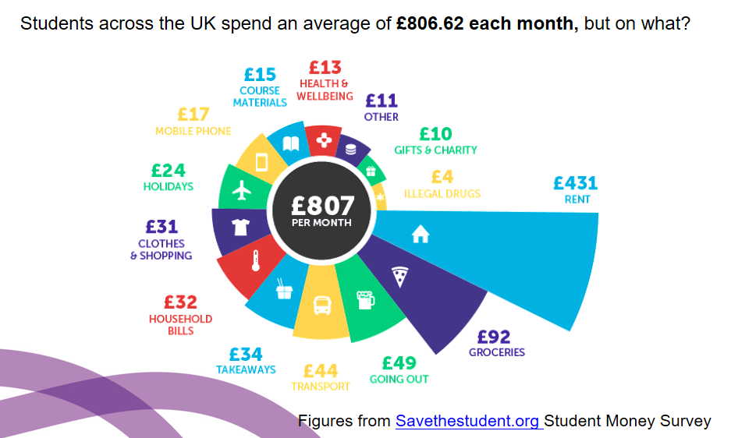
AVERAGE STUDENT COSTS
SPOTIFY STUDENT
Notes:
These figures are taken from the Savethestudent Student Money Survey. Encourage students to make a note of some of these costs to give them an idea of the average cost of living as a student

Slide 13
TOP TIPS ON TOPPING UP YOUR LOAN
Parents/guardians
Save a little before you go
Part-time work in bars or retail/transfer from current job
Working for the Student’s Union
Working at University accommodation (tours, moving in)
Completing studies for 3rd year research students
Tutoring GCSE/A Level students in your subject area
Agency work – up to £10 an hour!
Selling old clothes on Depop
Notes:
Be gentle about the first point, as some parents can’t or won’t be able to help the student out – advise students that it is both the governments and SFE’s recommendation that parents/guardians ‘top up’ the student loan
If they already have a job can they transfer stores? How long would they need to allow this to happen? It can be competitive with other students working at the same store in their home town moving to the same place. Would they need to start looking at making a CV and completing applications now?
The SU – run by students, for students, hiring students!
During the year prospective students come round for open days where the accommodation look for current students to be tour guides and/or help move students in
For subjects such as Psychology, 3rd year students will have to conduct studies and experiments. They need participants, and some are willing to pay in either cash or vouchers!
If you’re confident enough, tutoring is a good way to earn some money, help others and better your understanding of the subject you are studying
Agency work is flexible and can be both easy and fun! Companies will require young people to help promote products on campus or in town - £10 per hour for handing out free cans of coke doesn’t seem too bad!! Some universities have employment agencies which can help students find work. Some of the agency companies are TED Staffing, TRO, Executional, MASH and Coalition
Selling old clothes on depop when you stop wearing them – one person’s trash is another person’s treasure!

Slide 14



TOP TIPS FOR SAVING MONEY AT UNI
Unidays – up to 20% off loads of places including restaurants and clothes shops
Set up a standing order to give yourself an allowance, or even into your savings account
Go shopping at certain times/at night to get all the good reduced items!
Make your own lunch - taking a sandwich from home is much cheaper than buying one
Get a good student bank account with perks – some give you a free railcard!

Slide 15



STUDENT BANK ACCOUNTS
A student bank account is designed specifically for students, and include freebies and interest-free overdrafts
Some of the best student bank accounts for freebies are Santander, Barclays, Natwest and RBS – but always do your own research to see which suits you best!
  Santander for example give 16-25 railcards to customers, but how useful is this if you’re living at home during university and get the bus in?
  Barclays offer a 12 month Perlego subscription – would you save more on books and reading materials than you would do getting the train?

Slide 16
KEY MESSAGES FOR YOUR STUDENT FINANCE APPLICATION
Talk to me if you have any questions about who would support your student finance application
You don’t need a confirmed place at university or college to apply
Apply with your preferred choice, you can change details later if needed
Make sure any evidence and information needed to support your application is supplied ‘right first time’ both from you and your parents (or partner)
Make a note of your Student Finance England (SFE) account log-in details and password – Keep them safe!
Use an email address that you will check regularly!
Read, understand and agree to the loan Terms and Conditions
Notes:
What counts as household income
Your household income includes any of the following that apply:
your parents’ income, if you’re under 25 and live with them or depend on them financially
the combined income of one of your parents and their partner, if you’re under 25 and live with them or depend on them financially
your partner’s income, if you’re over 25 and live with them (even if they spend most of their time abroad)
income you get from your own savings, investments or property, for example dividends or rent
https://www.gov.uk/apply-for-student-finance/household-income?step-by-step-nav=18045f76-ac04-41b7-b147-5687d8fbb64a

Slide 17
COMPLETING AN APPLICATION
Talk to me if you have any questions about who would support your student finance application
Before starting an application, you should have the following to hand:
• Passport - SFE can check identity using valid UK passport details
• University and course details
Bank account details and National Insurance number
The easiest way for parents or other sponsors to support an application is also
online through GOV.UK, providing their information including:
• National Insurance numbers
Household income information (Based on prior tax year)
Details of other child dependants
Notes:
What counts as household income
Your household income includes any of the following that apply:
your parents’ income, if you’re under 25 and live with them or depend on them financially
the combined income of one of your parents and their partner, if you’re under 25 and live with them or depend on them financially
your partner’s income, if you’re over 25 and live with them (even if they spend most of their time abroad)
income you get from your own savings, investments or property, for example dividends or rent
https://www.gov.uk/apply-for-student-finance/household-income?step-by-step-nav=18045f76-ac04-41b7-b147-5687d8fbb64a

Slide 18
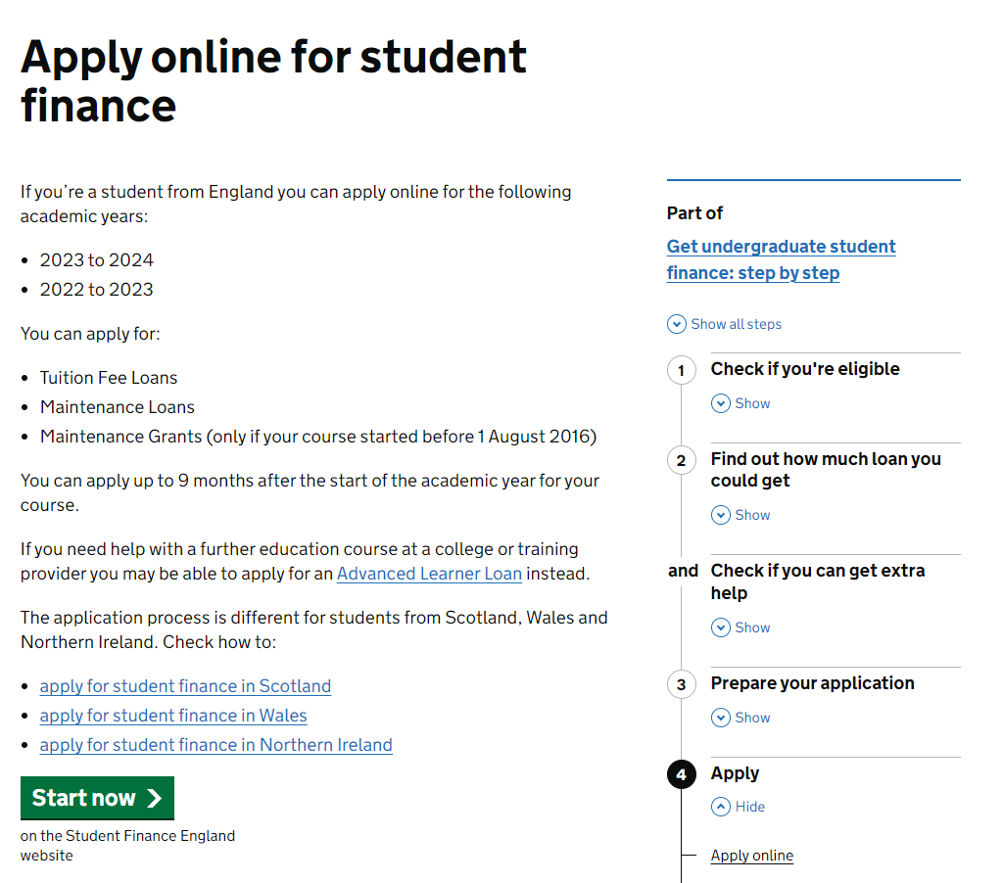


STARTING YOUR APPLICATION
Go onto www.gov.uk/apply-online-for-student-finance
Click ‘Start now’
Make sure you apply using the official gov.uk website!
Notes:
If students struggling with website link to type in ‘apply for SFE’ on google and it will come up (usually the first link).
Apply online for student finance - GOV.UK (www.gov.uk)

Slide 19
INDEPENDENT ACTIVITY
If you have started your Student Finance England application, continue and finish this.
Or start your Student Finance England application.

Slide 20



@aspiretohe

