Slide 1


SESSION 1: WHAT IS LEARNING?

Slide 2
TODAY’S OBJECTIVES:
OBJECTIVE 1: To understand the different types of learning
OBJECTIVE 2: To understand the different levels of learning and various qualifications
Notes:
1.1

Slide 3

SOMETHING I’VE LEARNED THIS WEEK
'North, East, West, South, Past And Present Events Report
Notes:
Check-in- Introduce yourself and share a fact that you have recently learnt
Here is a chance to talk through something you’ve learned this week. It can be anything! Tailor it to yourself. This is to emphasise that learning doesn’t just stop when you leave school. Ask the students if there’s anything different they’ve learned this week that they want to share

Slide 4

DIFFERENT TYPES OF LEARNING
There are several types of learning: here are some examples…
Academic
Vocational
Post-compulsory
Compulsory
Further Education
Higher Education
Notes:
Resource Booklet Page 4-5: 1.1 Learning Terminology
Ask the group what is learning? -Does it ever stop? What is the school-leaving age? Do the matching the key terms activity to explore key words like compulsory and post compulsory. Explain post-16 options.
Talk through that there are a variety of different types of learning and education. Ask if any of the students can provide a definition.
Activity: In pairs or 3’s (students) use the cut out resources to match up the terms and definitions

Slide 5
.
MATCH THE TERM TO THE DEFINITION
Term | Definition
Academic Education | Concerned with subjects such as Business Studies, Health and Social Care and Sport – practical subjects linking to a specific career.
Vocational Education | The education you pursue after the age of 16.
Compulsory Education | Applies to any form of education that results in a level 4+ qualification. This includes HND, foundation degree, university degree or degree apprenticeship.
Post-Compulsory Education | Post-compulsory learning at a non-degree level – e.g. apprenticeships, lifelong learning qualifications etc.
Further Education | Education that you are obliged by law to partake in.
Higher Education | Concerned with subjects such as English, Maths and Science which are theory based – lots of thinking, reading and writing.

Slide 6

WHAT IS THE DIFFERENCE BETWEEN COMPULSORY AND POST-COMPULSORY EDUCATION?
School-leaving age is 16 (compulsory)
Education-leaving age is 18 (post-compulsory)
Although some form of education or training is compulsory until the age of 18, this is still called post-compulsory
Between the ages of 16-18, you must do one of the following…
Notes:
This can be quite a complex topic. Talk about how you must stay in education or training until you are 18.

Slide 7
YOUR POST-16 OPTIONS
College
School 6th Form
Higher Education/ Employment
Training Provider Study Programme
Apprenticeship
Notes:
Introduce post-16 options and ask students what they already know first. Explain all the routes. Ask students if they have any idea if they know which route they’d like to take at this point. Also reinforce if they don’t know yet, that that’s ok!

Slide 8
PICTURE SORT!
Academic vs Vocational!
Sort the pictures into academic
and vocational piles
Notes:
Resource Booklet Page 6: 1.1 Vocational vs Academic
Picture sort- Explore vocational and academic. – use the resource of pictures for them to sort into academic/vocational piles, opening up a discussion about what type of learner they are.
Picture sort
Using the Vocational vs academic photo resource. Ask the students in pairs or individually to sort the career photos into ‘academic’ piles and ‘vocational’ piles

Slide 9










ACADEMIC VS VOCATIONAL
Notes:
Picture sort- Explore vocational and academic. – use the resource of pictures for them to sort into academic/vocational piles, opening up a discussion about what type of learner they are.
Resource: 1.1 Picture sort
Using the Vocational vs academic photo resource. Ask the students in pairs or individually to sort the career photos into ‘academic’ piles and ‘vocational’ piles

Slide 10

Term | Definition
Academic Education | Concerned with subjects such as English, Maths and Science which are theory based – lots of thinking, reading and writing.
Vocational Education | Concerned with subjects such as Business Studies, Health and Social Care and Sport – practical subjects linking to a specific career.
Are you more academic or vocational? Think for a minute then share.
Notes:
Discuss the 4 definitions- Ask students are they more vocational or academic, and which education is more important? Link this to next steps and HE routes
After talking through the different careers, make sure they students reflect upon themselves. Which education do they prefer and would like to study?
Academic courses are more likely to demand essays and logical reasoning, whereas vocational courses are about practical hands-on training and learning tangible skills.
There is a difference between vocational education and the word vocation. Vocation is a strong feeling of suitability for a particular career or occupation.
Explain that all careers can be a vocation, but this activity is explain the
difference between academic and vocational.

Slide 11
Term | Definition
Higher Education | Applies to any form of education that results in a level 4+ qualification. This includes HND, foundation degree, university degree or degree apprenticeship.
Further Education | Post-compulsory learning at a non-degree level – e.g. apprenticeships, lifelong learning qualifications etc.
DISCUSS…Why is it important to think about further/higher education now?
Notes:
Talk to them about how their GCSE choices influences the rest of their education. And also how choosing a career can influence FE and HE

Slide 12

CELEBRITY DEGREE QUIZ!
What degree did these celebrities choose?
Write your answers on your worksheets
Celebrity Degree Quiz
Notes:
Resource Booklet Page 7: 1.2 Celebrity Degree Quiz
1.2
Celebrity degree quiz- Looking at transferable skills and how not all paths are straightforward.
Using celebrity degree quiz resource, ask the students to fill in their answers to the quiz as they go

Slide 13

Meghan Markle
Former Suits actress who recently married into the Royal family with Prince Harry.
A) Drama
B) Theatre and International Studies
C) Law
D) Criminology and Psychology
Notes:
Foundation Degrees
Foundation degrees are ideal if you’re unsure about taking a full degree or if you want to study while you work.
Whether you’re working in or towards the role now, you can gain professional and technical skills to further your career – within a shorter time frame than a full degree.
They usually take two years full-time to complete, or longer for part-time students.
Normally you can continue for a further year to gain a full honours degree, which is useful if you decide to go for a full degree after all.
Higher Apprenticeships
Higher and Degree Apprenticeships are a great alternative to university, offering qualifications up to degree level, no tuition fees and the opportunity to earn while you learn.
Higher and degree apprentices typically split their time between college or university and the workplace. As with other apprenticeships they are employed throughout and the cost of the fees are shared between government and their employer.
What's an HND?
A Higher National Diploma (HND) is a work-related course provided by higher and further education colleges in the UK.
A full-time HND takes two years to complete, or three to four years part-time. Generally an HND is the equivalent to two years at university.
What's an HNC?
A full-time Higher National Certificate (HNC) takes one year to complete, or two years part-time.
Many HNC courses cover the same subjects as an HND, but an HNC is one level below an HND (it's generally equivalent to the first year at university).
Honours Degree Courses
An Honours degree is a course of study leading to a qualification such as a Bachelor of Arts (BA), Bachelor of Science (BSc), or Bachelor of Law (LLB).
This typically takes three or four years to complete full time (normally four years if you're doing a sandwich course, which includes a year in industry or abroad).
You can study for a full or part-time Honours Degree at a university, or more flexibly in your own time with the Open University, building up credits through a series of shorter courses.

Slide 14


Meghan Markle
B) Theatre and International Studies
Northwestern University, USA
Notes:
Foundation Degrees
Foundation degrees are ideal if you’re unsure about taking a full degree or if you want to study while you work.
Whether you’re working in or towards the role now, you can gain professional and technical skills to further your career – within a shorter time frame than a full degree.
They usually take two years full-time to complete, or longer for part-time students.
Normally you can continue for a further year to gain a full honours degree, which is useful if you decide to go for a full degree after all.
Higher Apprenticeships
Higher and Degree Apprenticeships are a great alternative to university, offering qualifications up to degree level, no tuition fees and the opportunity to earn while you learn.
Higher and degree apprentices typically split their time between college or university and the workplace. As with other apprenticeships they are employed throughout and the cost of the fees are shared between government and their employer.
What's an HND?
A Higher National Diploma (HND) is a work-related course provided by higher and further education colleges in the UK.
A full-time HND takes two years to complete, or three to four years part-time. Generally an HND is the equivalent to two years at university.
What's an HNC?
A full-time Higher National Certificate (HNC) takes one year to complete, or two years part-time.
Many HNC courses cover the same subjects as an HND, but an HNC is one level below an HND (it's generally equivalent to the first year at university).
Honours Degree Courses
An Honours degree is a course of study leading to a qualification such as a Bachelor of Arts (BA), Bachelor of Science (BSc), or Bachelor of Law (LLB).
This typically takes three or four years to complete full time (normally four years if you're doing a sandwich course, which includes a year in industry or abroad).
You can study for a full or part-time Honours Degree at a university, or more flexibly in your own time with the Open University, building up credits through a series of shorter courses.

Slide 15

Donald Trump
Former President of the United States of America.
A) Politics
B) Business Studies
C) English with Russian
D) Economics
Notes:
Foundation Degrees
Foundation degrees are ideal if you’re unsure about taking a full degree or if you want to study while you work.
Whether you’re working in or towards the role now, you can gain professional and technical skills to further your career – within a shorter time frame than a full degree.
They usually take two years full-time to complete, or longer for part-time students.
Normally you can continue for a further year to gain a full honours degree, which is useful if you decide to go for a full degree after all.
Higher Apprenticeships
Higher and Degree Apprenticeships are a great alternative to university, offering qualifications up to degree level, no tuition fees and the opportunity to earn while you learn.
Higher and degree apprentices typically split their time between college or university and the workplace. As with other apprenticeships they are employed throughout and the cost of the fees are shared between government and their employer.
What's an HND?
A Higher National Diploma (HND) is a work-related course provided by higher and further education colleges in the UK.
A full-time HND takes two years to complete, or three to four years part-time. Generally an HND is the equivalent to two years at university.
What's an HNC?
A full-time Higher National Certificate (HNC) takes one year to complete, or two years part-time.
Many HNC courses cover the same subjects as an HND, but an HNC is one level below an HND (it's generally equivalent to the first year at university).
Honours Degree Courses
An Honours degree is a course of study leading to a qualification such as a Bachelor of Arts (BA), Bachelor of Science (BSc), or Bachelor of Law (LLB).
This typically takes three or four years to complete full time (normally four years if you're doing a sandwich course, which includes a year in industry or abroad).
You can study for a full or part-time Honours Degree at a university, or more flexibly in your own time with the Open University, building up credits through a series of shorter courses.

Slide 16


Donald Trump
D) Economics
University of Pennsylvania, USA
Notes:
Foundation Degrees
Foundation degrees are ideal if you’re unsure about taking a full degree or if you want to study while you work.
Whether you’re working in or towards the role now, you can gain professional and technical skills to further your career – within a shorter time frame than a full degree.
They usually take two years full-time to complete, or longer for part-time students.
Normally you can continue for a further year to gain a full honours degree, which is useful if you decide to go for a full degree after all.
Higher Apprenticeships
Higher and Degree Apprenticeships are a great alternative to university, offering qualifications up to degree level, no tuition fees and the opportunity to earn while you learn.
Higher and degree apprentices typically split their time between college or university and the workplace. As with other apprenticeships they are employed throughout and the cost of the fees are shared between government and their employer.
What's an HND?
A Higher National Diploma (HND) is a work-related course provided by higher and further education colleges in the UK.
A full-time HND takes two years to complete, or three to four years part-time. Generally an HND is the equivalent to two years at university.
What's an HNC?
A full-time Higher National Certificate (HNC) takes one year to complete, or two years part-time.
Many HNC courses cover the same subjects as an HND, but an HNC is one level below an HND (it's generally equivalent to the first year at university).
Honours Degree Courses
An Honours degree is a course of study leading to a qualification such as a Bachelor of Arts (BA), Bachelor of Science (BSc), or Bachelor of Law (LLB).
This typically takes three or four years to complete full time (normally four years if you're doing a sandwich course, which includes a year in industry or abroad).
You can study for a full or part-time Honours Degree at a university, or more flexibly in your own time with the Open University, building up credits through a series of shorter courses.

Slide 17

Selena Gomez
Popstar famous for songs such as ‘Come & Get It’.
A) Theatre
B) Performing Arts
C) Never Attended
D) Sound Production
Notes:
Foundation Degrees
Foundation degrees are ideal if you’re unsure about taking a full degree or if you want to study while you work.
Whether you’re working in or towards the role now, you can gain professional and technical skills to further your career – within a shorter time frame than a full degree.
They usually take two years full-time to complete, or longer for part-time students.
Normally you can continue for a further year to gain a full honours degree, which is useful if you decide to go for a full degree after all.
Higher Apprenticeships
Higher and Degree Apprenticeships are a great alternative to university, offering qualifications up to degree level, no tuition fees and the opportunity to earn while you learn.
Higher and degree apprentices typically split their time between college or university and the workplace. As with other apprenticeships they are employed throughout and the cost of the fees are shared between government and their employer.
What's an HND?
A Higher National Diploma (HND) is a work-related course provided by higher and further education colleges in the UK.
A full-time HND takes two years to complete, or three to four years part-time. Generally an HND is the equivalent to two years at university.
What's an HNC?
A full-time Higher National Certificate (HNC) takes one year to complete, or two years part-time.
Many HNC courses cover the same subjects as an HND, but an HNC is one level below an HND (it's generally equivalent to the first year at university).
Honours Degree Courses
An Honours degree is a course of study leading to a qualification such as a Bachelor of Arts (BA), Bachelor of Science (BSc), or Bachelor of Law (LLB).
This typically takes three or four years to complete full time (normally four years if you're doing a sandwich course, which includes a year in industry or abroad).
You can study for a full or part-time Honours Degree at a university, or more flexibly in your own time with the Open University, building up credits through a series of shorter courses.

Slide 18


Selena Gomez
C) Never Attended
Notes:
Foundation Degrees
Foundation degrees are ideal if you’re unsure about taking a full degree or if you want to study while you work.
Whether you’re working in or towards the role now, you can gain professional and technical skills to further your career – within a shorter time frame than a full degree.
They usually take two years full-time to complete, or longer for part-time students.
Normally you can continue for a further year to gain a full honours degree, which is useful if you decide to go for a full degree after all.
Higher Apprenticeships
Higher and Degree Apprenticeships are a great alternative to university, offering qualifications up to degree level, no tuition fees and the opportunity to earn while you learn.
Higher and degree apprentices typically split their time between college or university and the workplace. As with other apprenticeships they are employed throughout and the cost of the fees are shared between government and their employer.
What's an HND?
A Higher National Diploma (HND) is a work-related course provided by higher and further education colleges in the UK.
A full-time HND takes two years to complete, or three to four years part-time. Generally an HND is the equivalent to two years at university.
What's an HNC?
A full-time Higher National Certificate (HNC) takes one year to complete, or two years part-time.
Many HNC courses cover the same subjects as an HND, but an HNC is one level below an HND (it's generally equivalent to the first year at university).
Honours Degree Courses
An Honours degree is a course of study leading to a qualification such as a Bachelor of Arts (BA), Bachelor of Science (BSc), or Bachelor of Law (LLB).
This typically takes three or four years to complete full time (normally four years if you're doing a sandwich course, which includes a year in industry or abroad).
You can study for a full or part-time Honours Degree at a university, or more flexibly in your own time with the Open University, building up credits through a series of shorter courses.

Slide 19

Will Ferrell
Actor famous for his role as Buddy in the film Elf.
A) Sports Information
B) Medicine
C) Film Studies
D) Drama
Notes:
Foundation Degrees
Foundation degrees are ideal if you’re unsure about taking a full degree or if you want to study while you work.
Whether you’re working in or towards the role now, you can gain professional and technical skills to further your career – within a shorter time frame than a full degree.
They usually take two years full-time to complete, or longer for part-time students.
Normally you can continue for a further year to gain a full honours degree, which is useful if you decide to go for a full degree after all.
Higher Apprenticeships
Higher and Degree Apprenticeships are a great alternative to university, offering qualifications up to degree level, no tuition fees and the opportunity to earn while you learn.
Higher and degree apprentices typically split their time between college or university and the workplace. As with other apprenticeships they are employed throughout and the cost of the fees are shared between government and their employer.
What's an HND?
A Higher National Diploma (HND) is a work-related course provided by higher and further education colleges in the UK.
A full-time HND takes two years to complete, or three to four years part-time. Generally an HND is the equivalent to two years at university.
What's an HNC?
A full-time Higher National Certificate (HNC) takes one year to complete, or two years part-time.
Many HNC courses cover the same subjects as an HND, but an HNC is one level below an HND (it's generally equivalent to the first year at university).
Honours Degree Courses
An Honours degree is a course of study leading to a qualification such as a Bachelor of Arts (BA), Bachelor of Science (BSc), or Bachelor of Law (LLB).
This typically takes three or four years to complete full time (normally four years if you're doing a sandwich course, which includes a year in industry or abroad).
You can study for a full or part-time Honours Degree at a university, or more flexibly in your own time with the Open University, building up credits through a series of shorter courses.

Slide 20


Will Ferrell
A) Sports Information
University of Southern California, USA
Notes:
Foundation Degrees
Foundation degrees are ideal if you’re unsure about taking a full degree or if you want to study while you work.
Whether you’re working in or towards the role now, you can gain professional and technical skills to further your career – within a shorter time frame than a full degree.
They usually take two years full-time to complete, or longer for part-time students.
Normally you can continue for a further year to gain a full honours degree, which is useful if you decide to go for a full degree after all.
Higher Apprenticeships
Higher and Degree Apprenticeships are a great alternative to university, offering qualifications up to degree level, no tuition fees and the opportunity to earn while you learn.
Higher and degree apprentices typically split their time between college or university and the workplace. As with other apprenticeships they are employed throughout and the cost of the fees are shared between government and their employer.
What's an HND?
A Higher National Diploma (HND) is a work-related course provided by higher and further education colleges in the UK.
A full-time HND takes two years to complete, or three to four years part-time. Generally an HND is the equivalent to two years at university.
What's an HNC?
A full-time Higher National Certificate (HNC) takes one year to complete, or two years part-time.
Many HNC courses cover the same subjects as an HND, but an HNC is one level below an HND (it's generally equivalent to the first year at university).
Honours Degree Courses
An Honours degree is a course of study leading to a qualification such as a Bachelor of Arts (BA), Bachelor of Science (BSc), or Bachelor of Law (LLB).
This typically takes three or four years to complete full time (normally four years if you're doing a sandwich course, which includes a year in industry or abroad).
You can study for a full or part-time Honours Degree at a university, or more flexibly in your own time with the Open University, building up credits through a series of shorter courses.

Slide 21

Emma Watson
Actress famous for her role as Hermione Granger in the Harry Potter films.
A) Business
B) English Literature
C) History
D) Politics
Notes:
Foundation Degrees
Foundation degrees are ideal if you’re unsure about taking a full degree or if you want to study while you work.
Whether you’re working in or towards the role now, you can gain professional and technical skills to further your career – within a shorter time frame than a full degree.
They usually take two years full-time to complete, or longer for part-time students.
Normally you can continue for a further year to gain a full honours degree, which is useful if you decide to go for a full degree after all.
Higher Apprenticeships
Higher and Degree Apprenticeships are a great alternative to university, offering qualifications up to degree level, no tuition fees and the opportunity to earn while you learn.
Higher and degree apprentices typically split their time between college or university and the workplace. As with other apprenticeships they are employed throughout and the cost of the fees are shared between government and their employer.
What's an HND?
A Higher National Diploma (HND) is a work-related course provided by higher and further education colleges in the UK.
A full-time HND takes two years to complete, or three to four years part-time. Generally an HND is the equivalent to two years at university.
What's an HNC?
A full-time Higher National Certificate (HNC) takes one year to complete, or two years part-time.
Many HNC courses cover the same subjects as an HND, but an HNC is one level below an HND (it's generally equivalent to the first year at university).
Honours Degree Courses
An Honours degree is a course of study leading to a qualification such as a Bachelor of Arts (BA), Bachelor of Science (BSc), or Bachelor of Law (LLB).
This typically takes three or four years to complete full time (normally four years if you're doing a sandwich course, which includes a year in industry or abroad).
You can study for a full or part-time Honours Degree at a university, or more flexibly in your own time with the Open University, building up credits through a series of shorter courses.

Slide 22


Emma Watson
B) English Literature
Brown University, USA
Notes:
Foundation Degrees
Foundation degrees are ideal if you’re unsure about taking a full degree or if you want to study while you work.
Whether you’re working in or towards the role now, you can gain professional and technical skills to further your career – within a shorter time frame than a full degree.
They usually take two years full-time to complete, or longer for part-time students.
Normally you can continue for a further year to gain a full honours degree, which is useful if you decide to go for a full degree after all.
Higher Apprenticeships
Higher and Degree Apprenticeships are a great alternative to university, offering qualifications up to degree level, no tuition fees and the opportunity to earn while you learn.
Higher and degree apprentices typically split their time between college or university and the workplace. As with other apprenticeships they are employed throughout and the cost of the fees are shared between government and their employer.
What's an HND?
A Higher National Diploma (HND) is a work-related course provided by higher and further education colleges in the UK.
A full-time HND takes two years to complete, or three to four years part-time. Generally an HND is the equivalent to two years at university.
What's an HNC?
A full-time Higher National Certificate (HNC) takes one year to complete, or two years part-time.
Many HNC courses cover the same subjects as an HND, but an HNC is one level below an HND (it's generally equivalent to the first year at university).
Honours Degree Courses
An Honours degree is a course of study leading to a qualification such as a Bachelor of Arts (BA), Bachelor of Science (BSc), or Bachelor of Law (LLB).
This typically takes three or four years to complete full time (normally four years if you're doing a sandwich course, which includes a year in industry or abroad).
You can study for a full or part-time Honours Degree at a university, or more flexibly in your own time with the Open University, building up credits through a series of shorter courses.

Slide 23

Dwayne Johnson
Former WWE wrestler and current actor also known as ‘The Rock’.
A) Psychology
B) Politics
C) General Studies
D) Sports Science
Notes:
Foundation Degrees
Foundation degrees are ideal if you’re unsure about taking a full degree or if you want to study while you work.
Whether you’re working in or towards the role now, you can gain professional and technical skills to further your career – within a shorter time frame than a full degree.
They usually take two years full-time to complete, or longer for part-time students.
Normally you can continue for a further year to gain a full honours degree, which is useful if you decide to go for a full degree after all.
Higher Apprenticeships
Higher and Degree Apprenticeships are a great alternative to university, offering qualifications up to degree level, no tuition fees and the opportunity to earn while you learn.
Higher and degree apprentices typically split their time between college or university and the workplace. As with other apprenticeships they are employed throughout and the cost of the fees are shared between government and their employer.
What's an HND?
A Higher National Diploma (HND) is a work-related course provided by higher and further education colleges in the UK.
A full-time HND takes two years to complete, or three to four years part-time. Generally an HND is the equivalent to two years at university.
What's an HNC?
A full-time Higher National Certificate (HNC) takes one year to complete, or two years part-time.
Many HNC courses cover the same subjects as an HND, but an HNC is one level below an HND (it's generally equivalent to the first year at university).
Honours Degree Courses
An Honours degree is a course of study leading to a qualification such as a Bachelor of Arts (BA), Bachelor of Science (BSc), or Bachelor of Law (LLB).
This typically takes three or four years to complete full time (normally four years if you're doing a sandwich course, which includes a year in industry or abroad).
You can study for a full or part-time Honours Degree at a university, or more flexibly in your own time with the Open University, building up credits through a series of shorter courses.

Slide 24


Dwayne Johnson
C) General Studies
University of Miami, USA
Notes:
Foundation Degrees
Foundation degrees are ideal if you’re unsure about taking a full degree or if you want to study while you work.
Whether you’re working in or towards the role now, you can gain professional and technical skills to further your career – within a shorter time frame than a full degree.
They usually take two years full-time to complete, or longer for part-time students.
Normally you can continue for a further year to gain a full honours degree, which is useful if you decide to go for a full degree after all.
Higher Apprenticeships
Higher and Degree Apprenticeships are a great alternative to university, offering qualifications up to degree level, no tuition fees and the opportunity to earn while you learn.
Higher and degree apprentices typically split their time between college or university and the workplace. As with other apprenticeships they are employed throughout and the cost of the fees are shared between government and their employer.
What's an HND?
A Higher National Diploma (HND) is a work-related course provided by higher and further education colleges in the UK.
A full-time HND takes two years to complete, or three to four years part-time. Generally an HND is the equivalent to two years at university.
What's an HNC?
A full-time Higher National Certificate (HNC) takes one year to complete, or two years part-time.
Many HNC courses cover the same subjects as an HND, but an HNC is one level below an HND (it's generally equivalent to the first year at university).
Honours Degree Courses
An Honours degree is a course of study leading to a qualification such as a Bachelor of Arts (BA), Bachelor of Science (BSc), or Bachelor of Law (LLB).
This typically takes three or four years to complete full time (normally four years if you're doing a sandwich course, which includes a year in industry or abroad).
You can study for a full or part-time Honours Degree at a university, or more flexibly in your own time with the Open University, building up credits through a series of shorter courses.

Slide 25
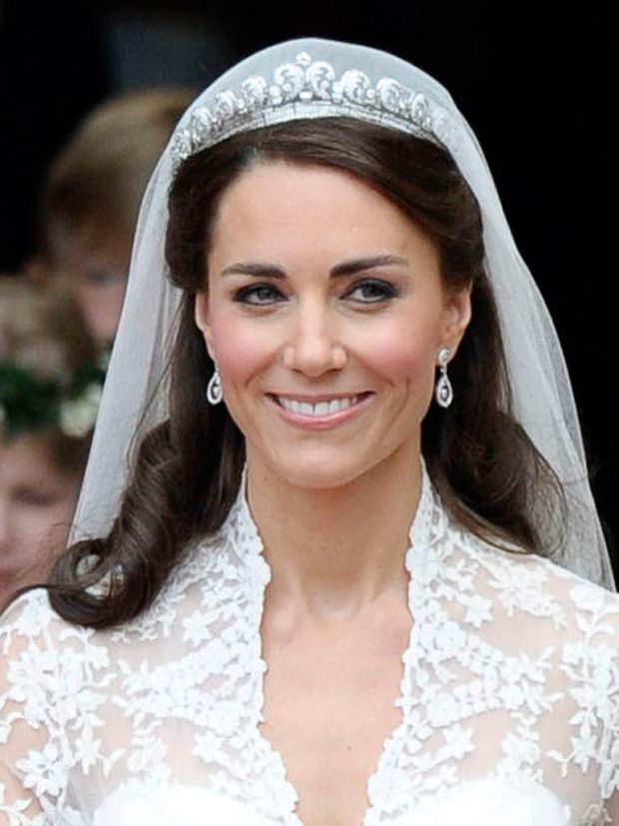
Kate Middleton
The Duchess of Cambridge who is also married to Prince William.
A) Dance History
B) History of Art
C) Royal History
D) History of Politics
Notes:
Foundation Degrees
Foundation degrees are ideal if you’re unsure about taking a full degree or if you want to study while you work.
Whether you’re working in or towards the role now, you can gain professional and technical skills to further your career – within a shorter time frame than a full degree.
They usually take two years full-time to complete, or longer for part-time students.
Normally you can continue for a further year to gain a full honours degree, which is useful if you decide to go for a full degree after all.
Higher Apprenticeships
Higher and Degree Apprenticeships are a great alternative to university, offering qualifications up to degree level, no tuition fees and the opportunity to earn while you learn.
Higher and degree apprentices typically split their time between college or university and the workplace. As with other apprenticeships they are employed throughout and the cost of the fees are shared between government and their employer.
What's an HND?
A Higher National Diploma (HND) is a work-related course provided by higher and further education colleges in the UK.
A full-time HND takes two years to complete, or three to four years part-time. Generally an HND is the equivalent to two years at university.
What's an HNC?
A full-time Higher National Certificate (HNC) takes one year to complete, or two years part-time.
Many HNC courses cover the same subjects as an HND, but an HNC is one level below an HND (it's generally equivalent to the first year at university).
Honours Degree Courses
An Honours degree is a course of study leading to a qualification such as a Bachelor of Arts (BA), Bachelor of Science (BSc), or Bachelor of Law (LLB).
This typically takes three or four years to complete full time (normally four years if you're doing a sandwich course, which includes a year in industry or abroad).
You can study for a full or part-time Honours Degree at a university, or more flexibly in your own time with the Open University, building up credits through a series of shorter courses.

Slide 26


Kate Middleton
B) History of Art
University of St Andrews, Scotland
Notes:
Foundation Degrees
Foundation degrees are ideal if you’re unsure about taking a full degree or if you want to study while you work.
Whether you’re working in or towards the role now, you can gain professional and technical skills to further your career – within a shorter time frame than a full degree.
They usually take two years full-time to complete, or longer for part-time students.
Normally you can continue for a further year to gain a full honours degree, which is useful if you decide to go for a full degree after all.
Higher Apprenticeships
Higher and Degree Apprenticeships are a great alternative to university, offering qualifications up to degree level, no tuition fees and the opportunity to earn while you learn.
Higher and degree apprentices typically split their time between college or university and the workplace. As with other apprenticeships they are employed throughout and the cost of the fees are shared between government and their employer.
What's an HND?
A Higher National Diploma (HND) is a work-related course provided by higher and further education colleges in the UK.
A full-time HND takes two years to complete, or three to four years part-time. Generally an HND is the equivalent to two years at university.
What's an HNC?
A full-time Higher National Certificate (HNC) takes one year to complete, or two years part-time.
Many HNC courses cover the same subjects as an HND, but an HNC is one level below an HND (it's generally equivalent to the first year at university).
Honours Degree Courses
An Honours degree is a course of study leading to a qualification such as a Bachelor of Arts (BA), Bachelor of Science (BSc), or Bachelor of Law (LLB).
This typically takes three or four years to complete full time (normally four years if you're doing a sandwich course, which includes a year in industry or abroad).
You can study for a full or part-time Honours Degree at a university, or more flexibly in your own time with the Open University, building up credits through a series of shorter courses.

Slide 27

Arsene Wenger
Former manager of Arsenal Football Club in the English Premier League.
A) Mathematics
B) Sports Coaching
C) Economics
D) Business Management
Notes:
Foundation Degrees
Foundation degrees are ideal if you’re unsure about taking a full degree or if you want to study while you work.
Whether you’re working in or towards the role now, you can gain professional and technical skills to further your career – within a shorter time frame than a full degree.
They usually take two years full-time to complete, or longer for part-time students.
Normally you can continue for a further year to gain a full honours degree, which is useful if you decide to go for a full degree after all.
Higher Apprenticeships
Higher and Degree Apprenticeships are a great alternative to university, offering qualifications up to degree level, no tuition fees and the opportunity to earn while you learn.
Higher and degree apprentices typically split their time between college or university and the workplace. As with other apprenticeships they are employed throughout and the cost of the fees are shared between government and their employer.
What's an HND?
A Higher National Diploma (HND) is a work-related course provided by higher and further education colleges in the UK.
A full-time HND takes two years to complete, or three to four years part-time. Generally an HND is the equivalent to two years at university.
What's an HNC?
A full-time Higher National Certificate (HNC) takes one year to complete, or two years part-time.
Many HNC courses cover the same subjects as an HND, but an HNC is one level below an HND (it's generally equivalent to the first year at university).
Honours Degree Courses
An Honours degree is a course of study leading to a qualification such as a Bachelor of Arts (BA), Bachelor of Science (BSc), or Bachelor of Law (LLB).
This typically takes three or four years to complete full time (normally four years if you're doing a sandwich course, which includes a year in industry or abroad).
You can study for a full or part-time Honours Degree at a university, or more flexibly in your own time with the Open University, building up credits through a series of shorter courses.

Slide 28


Arsene Wenger
C) Economics
University of Strasbourg, France
Notes:
Foundation Degrees
Foundation degrees are ideal if you’re unsure about taking a full degree or if you want to study while you work.
Whether you’re working in or towards the role now, you can gain professional and technical skills to further your career – within a shorter time frame than a full degree.
They usually take two years full-time to complete, or longer for part-time students.
Normally you can continue for a further year to gain a full honours degree, which is useful if you decide to go for a full degree after all.
Higher Apprenticeships
Higher and Degree Apprenticeships are a great alternative to university, offering qualifications up to degree level, no tuition fees and the opportunity to earn while you learn.
Higher and degree apprentices typically split their time between college or university and the workplace. As with other apprenticeships they are employed throughout and the cost of the fees are shared between government and their employer.
What's an HND?
A Higher National Diploma (HND) is a work-related course provided by higher and further education colleges in the UK.
A full-time HND takes two years to complete, or three to four years part-time. Generally an HND is the equivalent to two years at university.
What's an HNC?
A full-time Higher National Certificate (HNC) takes one year to complete, or two years part-time.
Many HNC courses cover the same subjects as an HND, but an HNC is one level below an HND (it's generally equivalent to the first year at university).
Honours Degree Courses
An Honours degree is a course of study leading to a qualification such as a Bachelor of Arts (BA), Bachelor of Science (BSc), or Bachelor of Law (LLB).
This typically takes three or four years to complete full time (normally four years if you're doing a sandwich course, which includes a year in industry or abroad).
You can study for a full or part-time Honours Degree at a university, or more flexibly in your own time with the Open University, building up credits through a series of shorter courses.

Slide 29

Rebel Wilson
Actress famous for her role in the Pitch Perfect films.
A) Law
B) Movie Production
C) Music
D) Agriculture
Notes:
Foundation Degrees
Foundation degrees are ideal if you’re unsure about taking a full degree or if you want to study while you work.
Whether you’re working in or towards the role now, you can gain professional and technical skills to further your career – within a shorter time frame than a full degree.
They usually take two years full-time to complete, or longer for part-time students.
Normally you can continue for a further year to gain a full honours degree, which is useful if you decide to go for a full degree after all.
Higher Apprenticeships
Higher and Degree Apprenticeships are a great alternative to university, offering qualifications up to degree level, no tuition fees and the opportunity to earn while you learn.
Higher and degree apprentices typically split their time between college or university and the workplace. As with other apprenticeships they are employed throughout and the cost of the fees are shared between government and their employer.
What's an HND?
A Higher National Diploma (HND) is a work-related course provided by higher and further education colleges in the UK.
A full-time HND takes two years to complete, or three to four years part-time. Generally an HND is the equivalent to two years at university.
What's an HNC?
A full-time Higher National Certificate (HNC) takes one year to complete, or two years part-time.
Many HNC courses cover the same subjects as an HND, but an HNC is one level below an HND (it's generally equivalent to the first year at university).
Honours Degree Courses
An Honours degree is a course of study leading to a qualification such as a Bachelor of Arts (BA), Bachelor of Science (BSc), or Bachelor of Law (LLB).
This typically takes three or four years to complete full time (normally four years if you're doing a sandwich course, which includes a year in industry or abroad).
You can study for a full or part-time Honours Degree at a university, or more flexibly in your own time with the Open University, building up credits through a series of shorter courses.

Slide 30


Rebel Wilson
A) Law
University of New South Wales, Australia
Notes:
Foundation Degrees
Foundation degrees are ideal if you’re unsure about taking a full degree or if you want to study while you work.
Whether you’re working in or towards the role now, you can gain professional and technical skills to further your career – within a shorter time frame than a full degree.
They usually take two years full-time to complete, or longer for part-time students.
Normally you can continue for a further year to gain a full honours degree, which is useful if you decide to go for a full degree after all.
Higher Apprenticeships
Higher and Degree Apprenticeships are a great alternative to university, offering qualifications up to degree level, no tuition fees and the opportunity to earn while you learn.
Higher and degree apprentices typically split their time between college or university and the workplace. As with other apprenticeships they are employed throughout and the cost of the fees are shared between government and their employer.
What's an HND?
A Higher National Diploma (HND) is a work-related course provided by higher and further education colleges in the UK.
A full-time HND takes two years to complete, or three to four years part-time. Generally an HND is the equivalent to two years at university.
What's an HNC?
A full-time Higher National Certificate (HNC) takes one year to complete, or two years part-time.
Many HNC courses cover the same subjects as an HND, but an HNC is one level below an HND (it's generally equivalent to the first year at university).
Honours Degree Courses
An Honours degree is a course of study leading to a qualification such as a Bachelor of Arts (BA), Bachelor of Science (BSc), or Bachelor of Law (LLB).
This typically takes three or four years to complete full time (normally four years if you're doing a sandwich course, which includes a year in industry or abroad).
You can study for a full or part-time Honours Degree at a university, or more flexibly in your own time with the Open University, building up credits through a series of shorter courses.

Slide 31

Stormzy
Famous grime artist with songs such as ‘Shut Up’.
A) Religious Studies
B) Engineering
C) Music Journalism
D) Never Attended
Notes:
Foundation Degrees
Foundation degrees are ideal if you’re unsure about taking a full degree or if you want to study while you work.
Whether you’re working in or towards the role now, you can gain professional and technical skills to further your career – within a shorter time frame than a full degree.
They usually take two years full-time to complete, or longer for part-time students.
Normally you can continue for a further year to gain a full honours degree, which is useful if you decide to go for a full degree after all.
Higher Apprenticeships
Higher and Degree Apprenticeships are a great alternative to university, offering qualifications up to degree level, no tuition fees and the opportunity to earn while you learn.
Higher and degree apprentices typically split their time between college or university and the workplace. As with other apprenticeships they are employed throughout and the cost of the fees are shared between government and their employer.
What's an HND?
A Higher National Diploma (HND) is a work-related course provided by higher and further education colleges in the UK.
A full-time HND takes two years to complete, or three to four years part-time. Generally an HND is the equivalent to two years at university.
What's an HNC?
A full-time Higher National Certificate (HNC) takes one year to complete, or two years part-time.
Many HNC courses cover the same subjects as an HND, but an HNC is one level below an HND (it's generally equivalent to the first year at university).
Honours Degree Courses
An Honours degree is a course of study leading to a qualification such as a Bachelor of Arts (BA), Bachelor of Science (BSc), or Bachelor of Law (LLB).
This typically takes three or four years to complete full time (normally four years if you're doing a sandwich course, which includes a year in industry or abroad).
You can study for a full or part-time Honours Degree at a university, or more flexibly in your own time with the Open University, building up credits through a series of shorter courses.

Slide 32


Stormzy
B) Engineering
Apprenticeship with an Oil Company
Notes:
Foundation Degrees
Foundation degrees are ideal if you’re unsure about taking a full degree or if you want to study while you work.
Whether you’re working in or towards the role now, you can gain professional and technical skills to further your career – within a shorter time frame than a full degree.
They usually take two years full-time to complete, or longer for part-time students.
Normally you can continue for a further year to gain a full honours degree, which is useful if you decide to go for a full degree after all.
Higher Apprenticeships
Higher and Degree Apprenticeships are a great alternative to university, offering qualifications up to degree level, no tuition fees and the opportunity to earn while you learn.
Higher and degree apprentices typically split their time between college or university and the workplace. As with other apprenticeships they are employed throughout and the cost of the fees are shared between government and their employer.
What's an HND?
A Higher National Diploma (HND) is a work-related course provided by higher and further education colleges in the UK.
A full-time HND takes two years to complete, or three to four years part-time. Generally an HND is the equivalent to two years at university.
What's an HNC?
A full-time Higher National Certificate (HNC) takes one year to complete, or two years part-time.
Many HNC courses cover the same subjects as an HND, but an HNC is one level below an HND (it's generally equivalent to the first year at university).
Honours Degree Courses
An Honours degree is a course of study leading to a qualification such as a Bachelor of Arts (BA), Bachelor of Science (BSc), or Bachelor of Law (LLB).
This typically takes three or four years to complete full time (normally four years if you're doing a sandwich course, which includes a year in industry or abroad).
You can study for a full or part-time Honours Degree at a university, or more flexibly in your own time with the Open University, building up credits through a series of shorter courses.

Slide 33
CELEBRITY DEGREE QUIZ!
What is the link between all of these celebrities?
Answer:
None of them currently work in jobs that relate to their area of study.
Notes:
Reinforce that you can develop transferable skills in HE and a degree does not limit you to one field

Slide 34

THE QUALIFICATION CHAIN
Notes:
1.3
This is an introductory slide to the next section. Ask students if they know what a qualification or qualification chain is.

Slide 35
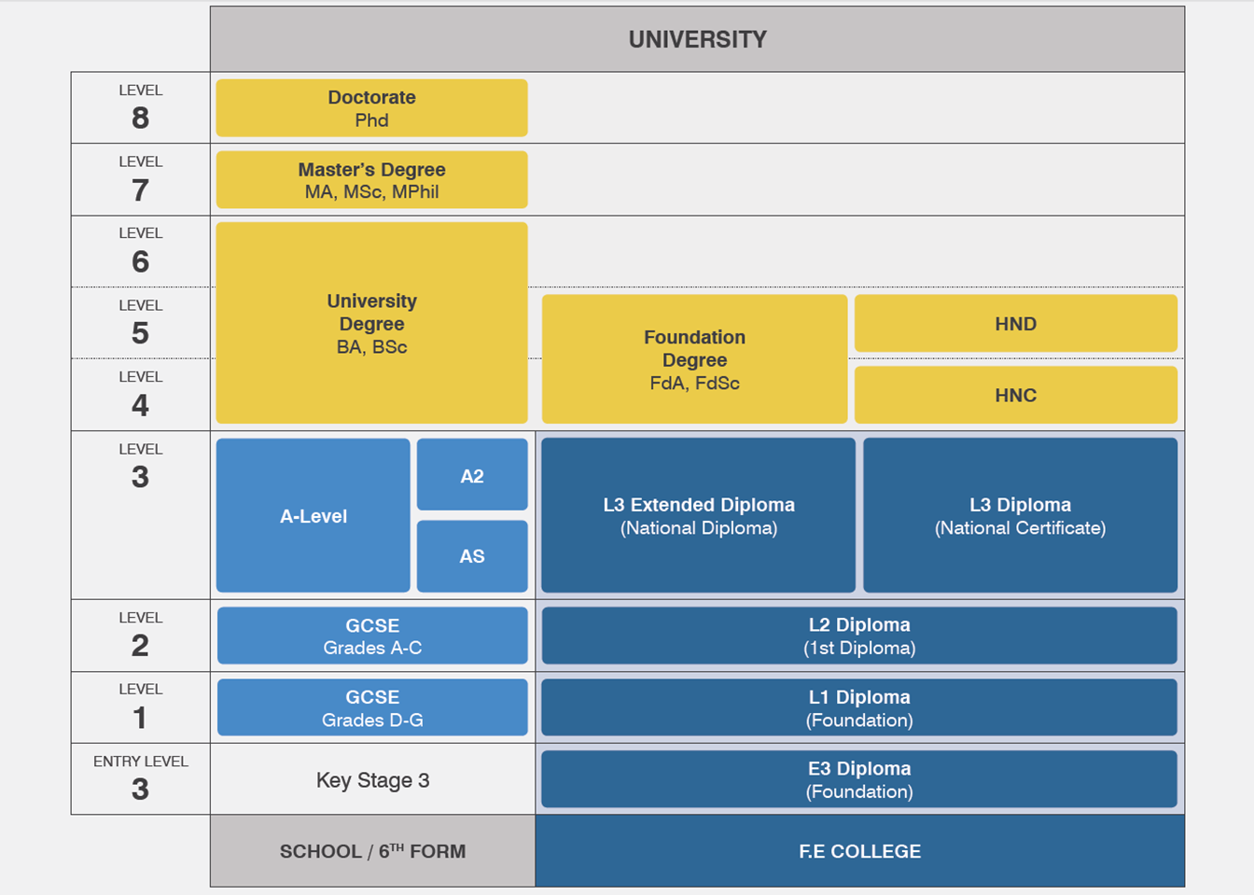
Higher National Diploma
Higher National Certificate
You are here!
Notes:
Qualification chain- From the lists of levels 3 – 7 qualifications, identify the university pathway. Where does it start and end? What are the qualifications called? (Foundation, BA, MA, PhD).
Talk through the levels. Relate back to what is FE and HE and where the students are at now. Talk about where you (EO) got up to and where they would like to get up to. Are there any doctors in the room?

Slide 36
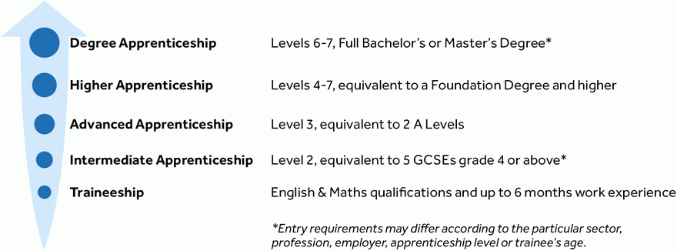
APPRENTICESHIP LEVELS
Notes:
Apprenticeship levels – talk through the different levels of apprenticeships and look at the equivalent levels. This is to introduce the terms
This may appeal to the vocational students, talk through how level 4-7 is equivalent to university standard and is a valuable route to take

Slide 37

DIAMOND 9
Sort your subjects with your favourite at the top
Notes:
Resource Booklet Page 8: 1.3 Diamond 9
Your learning- Contextualise GCSE option choices in terms of dreams and aspirations for the future by using the diamond nine resource to sort their GCSE options.
Activity:
Get students thinking about what enjoy vs what they think is important for the future. Highlights why the school’s prioritised subjects are English, Maths and Science. These are required for next steps.
Write your current GCSE subjects in the diamonds on the paper in front of you, cut them out with scissors and order them with your favourite subjects at the top and least favourite at the bottom.
Which do you value most and why.
Now rearrange them to the order the school values most. What's the difference and why?
*Perhaps change to favourite subject, as year 10 have favourite GCSE option. Would need to change this to make it suitable for students to do online
Some schools may not be doing GCSEs at Y9. This may need re wording
for schools that don’t start until Y10/11. Could this help students in
choosing their GCSE options? So what are their favourite subjects at
school. *Make a note on SoW document made need to be changed slightly
for some schools.*

Slide 38
INDEPENDENT ACTIVITY
Find an apprenticeship that interests you!
Bring some information to the next session
Notes:
Independent activity: For next session find an apprenticeship that interests you! Bring some information about it to next session

Slide 39



@aspiretohe

