Slide 1


SESSION 2:
WHAT DOES HE STUDY ENTAIL?

Slide 2
WHAT DID WE COVER LAST SESSION?
OBJECTIVE 1: To understand the different types of learning
OBJECTIVE 2: To understand the different levels of learning and various qualifications
Notes:
Students should have all done the baseline survey by now
Create a short quiz/recap based on last session to see what students remember. You don’t need to write a quiz out, just ask the students a few questions from topics you covered last time or pick a few below
What do students think learning is? Does it ever stop?
Matching key terms EG compulsory post compulsory
Picture game vocational/academic
Celeb degree quiz, which celebs studied which degrees and do they use those degrees in their careers now
Qualification chain, different pathways to get to a degree/certain career
What are the qualifications called? (Foundation, BA, MA, PhD).
Different levels of Apprenticeships

Slide 3

CHECK IN
What apprenticeships did you find?
Why did it interest you?
Who was the employer?
Where was it?
Notes:
Independent activity from first session: Go away and find an apprenticeship that interests you! Bring some information about it to next session
Check in from the first session and ask students to talk about an apprenticeship they have found

Slide 4
TODAY’S OBJECTIVES:
OBJECTIVE 1: To look at lifelong learning and personal development
OBJECTIVE 3: To understand the different types of learning at university
OBJECTIVE 2: To gain an understanding of which careers need professional qualifications
Notes:
Objectives for session 2

Slide 5


CELEBRITY DEVELOPMENT QUIZ
How old were they when they got famous?
2. What was their job before fame?
Notes:
2.1
Personal development- celebrity development quiz! Looking at what age celebs became famous and what their job was before success. This shows the importance of lifelong learning and how it can lead to success
Interactive quiz!! Get students involved, 1) how old were they when they got famous? 2) What job did they have before they got famous?
Celebrity development quiz!
Looking at what age celebs became famous and what their job was before success. This shows the importance of lifelong learning and how it can lead to success.
It is completely fine for Y9 students to not know what they want to study in the future or know what career/area they want to go in to like a lot of these celebrities
It is good to research your options and see what options are available, part of the EO’s job is to help with you with research and any questions you may have about your future

Slide 6
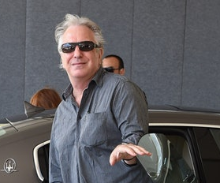

ALAN RICKMAN
Age they became famous: 26 or 46
Job Before: History Teacher or Graphic Designer
The man who would become Snape didn’t start his film career until age 46, when he was cast as the villain in Die Hard.

Slide 7
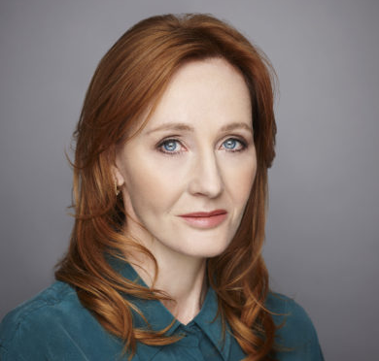
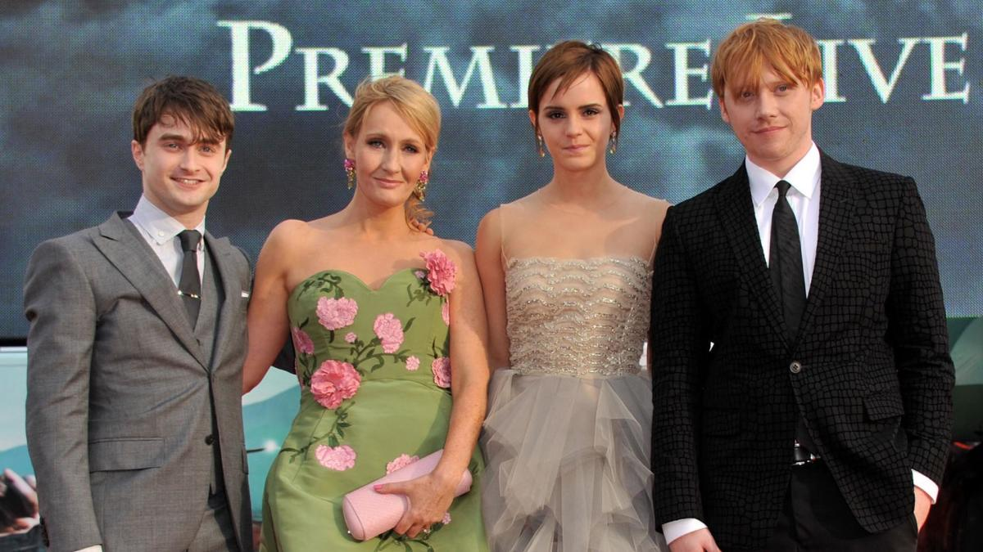
J.K. ROWLING
Age they became famous: 18 or 32
Job Before: Nurse or Secretary
J.K. Rowling was 32 and had a round of rejections before "Harry Potter and the Philosopher's Stone" was published.

Slide 8
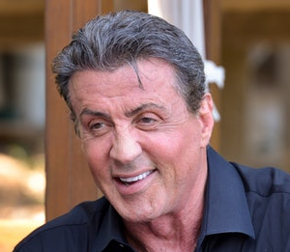
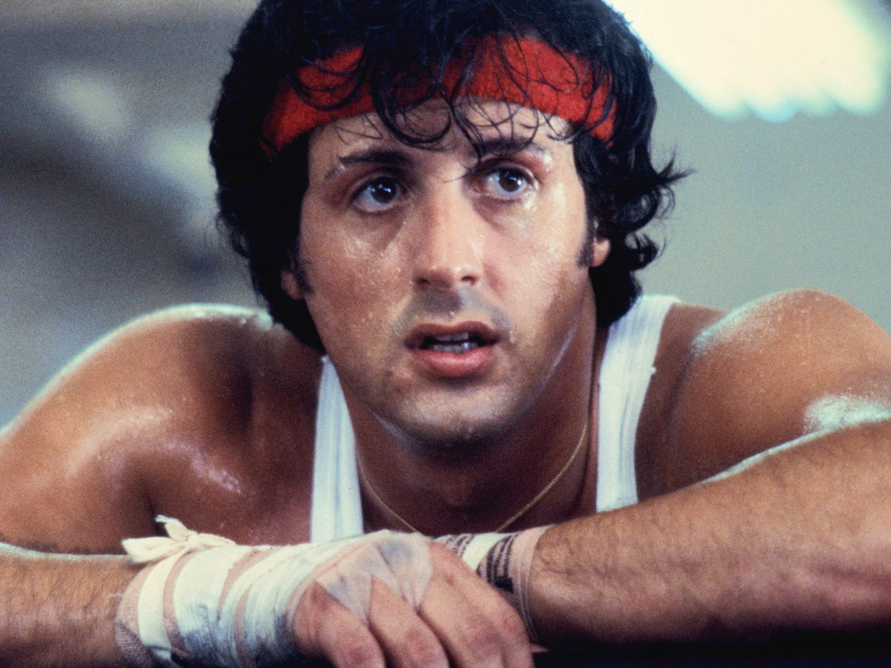
SYLVESTER STALLONE
Age they became famous: 50 or 30
Job Before: Lion cage cleaner or Usher at Cinema
Stallone struggled to make ends meet as an actor. Then, at age 30, he was cast in Rocky as the titular character. The Academy awarded his struggle with an Oscar nomination.
Notes:
Both

Slide 9


MELISSA MCCARTHY
Age they became famous: 30 or 40
Job Before: Fashion Designer or Comedian
Gilmore Girls knew McCarthy as Sookie St. James for years, but the world didn’t truly get to know this funny girl until her hysterical supporting role in Bridesmaids in 2011.

Slide 10
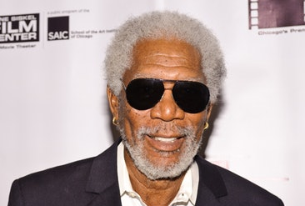
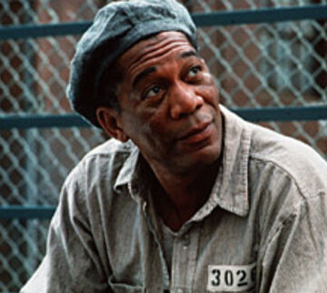
MORGAN FREEMAN
Age they became famous: 26 or 52
Job Before: Trainee Pilot or Sniper
Freeman didn’t score his first big role until Driving Miss Daisy — a film that he made when he was 52 years old.

Slide 11
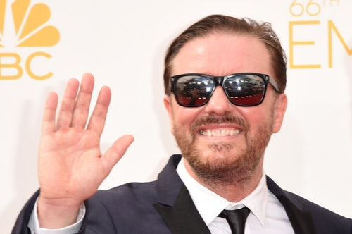
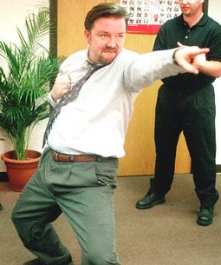
RICKY GERVAIS
Age they became famous: 40 or 50
Job Before: Waste Disposal or Events Manager
The Invention of Lying star was 40 when he starred on the UK version of The Office.

Slide 12
PERSONAL DEVELOPMENT
All of these celebrities worked hard on their personal development to achieve their dream career.
This shows the importance of lifelong learning and how it can lead to success
What could you do to achieve your dream career?
Notes:
Professional development refers to the continued training and education of an individual in regards to his or her career. The goal of professional development is to keep you up-to-date on current trends as well as help you develop new skills for the purpose of advancement in the field.
What could you do to achieve your dream career?
Talk about volunteering, jobs, working hard, university courses etc

Slide 13
WHAT ARE PROFESSIONAL QUALIFICATIONS?
“Professional qualifications are vocational training courses that relate to a specific industry or career path. Some can be taken directly after completing university, while others are aimed at professionals with several years of experience who are looking to develop their career further.”
Notes:
2.2
Professional qualifications- What is a professional qualification? Talk through definition
Professional development refers to the continued training and education of an individual in regards to his or her career. The goal of professional development is to keep you up-to-date on current trends as well as help you develop new skills for the purpose of advancement in the field.

Slide 14
WHICH OF THE FOLLOWING CAREERS NEED A PROFESSIONAL QUALIFICATION?
Notes:
Careers that need professional qualification- Present different careers and ask students if they think these need professional qualifications. Discuss what these are if each career needs one.
Interactive, ask students if they think these jobs need professional qualifications

Slide 15


TEACHER
Do they need a professional qualification?
Notes:
Use these slides to go through what careers need professional qualifications

Slide 16
TEACHER
Undergraduate education degree
Undergraduate degree AND PGCE
OR
PGCE (Postgraduate Certificate in Education)
Notes:
https://www.ucas.com/ucas/after-gcses/find-career-ideas/explore-jobs?k=TEACHER&j=/secondary-school-teacher – more info
Essential qualifications
Undergraduate education degree
OR undergraduate degree AND a PGCE/PGDE
A PGCE (Postgraduate Certificate in Education) is a very popular route for graduates to take and an undergraduate degree is essential to gain access to the course.
PGCE vs PGDE
A Professional Graduate Diploma in Education (PGDE) is effectively the Scottish equivalent of the PGCE. However, there is also a qualification called the PGDE (Postgraduate Diploma in Education) in England, Wales and Northern Ireland. These are worth 120 CATS credits, rather than 60.

Slide 17

SOLICITOR
Do they need a professional qualification?

Slide 18
SOLICITOR
Complete a qualifying Law Degree
Complete a non-law degree, then take CPE or GDL
OR
Work in legal profession and complete CILEx membership
OR
CPE (Common Professional Exam)
GDL (Graduate Diploma in Law)
CILEx (Chartered Institute of Legal Executives
Notes:
https://www.ucas.com/ucas/after-gcses/find-career-ideas/explore-jobs?k=TEACHER&j=/secondary-school-teacher – more info
What do I need to do to become a solicitor?
Complete a qualifying law degree, followed by the Legal Practice Course (LPC).
OR
Complete a non-law degree then take the Common Professional Examination (CPE) or Graduate Diploma in Law (GDL) conversion course, followed by the LPC.
OR
Complete the membership or fellowship route of the Chartered Institute of Legal Executives (CILEx) while working in the legal profession – this route can be taken if you do not have a degree

Slide 19
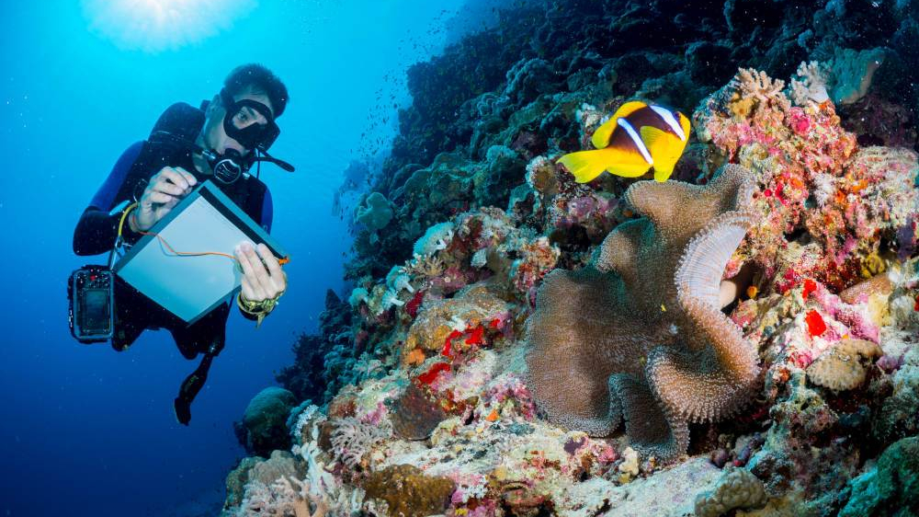
MARINE BIOLOGIST
Do they need a professional qualification?

Slide 20
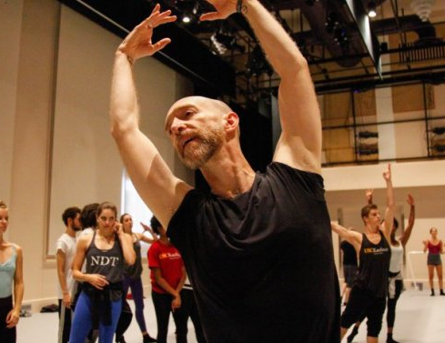
CHOREOGRAPHER
Do they need a professional qualification?

Slide 21
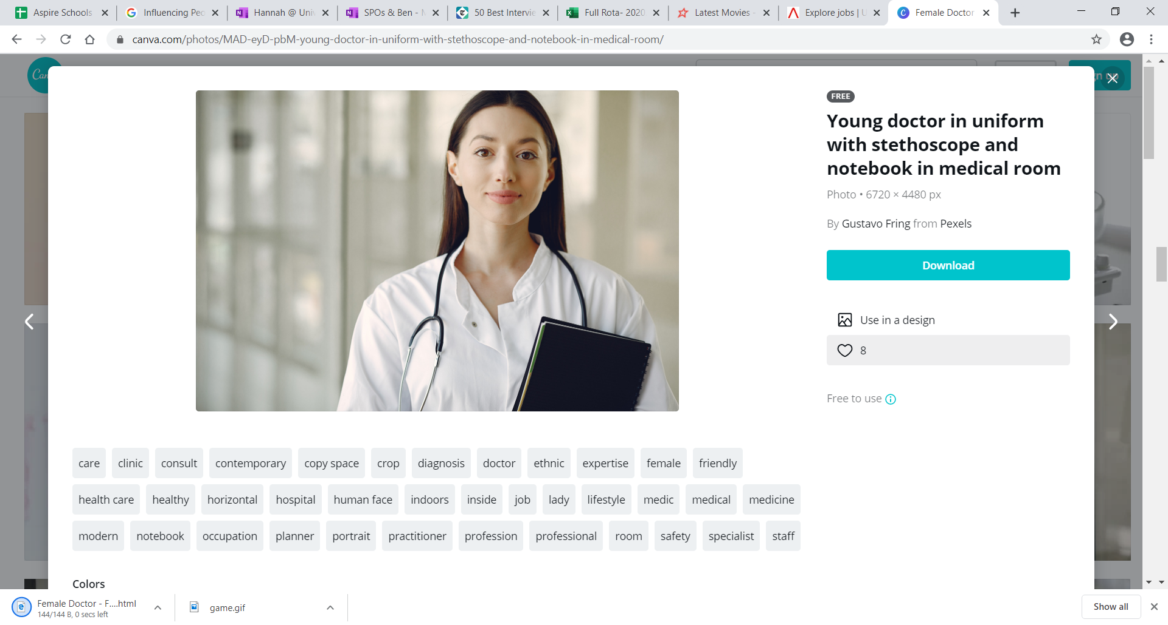
DOCTOR
Do they need a professional qualification?

Slide 22
DOCTOR
5 year degree in Medicine
2 year foundation course in general training
AND
AND
3 year specialist training course in general practice
OR
Complete a science based degree and take a 4 year graduate entry programme
Notes:
What do I need to do to become a GP?
You can get into this job through a university course.
You'll need to complete:
a 5-year degree in medicine, recognised by the General Medical Council
a 2-year foundation course of general training
a 3-year specialist training course in general practice
If you already have a degree in a science subject (minimum upper second), you could take an accelerated 4-year graduate entry programme.
You may be able to join a 6-year degree course in medicine if you have no science qualifications. This includes a one-year pre-medical or foundation year.

Slide 23

INTERPRETER
Do they need a professional qualification?

Slide 24

PSYCHOLOGIST
Do they need a professional qualification?

Slide 25
PSYCHOLOGIST
Psychology degree accredited by BPS
Postgraduate degree & further work experience to train as Psychologist
AND
OR
Another degree with a Psychology approved conversion course
BPS (British Psychological Society)
Notes:
Add more info on the different qualifications https://www.ucas.com/ucas/after-gcses/find-career-ideas/explore-jobs?k=Psychologist&j=/psychologist
What do I need to do to become a psychologist?
You'll need to complete:
a psychology degree accredited by The British Psychological Society (BPS)
Graduate Basis for Chartered Membership
an accredited postgraduate qualification in your chosen specialism
Once you've got a psychology degree, you can specialise in a particular area, for example educational or forensic psychology.
Competition for postgraduate training is strong. You'll need a first or upper second class degree, and evidence of excellent research skills to apply. You'll also need relevant work experience.
If you have a degree in a different subject, you may be able to complete an approved psychology conversion course.

Slide 26
WHAT CAREER ARE YOU THINKING OF DOING?
DOES IT REQUIRE PROFESSIONAL QUALIFICATIONS?
Notes:
Interactive. Ask students about career prospects

Slide 27
MEMORY GAME
Try to remember all of the items that you see on screen.
https://www.youtube.com/watch?v=BZxavwAnrPg
You can’t write anything down!
Notes:
2.3
Memory game – Show the video and get students to play along with prompt questions. Teach them about the basis of memory from the slides. (5 mins)
Click on the blue box to access the Youtube video
https://www.youtube.com/watch?v=BZxavwAnrPg
This is the link to a youtube video to test student memory. Students can not write anything down!
Get the students to note down how many they got right

Slide 28
MEMORY GAME
What did you remember?
How many questions did you get right?
Notes:
TASK:
Ask students to write down what they remembered
Teach them about the basis of memory from the slides. This leads on to the next slides which discuss memory's three basic tasks

Slide 29

MEMORY’S THREE BASIC FUNCTIONS
Encoding
Storage
Retrieval
Involves modification of information to fit the preferred format of the memory system
Typing info into a computer
Notes:
To mimic a lecture – 3 basic tasks of memory. These are examples of what they are.
Go through what each one means (definitions and examples)

Slide 30

MEMORY’S THREE BASIC FUNCTIONS
Encoding
Storage
Retrieval
Involves retention of encoded material over time
Pressing Ctrl S and saving the info.

Slide 31

MEMORY’S THREE BASIC FUNCTIONS
Encoding
Storage
Retrieval
Involves the location and recovery of information from memory
Finding your document and opening it up.

Slide 32
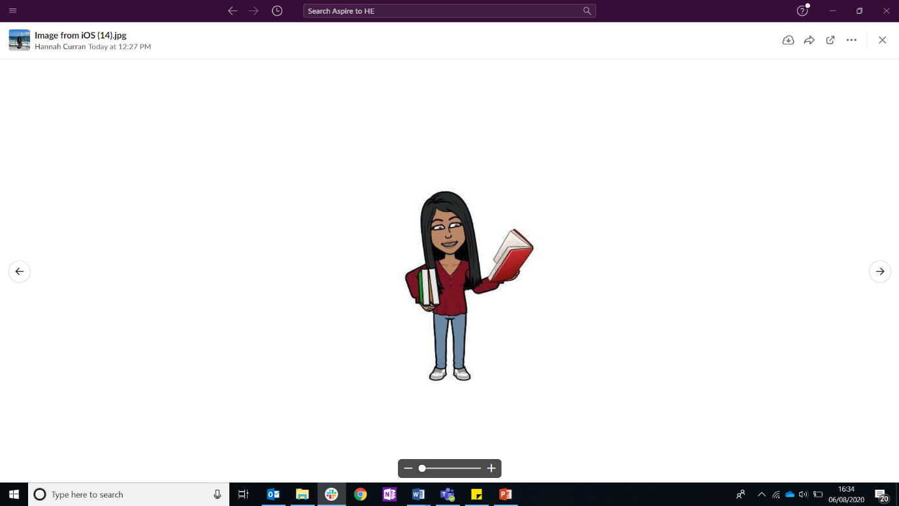
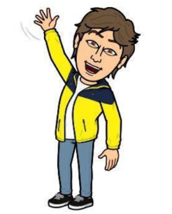
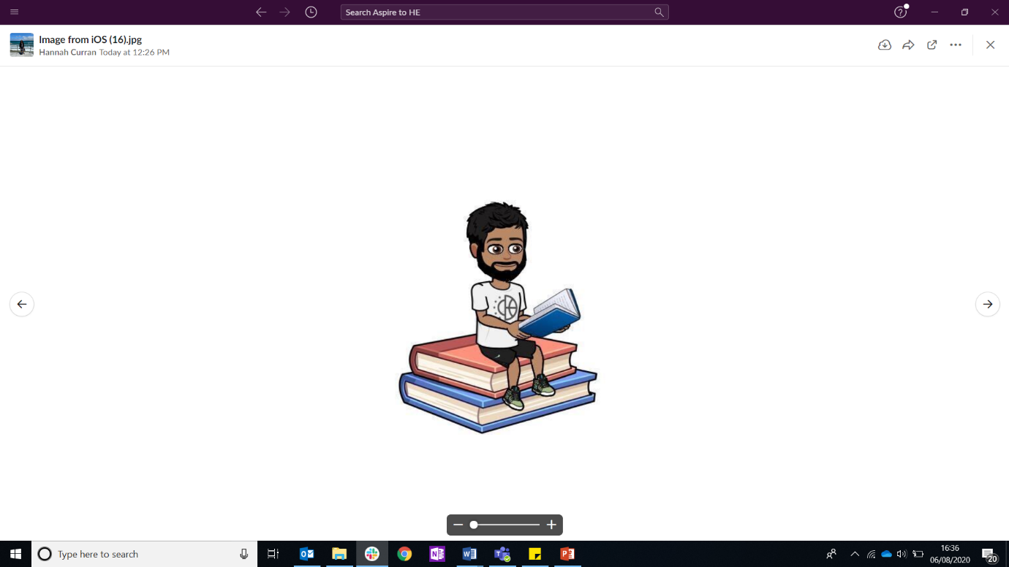

5 MINUTE POSTERS
You will be assigned a student from the handout which you need to help with their university choices
Your poster must include:
1) Short introduction on the university (where is it and a fact about it)
2) What course have you decided for your person and why?
3) What support is there available for them?
You can be creative about your person!
Notes:
Resource Booklet Page 9: 2.3 University Life
Posters - Get students to individually or in groups make a poster for their given ‘uni student’. Use either prospectuses or computers. Emphasise the support available at university (10 mins MAX)
Get students to individually or in groups make a poster for their given ‘uni student’ which are on the next slide
Use either prospectuses or computers
Emphasise the support available at university

Slide 33


NO SPEAKING!!!
Task:
Line up without communicating verbally with each other.
Get in order of who's birthday comes first, starting with January.
Notes:
Communication activity- Instruct the students to line up without communicating verbally, in order of their birthday. This should only take a couple of mins

Slide 34
3 TYPES OF LEARNING AT UNIVERSITY
Lecture: Structured session taken by the lecturer, usually 30-100 students take part
Seminar: Semi-structured and more interaction, usually 10-30 students take part
Tutorial: Relatively informal, specific topic and can be lead by students needs, usually 1-5 student take part

Slide 35
3 TYPES OF LEARNING AT UNIVERSITY
So today you have done a presentation about a university student, practiced communication and learnt about memory.
Which one was like a lecture, seminar and tutorial?
Notes:
Summary: Ask the students if they can tell which activity they have done today is a lecture/seminar/tutorial
Students have taken part in:
Lecture (memory game)
Seminar (posters)
Tutorial (communication activity – [this is not in terms of the content covered, but it’s a fun task showing students an example of informality])
this is similar to what university is like

Slide 36








MY FIRST YEAR AT UNIVERSITY
Monday | Tuesday | Wednesday | Thursday | Friday
 | 9-11 Sports Psychology Lab | 9-10 Clinical Psychology Seminar
11-1 Forensic Psychology Lecture
2-3 Forensic Psychology Seminar |  |  |  | 1-2 Sports Science Lecture
3-4 Sports Psychology Lecture |  |  |  | 2-3 Sports Science Lab
 | 2:30-4:30 Clinical Psychology Lecture
Notes:
Monday: Lie in, Lecture, Seminar, Lecture, Netball Practice
Tuesday: Lab, Library, Gym, Lecture
Wednesday: Seminar, Library, BUCS afternoon, SU night out
Thursday: Lie in, Part time waitress job
Friday: Library, Lecture, Lab
My university timetable- Show students a timetable (your own if possible) of a usual university week. Discuss how students at university can personally develop, alongside their studies

Slide 37
INDEPENDENT ACTIVITY
Have a think about what type of learning at university you would prefer and why?
We will discuss this in our next session.
Notes:
Independent activity: Go away and have a think about what type of learning at university you would prefer and why?
The first check in for session 3.1

Slide 38



@aspiretohe

