Slide 1
SESSION 3: THE BENEFITS OF HE
Notes:
This session focuses on the benefits of HE, including salary, well-being, mental health, ongoing development and transferable skills.

Slide 2
WHAT DID WE COVER LAST SESSION?
OBJECTIVE 1: To look at your own personal development
OBJECTIVE 3: To understand the different types of learning at university
OBJECTIVE 2: To gain an understanding of which careers need professional qualifications
Notes:
Objectives for session 2 – Create quick quiz/recap based on last session to see what students remember. You don’t need to write a quiz out, just ask the students a few questions from topics you covered last time.

Slide 3
CHECK IN
Who can remember the types of learning at university?
What did you decide was your preferred university learning style?
Notes:
Check-in. Ask students if they can remember all the types of learning at university. Discuss which was their favourite and why.
Task from last week which was your preferred learning style?

Slide 4
TODAY’S OBJECTIVES:
OBJECTIVE 1: To look at personal learning styles and consider the impact of different salaries
OBJECTIVE 2: To be aware of some of the benefits of higher education
OBJECTIVE 3: To explore personal and professional development by looking at transferable skills

Slide 5
WHAT TYPE OF LEARNER ARE YOU?
Notes:
Resource Booklet Pages 10-11: 3.1 Learning Styles
3.1
What type of learner are you quiz- Discuss the different levels. Can also be linked to vocational and academic and styles of learning at HE.

Slide 6
LEARNING STYLES QUESTIONNAIRE
Notes:
What they mean

Slide 7
GRAPHS
In pairs, describe what this graph is telling us
Describer: Partner A
Notes:
Get students in pairs to discuss the graph
Task:
Ask students, in pairs, to explain what the graphs are showing. Use this time for an open conversation about improved salary and employment rates
Partner A to explain this graph to Partner B

Slide 8
GRAPHS
In pairs, describe what this graph is telling us
Describer: Partner B
Notes:
Follow onscreen instructions
Task
Partner B to describe this graph to Partner A

Slide 9
GRAPHS
In pairs, describe what this graph is telling us
Describer: Both
Notes:
Follow onscreen instructions
Task
Work together Partner A and B to discuss this graph

Slide 10
SUPPORT AVAILABLE AT UNIVERSITY
It’s important to know what health and wellbeing support is available to you during your studies.
Universities help with a variety of personal difficulties which include:
Can anyone remember any specific services from last sessions posters?
Notes:
3.2
Link to last weeks posters they created for some students who may need additional support
Counselling services
Most universities and colleges provide counselling for students who need emotional support. Student services or the students’ union (or other student body) can give you information about what’s available – make sure you check the university or college website too.
Mental health advisers
Student support teams often include specialist advisers dedicated to helping students with mental health difficulties. This help is not limited to people with diagnosed conditions – it’s available to all students who would like support to cope with any aspect of life. Mental health advisers can explain the different services available – discussing your particular needs or concerns will help them decide the best support for your needs.
You don’t have to wait until you arrive at university or college to contact the mental health adviser. In fact, it’s a good idea to contact them when you have been offered a place on the course, so they can ensure you’re fully supported and feel confident when you arrive.
Check out UMHAN (University Mental Health Advisers Network) for more information, and the student mental health charity, Student Minds.
Buttle UK provides grants for estranged students who need financial help for access to emotional, physical, or mental health care. See our financial support information for more details.
Personal Tutors
When you join the University you will be given a personal. Your personal tutor is someone who can offer you guidance and advice, this could be about your course, and any other aspects that affect your study. In order for personal tutoring to be a beneficial and meaningful relationship for you, you need to communicate with your personal tutor.

Slide 11
WHAT IS HIGHER EDUCATION?
Higher education is third level education after you leave school.
It takes places at universities and further education colleges and normally includes undergraduate and postgraduate study.
Notes:
Remind students what Higher Education actually is

Slide 12
BENEFITS OF HIGHER EDUCATION
Note down as many benefits of Higher Education that you can think of…
Notes:
What are the benefits?- Ask students what they think the benefits of HE could be. EO then to share benefits and journey of their HE experience. Link to mental health and support (from last week’s session)

Slide 13
WHAT ARE THE BENEFITS OF HIGHER EDUCATION?
Notes:
This is the discussion of the benefits of HE. What benefits can the students think of??
After discussion go in to the game which is true or false
Personal Benefits
Independence, managing your own money and time
Social life, meeting new like minded people to make new friendships
Extra curricular activities, such as societies, this is a great way to further an existing interest, or try something new in addition to meeting new people.
Financial Benefits
In addition to having a greater range of jobs available to them, graduates also attract higher salaries throughout their working life.
Career Benefits
There are careers that require a specific higher education qualification, i.e. becoming a doctor, dentist, lawyer or architect. However holding a higher education qualification can open the doors to many other career options, some which may not be directly related to the subject studied. This is because employers recognise the dedication required to study for these qualifications, and also the transferrable skills they equip graduates with.

Slide 14
You can study a
degree in Knitting
50,000 courses
395 facilities
So many options available!
Sport
Psychology
Notes:
Talking specifically about range of courses over numbers of universities. Important to find your passion and signpost to UCAS. The sport and psychology part is explaining how you can do a joint honours (Sport and Psychology) which I (LB) did, and how I combined my passions- tailor this to your passion

Slide 15
Individuals who are
Graduates can earn up
to £250,000 more than
Non-Graduates
Notes:
This is the “Graduate premium”.
Although do explain to students having a passion for your career is most important, don’t just ‘chase the money’.

Slide 16
Graduates drink and
smoke more than
non-graduates
Graduates have:
Access to information
Higher risk perception

Slide 17
50%!
By 2022 25% of jobs will
require a higher
education qualification
Some of the key reason. Graduates:
Use their initiative
Problem Solve
Learn quickly
Develop new Ideas
Notes:
It’s not 25% of jobs that will require a HE qualification, it’s higher than that: 50%!

Slide 18
At University you have
the opportunity to study
abroad
Cultures
Education
Languages
Internships
Volunteering

Slide 19
The stress of a degree is
likely to lead to mental
health problems
30% less likely
Aged 30

Slide 20
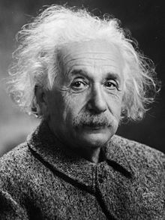
If I have any learning
difficulties or disabilities
Higher Education is not the
route for me
Finance
Living in halls and travelling to Uni
Care in and out of Uni
Educational plans
Notes:
Talk about all the support available to students, such as SFE.
Albert Einstein was dyslexic don’t let this put you off further education

Slide 21
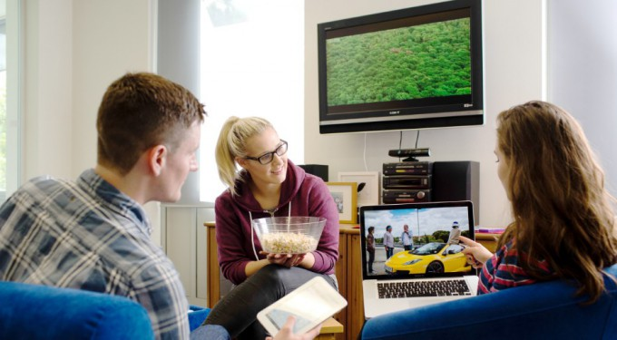
The only skills you learn
at University are academic skills

Slide 22
Let’s review the benefits!
Opportunity to study
your passion
Earn higher salaries
What employers
look for
More than
academic skills
Overall better
health
Learning support
Better mental health
Study abroad and learn about new cultures

Slide 23
MY TOP 5 PERSONAL BENEFITS
1. Volunteering and jobs
2. Made friends
3. Learnt to cook
4. Public speaking
5. Transferable skills
Notes:
These are from an ex-university student. Tailor to suit your own university experience, change the top 5 and think about how you can discuss the categories. You could always included a graduation photo here if you wish!

Slide 24
OPPORTUNITIES
Notes:
Resource Booklet Page 12: 3.2 Volunteering
Benefit activity - Give students cut outs of logos (in resource booklet) and descriptions of volunteering opportunities and ask them to match them up. Use this as open discussion about opportunities at HE to volunteer and develop skills.

Slide 25
OPPORTUNITIES
Notes:
Answers

Slide 26
WHAT IS A TRANSFERABLE SKILL?
“Transferable skills are a core set of skills and abilities, which can be applied to a wide range of different jobs and industries.
They’re usually picked up over time, and can be gained from previous positions, charity or voluntary work, your hobbies, or even just at home.”
Notes:
Resource Booklet Pages 13-14: 3.3 Transferable skills
3.3
Transferable skills check- Most students do not give enough recognition to the things they have already achieved. The next activity is designed to help them do that, and develop the schema and language to start recognising and communicating their potential.

Slide 27
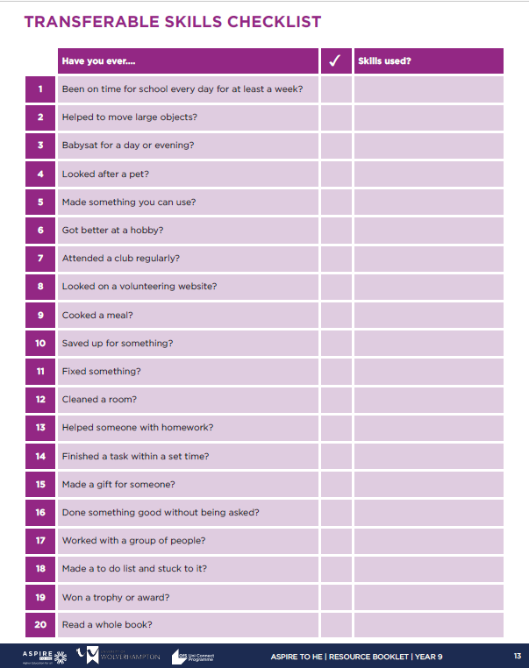
TRANSFERABLE SKILLS CHECK
Fill in the sheets with your skills!
Notes:
Transferable Skills check
1. Hand out a copy of the ‘Transferable Skills Checklist’ to each student.
2. Explain what a skill is giving examples and then show how this skill is ‘transferable’ to work.
3. Ask students to go through the ‘Transferable Skills Checklist’ and tick if they have ever done the activity.
4. Ask students to think of the skills the used for each of the activities they have done.

Slide 28
WHAT CAREER DO YOU WANT TO DO?
Think about which career you want to pursue…
Highlight which transferable skills would be utilised in that job.
Notes:
Link to career- Ask students what career interests them. Discuss and ask them to select which of their transferable skills will be relevant and useful.

Slide 29
MY TRANSFERABLE SKILLS
Volunteered at an event → Communication
Worked in a group → Team work
Finished a computer game → Problem Solving
Fixing things/DIY → Creativity
Notes:
Discuss how some of your own transferable skills have aided their education/careers.
This is a short ending where EO should explain their transferable skills through careers and education. Make sure you change this to suit your own journey.

Slide 30
INDEPENDENT ACTIVITY
Think of 3 careers/jobs that interest you

Slide 31
@aspiretohe

