Slide 1
SESSION 4: WHAT ARE MY CHOICES?
Notes:
This session focuses on choices, including unfamiliar careers (specialisation, professional, job/career), experimentation, passion, self-realisation, service/duty, pathways, and opportunity cost.

Slide 2
WHAT DID WE COVER LAST SESSION?
OBJECTIVE 1: To look at personal learning styles and consider the impact of different salaries
OBJECTIVE 2: To be aware of some of the benefits of higher education
OBJECTIVE 3: To explore personal and professional development by looking at transferable skills
Notes:
Create quick quiz/recap based on last session to see what students remember. You don’t need to write a quiz out, just ask the students a few questions from topics you covered last time.

Slide 3
CHECK IN
What careers/ jobs interested you and why?
What type of learner were you?
Can you remember any of the benefits of higher education?
Name 2 of your transferable skills
Notes:
Check-in. What’s careers interested you and why?

Slide 4
TODAY’S OBJECTIVES:
OBJECTIVE 1: To explore unfamiliar careers
OBJECTIVE 2: To think about your passion in life
OBJECTIVE 3: To understand the term ‘opportunity cost’ and how it can be implemented in your life

Slide 5
WHAT DOES THIS WORD MEAN TO YOU?
Development
Occupation
Progression
CAREER
Success
Contacts
Experience
Money
Skills
Notes:
4.1
What is a career?- Talk through definitions and ask students for their definitions and what it means to them

Slide 6
WHAT IS A CAREER?
An occupation undertaken for a significant period of a person's life and with opportunities for progress.
Synonyms for ‘career’:
job, occupation, trade, profession, vocation.

Slide 7
UNFAMILIAR CAREERS

Slide 8
UNFAMILIAR CAREERS
What is a…?
Cloud Architect
Cloud Architects are IT professionals that are responsible for the designing, building, maintaining, and deployment of a company’s cloud computing strategy – in a way which fulfils an organisation’s requirements.
Average Yearly Salary: £98,000
Notes:
Unfamiliar careers- Use these slides to introduce the students to careers they may not have heard of. When the slides present a career title, ask the students what they think that person does. Once the description of the career has come up, ask the students to guess the salary

Slide 9
UNFAMILIAR CAREERS
What is a…?
Beefeater
Beefeaters are technically meant to guard the Tower of London but act more day-to-day as a tourist guide. They are also famous for their distinctive red uniforms. However, to become a Beefeater, you need to have previously served in the Armed Forces for at least 22 years.
Average Yearly Salary: £25,000
Notes:
Unfamiliar careers- Use these slides to introduce the students to careers they may not have heard of. When the slides present a career title, ask the students what they think that person does. Once the description of the career has come up, ask the students to guess the salary

Slide 10
UNFAMILIAR CAREERS
What is a…?
Sonographer
Sonographers use ultrasound technology to produce diagnostic scans of organs, blood vessels, joints, and soft tissue inside the body. Their work is vital in helping to diagnose health problems and monitor other conditions (e.g. pregnancy).
Average Yearly Salary: £95,000
Notes:
Unfamiliar careers- Use these slides to introduce the students to careers they may not have heard of. When the slides present a career title, ask the students what they think that person does. Once the description of the career has come up, ask the students to guess the salary

Slide 11
UNFAMILIAR CAREERS
What is a…?
Cool Hunter
The job is basically to keep your finger on the pulse of what people think are cool. It can help big brands make billions if they create and market a new product that consumers will love.
Average Yearly Salary: £25,000
Notes:
Unfamiliar careers- Use these slides to introduce the students to careers they may not have heard of. When the slides present a career title, ask the students what they think that person does. Once the description of the career has come up, ask the students to guess the salary

Slide 12
UNFAMILIAR CAREERS
What is a…?
Chief Listening Officer
Think you are the master of social media? Well, you could get paid more than nearly triple the average wage in the UK by just monitoring what people are saying about the brand you work for on Twitter, Facebook, and other types of social media platforms.
Average Yearly Salary: £61,000
Notes:
Unfamiliar careers- Use these slides to introduce the students to careers they may not have heard of. When the slides present a career title, ask the students what they think that person does. Once the description of the career has come up, ask the students to guess the salary

Slide 13
Notes:
Higher/lower game- Get the students out of their seats, or ask them to raise their hands with their answers. The slides present them with a career and its salary, followed by another career. Ask the students to decide whether they think the following career earns higher or lower than the initial career

Slide 14
OR
Chief Listening Officer
Average Yearly Salary: £61,000
Notes:
Higher/lower game- Get the students out of their seats, or ask them to raise their hands with their answers. The slides present them with a career and its salary, followed by another career. Ask the students to decide whether they think the following career earns higher or lower than the initial career

Slide 15
OR
Chief Listening Officer: £61,000
Nurse
£26,500
Average Yearly Salary:
Notes:
Higher/lower game- Get the students out of their seats, or ask them to raise their hands with their answers. The slides present them with a career and its salary, followed by another career. Ask the students to decide whether they think the following career earns higher or lower than the initial career

Slide 16
OR
Nurse: £26,500
Veterinarian
£36,000
Average Yearly Salary:
Notes:
Higher/lower game- Get the students out of their seats, or ask them to raise their hands with their answers. The slides present them with a career and its salary, followed by another career. Ask the students to decide whether they think the following career earns higher or lower than the initial career

Slide 17
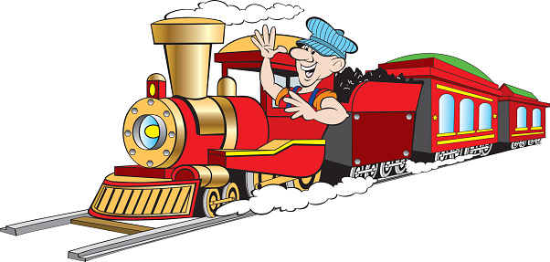
OR
Veterinarian: £36,000
Train Driver
£41,000
Average Yearly Salary:
Notes:
Higher/lower game- Get the students out of their seats, or ask them to raise their hands with their answers. The slides present them with a career and its salary, followed by another career. Ask the students to decide whether they think the following career earns higher or lower than the initial career

Slide 18
OR
Train Driver: £41,000
Mechanic
£23,000
Average Yearly Salary:
Notes:
Higher/lower game- Get the students out of their seats, or ask them to raise their hands with their answers. The slides present them with a career and its salary, followed by another career. Ask the students to decide whether they think the following career earns higher or lower than the initial career

Slide 19
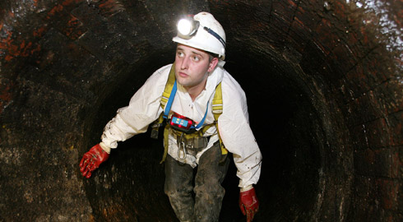
OR
Mechanic: £23,000
Sewer Flusher
£45,000
Average Yearly Salary:
Notes:
Higher/lower game- Get the students out of their seats, or ask them to raise their hands with their answers. The slides present them with a career and its salary, followed by another career. Ask the students to decide whether they think the following career earns higher or lower than the initial career

Slide 20
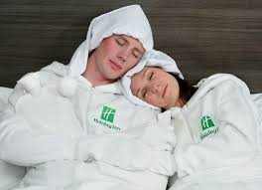
OR
Sewer Flusher: £45,000
Bed Warmer
£16,000
Average Yearly Salary:
Notes:
Higher/lower game- Get the students out of their seats, or ask them to raise their hands with their answers. The slides present them with a career and its salary, followed by another career. Ask the students to decide whether they think the following career earns higher or lower than the initial career

Slide 21
OR
Bed Warmer: £16,000
Professional Line Queuer
£12,000
Average Yearly Salary:
Notes:
Higher/lower game- Get the students out of their seats, or ask them to raise their hands with their answers. The slides present them with a career and its salary, followed by another career. Ask the students to decide whether they think the following career earns higher or lower than the initial career

Slide 22
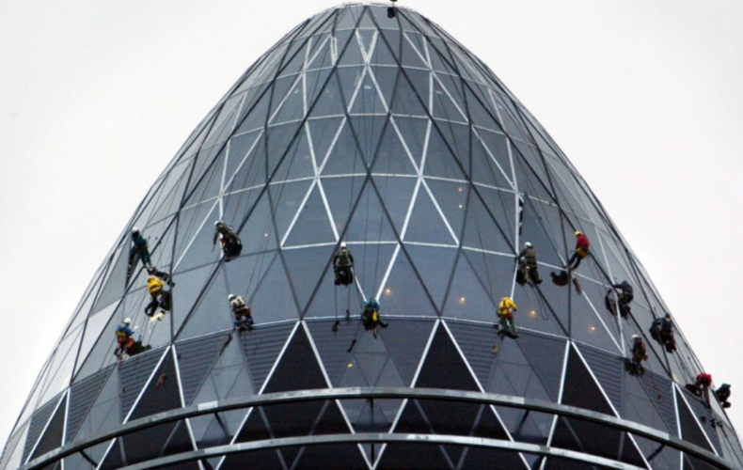
OR
Professional Line Queuer: £12,000
Gherkin Window Cleaner
£50,000
Average Yearly Salary:
Notes:
Higher/lower game- Get the students out of their seats, or ask them to raise their hands with their answers. The slides present them with a career and its salary, followed by another career. Ask the students to decide whether they think the following career earns higher or lower than the initial career

Slide 23
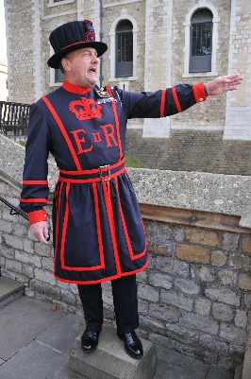
Which unfamiliar job would you want to do?
Notes:
Ask the students which jobs they liked the sound of, were there any surprises?

Slide 24
When looking into careers, the most important thing to do is…
RESEARCH

Slide 25
DOING YOUR RESEARCH
College and University Websites

Slide 26
NOW IT’S YOUR TURN!
Doing your research will give you more information about your options and what is available to you.
Your task
Each group will be given a different ‘unfamiliar career’ and must produce a poster to explain the career to the rest of the group. Using the information, include in your poster:
Summary of the job
Level of education required
University courses / Apprenticeships available
Average Salary
Companies that offer this type of employment
Art Therapist
2) Animal Physiotherapist
3) Meteorologist
Notes:
Resource Booklet Pages 15-29: 4.1 Prospects career profiles
Prospects unfamiliar careers activity- This teaches the students the importance of research when looking at careers. Students will be given a prospects job profile each or in pairs and they will need to answer the questions on the PowerPoint to create a summary of the job
Task
Create a poster on the career you have been given

Slide 27
Presentation Time!
Notes:
4.2
Present/share prospects unfamiliar careers activity- Students have short time to finish their job summary’s and share them with the rest of the group

Slide 28
YOUR PASSION
Now it’s time to explore your passion!
→Including your values, skills and interests!
Notes:
Resource Booklet Pages 30-31: 4.2 Passion
Find your passion worksheet- Use the provided resource to find the students skills, values and interest. Help them make the link between these and a potential career.
Examples/prompts on next slide to help students complete the worksheet

Slide 29
WHAT IS YOUR PASSION?
Examples of values:
Loyalty
Honesty
Responsible
Reliable
Money/Wealth
Committed
Open minded
Kind
Patient
Compassionate
Forgiveness
Examples of skills:
Communication
Listening
Teamwork
Problem solving
Adaptable
Creative
Analytical
Time management
Leadership
Confident
Punctual
Examples of interests:
Sports
Arts
Gaming
Travelling
Collecting
Volunteering
Blogging/Media
Music
Cooking
Reading
Gardening
Notes:
You can use these examples to help the students

Slide 30
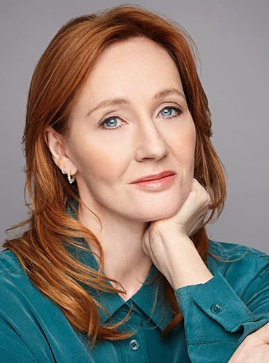
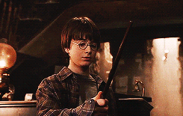
GUESS WHO
Education is a gift from society, and empowers us to give back, to give service.
Notes:
Celebrity case studies- Ask the students;
Who are the celebrities?
Encourage students to provide details about them
Show GIFs
What the link is between Stormzy and Taylor Swift?
How do they relate to the quote? Or how might they? Explore what the quote means briefly…
Discuss how they recognize the importance of education and their duty to give back to society.
Taylor Swift,
Why Do Music Stars Like Taylor Swift And Stormzy Care More About Education Than Our Politicians?
Taylor Swift donates £23,000 to help student go to university

Slide 31
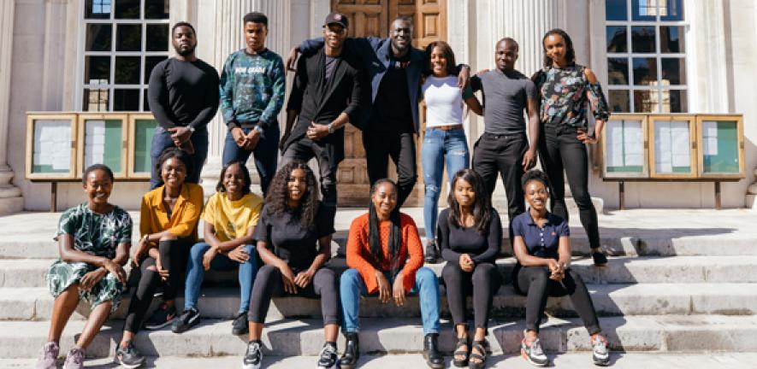
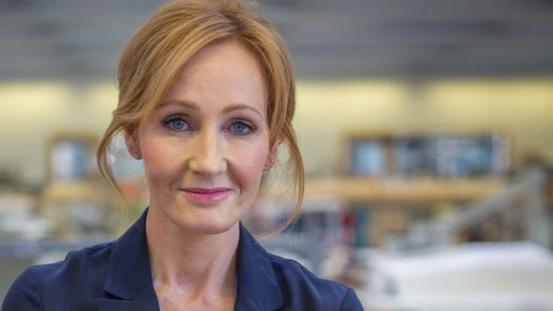
They both found that it was their duty to give back, as education can be the vehicle to success.
‘The Stormzy Scholarship’ Studentship (2018)
A scheme for University of Cambridge students, which will see British black students provided with financial support during their degree courses.
The Anne Rowling Regenerative Neurology Clinic
JK Rowling has donated £15.3 million to support more research into conditions such as MS, motor neurone disease, Parkinson’s and dementia at a medical research facility she helped to set up.
Notes:
Use this slide to provide information about the education that Stormzy and JK Rowling have invested in.
‘The Stormzy Scholarship’ studentship, announced in August 2018, is a scheme for University of Cambridge students, which will see British black students provided with financial support during their degree courses.
It will cover the full cost of four tuition fees (2 students in 2018 and 2 students in 2019) and a maintenance grant for up to four years of any undergraduate course. Like last year, this year's studentships will be self-funded by Stormzy, however he hopes to engage more support from additional investors to become part of the scheme.
---
JK Rowling has donated £15.3 million to a medical research facility, which she helped to set up. The facility is named after the Harry Potter author’s mother, who died at the age 45 from complications related to a condition called multiple sclerosis (MS). JK Rowling wants the money to support more research into conditions such as MS, motor neurone disease, Parkinson’s and dementia. It isn't her first charitable contribution - She also founded a charity called Lumos after making it her mission to take children out of poorly-run orphanages by by 2050.

Slide 32
THE COST OF OPPORTUNITY
Notes:
4.3
Stephen Seki opportunity cost video- Show students the video and have a discussion about the definition of opportunity cost
(this is an internet video so if you won’t have access, download it first)
https://www.youtube.com/watch?v=h5qxc7nw5zE
Can cut off at the end at….

Slide 33
Notes:
If you want full screen, you can use this slide

Slide 34
NOW IT’S YOUR TURN!
Whenever a choice is made, something is given up…
The opportunity cost of a choice is the value of the best alternative given up.
So for example, when your alarm goes off in the morning, what choices do you face?
Notes:
Opportunity cost examples- Go through an example with the students and then allocate them a scenario to fill in on their sheet in pairs or individually. Now that they are confident with the definition, ask them to think of their own scenario!
Explain the second sentence -

Slide 35
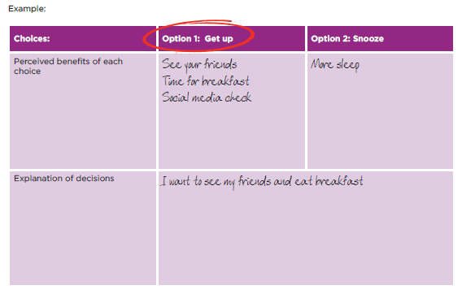
MAIN TWO CHOICES
Get up
Snooze/ Go back to sleep
Notes:
Resource Booklet Page 32: 4.3 Opportunity Cost

Slide 36
TRY ONE YOURSELF OR IN PAIRS
Pick one of the boxes below:
Do some revision at the weekend
Or
Go to the park with your friends
Walk your friend to class, but be late for your own class
Or
Get to your own lesson on time
Or think of two options for yourself!
Notes:
Resource Booklet Page 32: 4.3 Opportunity Cost

Slide 37
MAKING DECISIONS
Decision making can be really difficult…
Using the factors we have learnt from the activities today can aid decision making and evaluate opportunity costs!
Notes:
Pathways link- Link to how pathways can change, depending on decision making, as success isn’t always linear
Summary of why we need to make decisions

Slide 38
INDEPENDENT ACTIVITY
Thinking about the Stephen Seki video, opportunity cost and your passion…
What opportunities can you undertake now and in the next 2 years?
Notes:
Independent activity: Thinking about the Stephen Seki video, opportunity cost and your passion, what opportunities can you undertake now and in the next 2 years?

Slide 39
@aspiretohe

