Slide 1


SESSION 5:
WHAT ARE MY OPPORTUNITIES?
Notes:
This session focuses on opportunities, including; extra-curricular, volunteering and work experience.

Slide 2
WHAT DID WE COVER LAST SESSION?
OBJECTIVE 1: To explore unfamiliar careers
OBJECTIVE 2: To think about your passion in life
OBJECTIVE 3: To understand the term ‘opportunity cost’ and how it can be implemented in your life
Notes:
Create quick quiz/recap based on last session to see what students remember. You don’t need to write a quiz out, just ask the students a few questions from topics you covered last time.

Slide 3
CHECK IN
Thinking about the Stephen Seki video, opportunity cost and your passion, what opportunities can you undertake now and in the next 2 years?
Notes:
Check in with the students and remind them of a few topics from last session. Ask students if they’re willing to share what opportunities they have thought about doing, and encourage them to think of some if they are unsure

Slide 4
TODAY’S OBJECTIVES:
OBJECTIVE 1: To understand what extra-curricular activities are, and what a CV is.
OBJECTIVE 2: To understand how extra-curricular activities, volunteering and work experience can enhance your CV.

Slide 5


EXTRA-CURRICULAR ACTIVITIES
What are extra-curricular activities?
An extra-curricular activity is a club or hobby that you take part in outside your usual school curriculum time. For example, this could be football practice, choir or art club!
What extra-curricular activities do you do?
Notes:
1.1
Basic definitions. Look at the definition of what extra-curricular activities are and ask students what they do individually.
Talk through the definitions and ask students what activities they currently do

Slide 6


.
CURRICULUM VITAE (CV)
What is a CV?
A CV (also known as a Curriculum Vitae, or résumé), is a written overview of your skills, education, and work experience. This is used as a supporting document for when you apply for a job
Notes:
Resource Booklet Page 33-39: 5.1 Good and bad CVs
CV’s. What is a CV? Look at some good and bad CV’s, giving the students one individually. Discuss what makes a good and a bad CV. Identify extra-curricular, volunteering or work experience on the example CV’s. How do these aid the CV’s?
Talk through the definition and answer any initial questions

Slide 7
GOOD AND BAD CV’S
What’s good and what’s bad about the CV you’ve been given?
Highlight extra-curricular activities, volunteering and work experience on your example CV’s.
How do these aid the CV?
Lets discuss:
Font?
Pictures?
Contact details?
Structure?
Overall professionalism?
Notes:
Give the students a CV each, ensuring you have distributed a mixture of good and bad CV’s. Give them 2 minutes to read over them. Ask them to feedback what is good and bad about the CV they’ve been given. Discuss the highlighted points. With contact details- talk about using a professional email. Get them to use a highlighter or just circle the extra-curricular activities, volunteering and work experience and ask them why these aid a CV and why.

Slide 8



CV BUILDER
Now it’s your turn!
Using your CV builder, lets think about what skills and experiences you could put on your CV
Chose a job to apply for!
Barista at Starbucks
Counter assistant at WH Smith
Cashier at William Hill
Notes:
Resource Booklet Page 40: 5.2 CV builder
5.2
CV builder. This is an opportunity for the study to reflect on their experiences and associate them with valuable skills. Give them help with providing a personal example for each skill. Ask the students to choose a job from the list to apply for as this will be used in their interview too!
Hand out the CV builder worksheets. Get the students to individually fill in the CV builder, helping them with associating experiences to the skills.

Slide 9
HOW TO PREPARE FOR AN INTERVIEW
What would you wear and what would you bring with you?
- Smart, clean clothes - Unwashed, un-ironed clothes
- Pen and paper - Chewing gum
- Water - Earphones/Phone out
- CV, ID - Wear hat/cap during interview
- Be on time/early - Do not be late!!
Notes:
Preparing for an interview. Students will learn what is best to wear and what to take to an interview. Link to being a professional. Would they do their top button up?
Now that they have ‘built’ a CV, talk to the students about how to prepare for an interview. Ask them what they would wear and what they would bring. Talk about the do’s and the don’t‘s
You can add your own stories if you want to.

Slide 10
ACTIVE LISTENING
What makes a good listener?
Eye contact
Positive body language
Acknowledging aspects of the speakers story
Being fully focused on what that person is saying- no daydreaming!
Are you a good listener?
Let’s find out…
Notes:
(There is animation on these slides)
Active listening activity. The students will take it in turns to tell each other about their favourite hobby/holiday/TV show. The first listener will show good active listening skills, whereas the second listener will show bad active listening skills. Both speakers will be asked how their partner made them feel, and this is a chance to discuss the importance of active listening especially in a professional environment.
This teaches the students about the importance of active listening, specifically at an interview. Split the students into pairs. Ask one member of the pair to stand outside the room. Tell the member still in the room to tell their partner all about their favourite hobby/food/tv show. Tell the member outside the room to show good active listening skills such as eye contact and body language. Give them 1 minute to complete the task. Ask for feedback from the storyteller on how the listener listened. Now swop over! Tell the member in the room the same (to tell their partner all about their favourite hobby/food/tv show). However, this time tell the partner outside the room to be a bad listener. Give them 1 minute to complete the task. Ask for feedback from the storyteller on how the listener listened. Discuss what makes a good listener and the importance of this!

Slide 11
9 IDEAS FOR JOBS WHEN YOU ARE 13-14
Starting your first job can seem like a daunting prospect at any age. But it can seem even tougher when you’re under 16.
Firstly, you need to figure out what job you can do, and how you can get the one you want. And then you need to work out how to approach the employer.
Here are a few ideas to get you thinking!
Notes:
Resource Booklet Pages 41-42: 5.3 9 Ideas for jobs when you are 13-14
5.3
Talk through the following slides, explaining possible opportunities

Slide 12
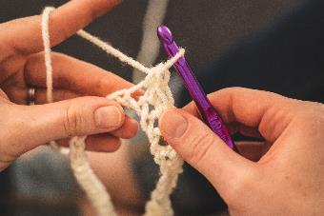

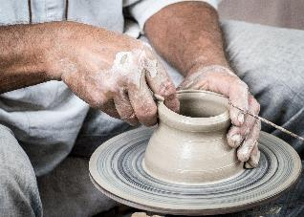
1. MAKING SOMETHING TO SELL
This requires you to have a level of skill as well as some business experience. If you are creative you could craft hand-made greetings cards which can be sold at craft or school fairs or on Etsy or Ebay. Jewellery and pottery is an option too.
Notes:
If you want to read out and go into more detail, feel free.
You could ask the students if they can make anything and discuss using that example.

Slide 13


2. BUYING SOMETHING TO SELL
Get it right and this can be very profitable. Many schools will not take kindly to pupils selling items on school property, so look at pitches in local markets or boot sales or go online instead. PayPal is good to use for safe payments.
Dropshipping is an order fulfilment method that does not require a business to keep products in stock. Instead, the store sells the product, and passes on the sales order to a third-party supplier, who then ships the order to the customer.
Notes:
Read off the screen include any of your own examples too ☺
See here to find more info on what dropshipping is:
https://www.shopify.co.uk/blog/what-is-dropshipping

Slide 14

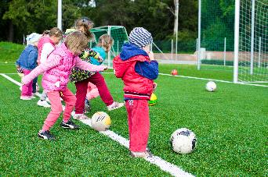

3. SPORTS COACHING AND HOLIDAY CAMPS
Many sports courses and children’s activities need extra help in the holidays or after school. If you are an active sports player, you might be able to get a basic qualification and then work on a regular basis.
Notes:
Use the information above

Slide 15
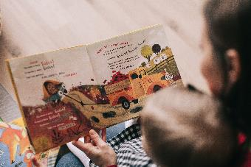
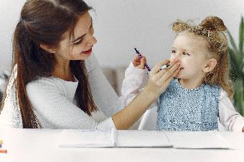

4. BABYSITTING
There aren’t any laws about a minimum age for babysitters but the NSPCC does suggest parents “think carefully about using anyone under 16”.
You can still get work and build experience, perhaps entertaining small children or helping with babies when their parents are in the house but need to get on with other things.
Notes:
Read off the screen – maybe focus on the NSPCC bit about age limits

Slide 16
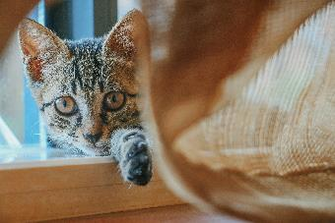
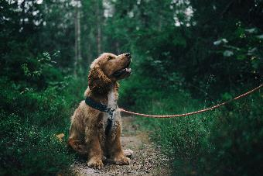

5. DOG WALKING OR CAT SITTING
Having some experience of being around dogs or cats will be useful in these roles. This can be a flexible way to make some additional cash and should be enjoyable for animal lovers. The timing can work well too as pet owners might be more likely to be away in the main school holidays.
You will need to leave homeowners feeling confident that they will lock the house up securely after each visit.
Notes:
Talk about pets or helping out others. Talk about building trust with people.

Slide 17
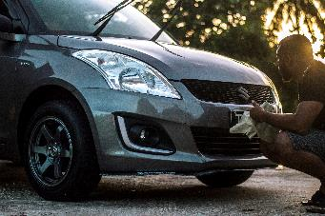
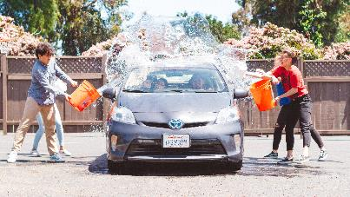

6. WASHING CARS
Easy to do and especially popular over the summer when cars tend to get more dirty during dry spells. Perhaps you can practice at home on your families cars first. This is a good way to check people would be happy to pay for your service, before you offer the service locally.
Notes:
Read from the slides

Slide 18


7. VLOGGING AND BLOGGING
One word of inspiration here: Zoella. The vlogger has made her career and a lot of money out of this. Under 16’s should check with parents/guardians before getting started and it would be sensible for an adult to keep a very close eye on reader comments and interactions.
Revenue comes from ad sales and there’s the scope for reviewing products or services once a readership has built up - although bloggers must state if they received something for free.
Check out kidsblogclub.com for more advice.
Notes:
Could bring in personal vlogging people or ask the students who they know about.
E.g. James Charles, KSI, Joe Suggs etc.

Slide 19


8. WEBSITE DESIGN
If you're interested in computers and design, you could design websites for family friends and relatives who have small businesses; perhaps that uncle who’s a painter and decorator or a cousin with a hairdressing salon.
Lots of small companies don’t have sites or need theirs updating and will appreciate (and pay) for even a simple design.
Notes:
Read from the slides – could mention social media set ups too.

Slide 20
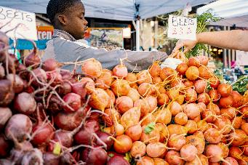


9. RETAIL JOBS
Smaller independent shops, and particularly those owned by family or friends can be a better bet than big chains.
Ask around and use Facebook or other social media platforms to see if anyone in your local area is happy to employ you.
Notes:
It’s good if you have a family member or friend who owns a smaller shop.
Paper rounds may be an option too
There is a info sheet in the resources that you can use if necessary.

Slide 21
VIRTUAL WORK EXPERIENCE (VWEX)
Virtual Work Experience gives you a unique opportunity to gain work experience in a company that you might not normally get access to while highlighting the essential skills you might need.
Some firms are beginning to provide virtual work experience opportunities to students and young people.
Placements are available across several sectors including accountancy, law, marketing and the veterinary sciences.
Notes:
https://www.theparentsguideto.co.uk/post/virtual-work-experience < Useful website with where to find more opportunities
Benefits of virtual work experience:
Think global!
Virtual work placements are open to everyone and location does not need to be a limiting factor. This opens many possibilities for your child to explore new jobs and industries in areas that may not have been possible under face to face arrangements.
It’s free
The majority of virtual work experience placements are free, although some employers charge for the opportunity; working from home will also mean your child will not incur any travel related costs.
Future proof
Remote working is likely to be important to many businesses in the future and learning how to conduct business and work online will develop extremely valuable skills for the modern workplace.
Transferable skills
It’s not always easy working from home and taking part in virtual work experience placements will help your child develop those soft skills that all employers are seeking, such as organisation, time-management and self-motivation.
Knowing what’s right (or what isn’t)
Understanding what a job or a career entails might help your child make decisions about whether or not that role is right for them in the future.

Slide 22
BENEFITS OF VIRTUAL WORK EXPERIENCE
THINK GLOBAL!
Location does not need to be a limiting factor, you can gain work experience outside of your local area.
TRANSFERABLE SKILLS!
It is not always easy to work from home, virtual work experience placements allow you to develop these soft skills, such as organisation, time management and self motivation.
GETTING TO KNOW AN INDUSTRY!
Understanding what a careers or job entails may help you devide whether that role if right or not for your in the future.
FUTURE PROOF!
Remote working is likely to be important to many businesses in the future and learning how to work online now will be a useful skill.
ITS FREE!
The Majority of virtual work experience placements are free.
Notes:
https://www.theparentsguideto.co.uk/post/virtual-work-experience
What are the benefits of a virtual work placement?
Think global!
Virtual work placements are open to everyone and location does not need to be a limiting factor. This opens many possibilities for your child to explore new jobs and industries in areas that may not have been possible under face to face arrangements.
It’s free
The majority of virtual work experience placements are free, although some employers charge for the opportunity; working from home will also mean your child will not incur any travel related costs.
Future proof
Remote working is likely to be important to many businesses in the future and learning how to conduct business and work online will develop extremely valuable skills for the modern workplace.
Transferable skills
It’s not always easy working from home and taking part in virtual work experience placements will help your child develop those soft skills that all employers are seeking, such as organisation, time-management and self-motivation.
Knowing what’s right (or what isn’t)
Understanding what a job or a career entails might help your child make decisions about whether or not that role is right for them in the future.

Slide 23
VIRTUAL WORK EXPERIENCE EXAMPLES
National Cyber Security Centre
A website dedicated to helping the UK's next generation of cyber professionals through a variety of free courses for 11-17 year olds and exciting competitions.
Premed Projects Live TV
Suitable for students aged 14-19 and interested in Biology, Science, healthcare and / or for those considering careers in medicine. Watch live videos within the operating theatre, download exam linked worksheets, watch interviews with healthcare professionals and receive tips and advice on applications to medicine.
Barclays LifeSkills
An excellent website to help young people develop the skills they need for a better future.
PricewaterhouseCoopers (PWC)
Suitable for students aged 14-18 and interested in learning more about careers in finance. The placement lasts 5 days and includes a mix of live and pre-recorded videos, project work and live Q&A sessions
Notes:
https://www.theparentsguideto.co.uk/post/virtual-work-experience
Which organisations offer virtual work experience?
As social distancing seems set to remain for the foreseeable future, more and more firms are beginning to provide virtual work experience opportunities to students and young people. Placements are available across several sectors including accountancy, law, marketing and the veterinary sciences. While this is by no means an exhaustive list, here are some companies and businesses currently offering virtual work experience:
Barclays LifeSkills
An excellent website to help young people develop the skills they need for a better future.
Barclays LifeSkills - virtual work experience with a 'digital transformation' agency
An excellent opportunity for those interested in design to actively work with different departments on one exciting project, helping them solve problems and complete real-life tasks.
Brighton and Sussex Medical School
Suitable for those looking to apply to medical school, this virtual work placement introduces students to the NHS before exploring the roles and skill sets of six different medical specialists.
Cyber Discovery
A chance to learn from industry experts and take part in over 200 free cyber security challenges
Halliday Fraser Munro
An online work experience programme for those interested in architecture and design.
Hunter Bevan
A remote virtual work experience with a twist. Suitable for anyone interested in developing their design or marketing skills. Feedback will be given plus a chance to feature on Hunter Bevan's website.
InsideSherpa
An excellent website which offers virtual work experience placements from a range of companies, from banking to careers in tech. Most options last up to six hours and involve tutorials, videos and activities.
InvestIn (paid)
Aimed at students between 14 and 18 years old, InvestIn offers an impressive array of virtual work placements involving real life work and contact with professionals. This is a paid service, and placements range from one day to one week. Prices start from £90.
National Council for the Training of Journalists (NCTJ)
An online summer school, designed to provide an introduction to journalism for beginners. A range of topics is covered, including newsgathering, interviewing skills, media law, sports journalism and broadcasting.
National Cyber Security Centre
A website dedicated to helping the UK's next generation of cyber professionals through a variety of free courses for 11-17 year olds and exciting competitions.
Oak National Academy (aimed at students in Year 10 )
A virtual 'work experience week' with access to videos, lessons and insights into a range of different industries and careers.
Operation Wallacea (paid)
A range of week-long internships with live online mentoring, a daily schedule, regular deadlines and constant contact with managing staff. Prices start from £100 for 5 days and run throughout August and September.
Premed Projects Live TV (paid)
Suitable for students aged 14-19 and interested in Biology, Science, healthcare and / or for those considering careers in medicine. Watch live videos within the operating theatre, download exam linked worksheets, watch interviews with healthcare professionals and receive tips and advice on applications to medicine. This is a paid service (monthly subscriptions start from £12.99).
PWC
Suitable for students aged 14-18 and interested in learning more about careers in finance. The placement lasts 5 days and includes a mix of live and pre-recorded videos, project work and live Q&A sessions.
Royal College of General Practioners (RCGP)
Organised, by the RCGP, Observe GP is an alternative to work experience for aspiring medics aged 16 and over, who are living in the UK. It is a free interactive video platform providing insights into the role of a GP and the wider primary care team.
Speakers4Schools
Recently launched, Speakers4schools aims to provide a level playing field by connecting young people to high quality virtual work placements. Register to stay up to date with their latest developments.
The Lawyer Portal
A list of law firms offering virtual work experience.
Youth Opportunities
An online platform providing a range of virtual work experiences including workshops, fellowships and internships. External companies are free to post opportunities, so we strongly recommend you encourage your child to research all options thoroughly before applying.

Slide 24

INTERVIEW TIME
In pairs, take it in turns to be the interviewer and candidate
Give each other feedback on:
How the candidate answered the question
Active listening skills
Overall professionalism
Notes:
Resource Booklet Pages 43-45: 5.3 Interview feedback cards
Job interview. Role-play one or more job interviews using interviewer and candidate cards. Ensure the interview gives the candidate feedback on their active listening skills and their overall performance.
Split the students in to pairs. Give one student the candidate card and one student the interviewer and feedback cards. Get the students to practice their interview role plays and ask the interviewer to fill in the feedback cards which the students can take away with them
Resources in the folder.

Slide 25
INDEPENDENT ACTIVITY
Prepare an answer for the following interview question:
If you were a kitchen appliance, what would you be and why?
Notes:
Ask students to think about this and have an answer for next session
Think of one yourself too

Slide 26



@aspiretohe

